Slide 1
UNEP/WHO project on mercury human biomonitoring
Irina Zastenskaya, Dorota Jarosinska
WHO European Centre for Environment and Health
7 June, 2017
Geneva, Switzerland

Slide 2
Update on the project implementation
Planned (according to the contract)
Performance
Three sample matrices selected
At least three detailed SOPs for mercury HBM
More than four countries in at least 4 UNEP regions for a pilot survey
250 individuals, at least two matrices
National survey protocols
Update WHO Report incorporating results from national surveys
- Scientific report on biological matrices: scalp hair, cord blood and urine
- Four SOPs (+ quality control)
- 7 countries were selected: implemented in 5 countries; reported by 3 countries (+ Croatia will be included in the WHO report)
- 250x3 matrices; 100 samples in Kyrgyzstan; two matrices in the RF
- 3 countries; WHO template survey protocol
- To the end of 2017
Notes:
(Art 118 and 119 of REACH Regulation also address access to data)

Slide 3
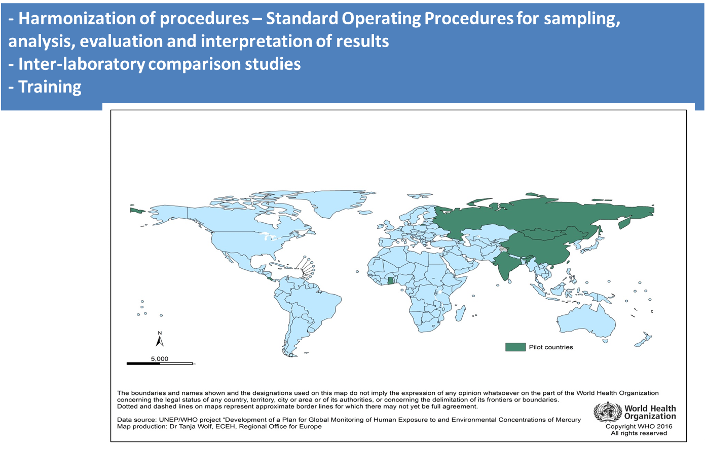
Update on the project implementation
Notes:
considered the most ambitious chemicals legislation, combining the ambition for the highest health and environmental protection with enhancing the competitiveness of the European industry

Slide 4
Update on the project implementation
A monitoring plan for human exposure to mercury that feeds into an overall plan for global monitoring of mercury

