Slide 1
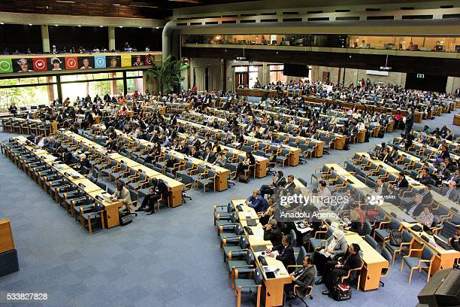
  Draft structure of the fifth session of the OECPR -15 – 19 February 2021

Slide 2
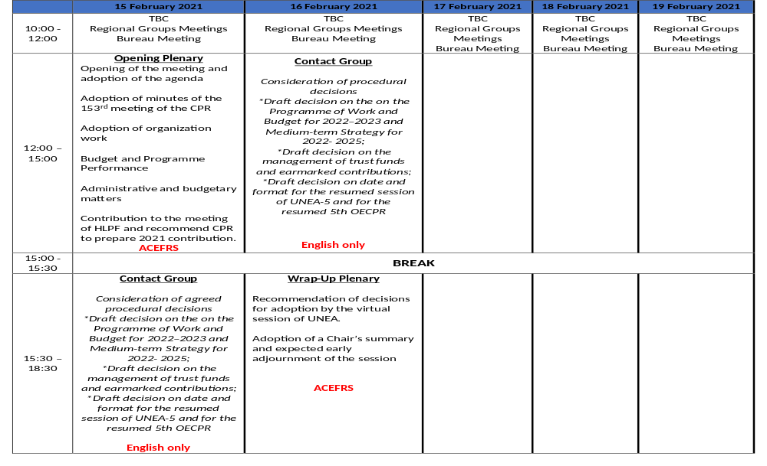

Slide 3
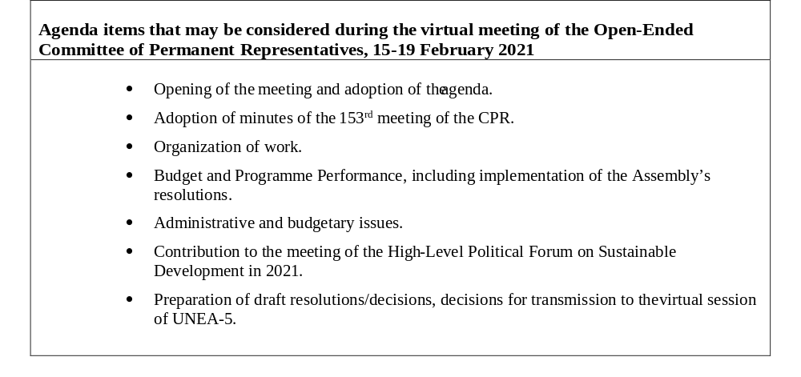

Slide 4
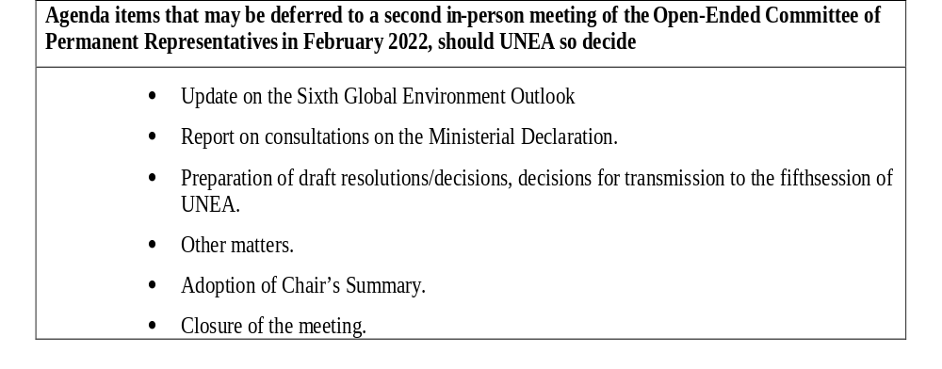

Slide 5
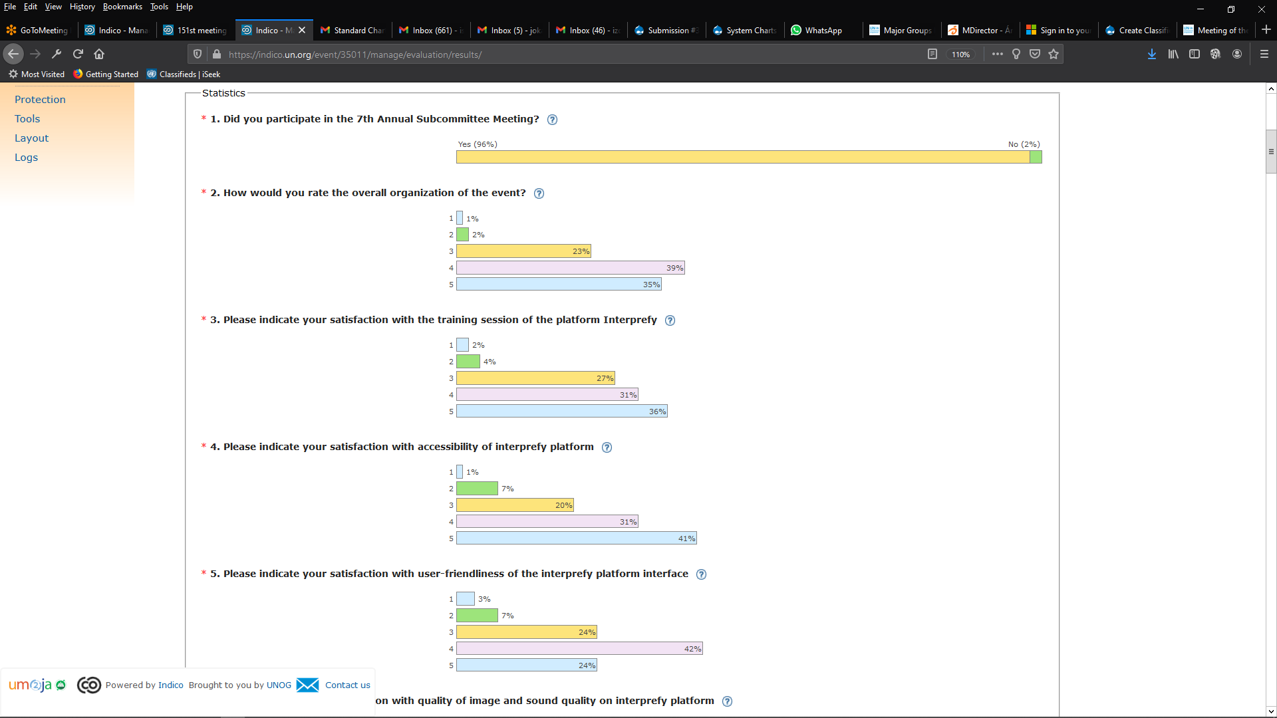
Survey results to the seventh annual subcommittee meeting of the seventh committee of permanent representatives
LEGEND
1 > Poor 2 > Average 3 > Good 4 > Very Good 5 > Excellent

Slide 6
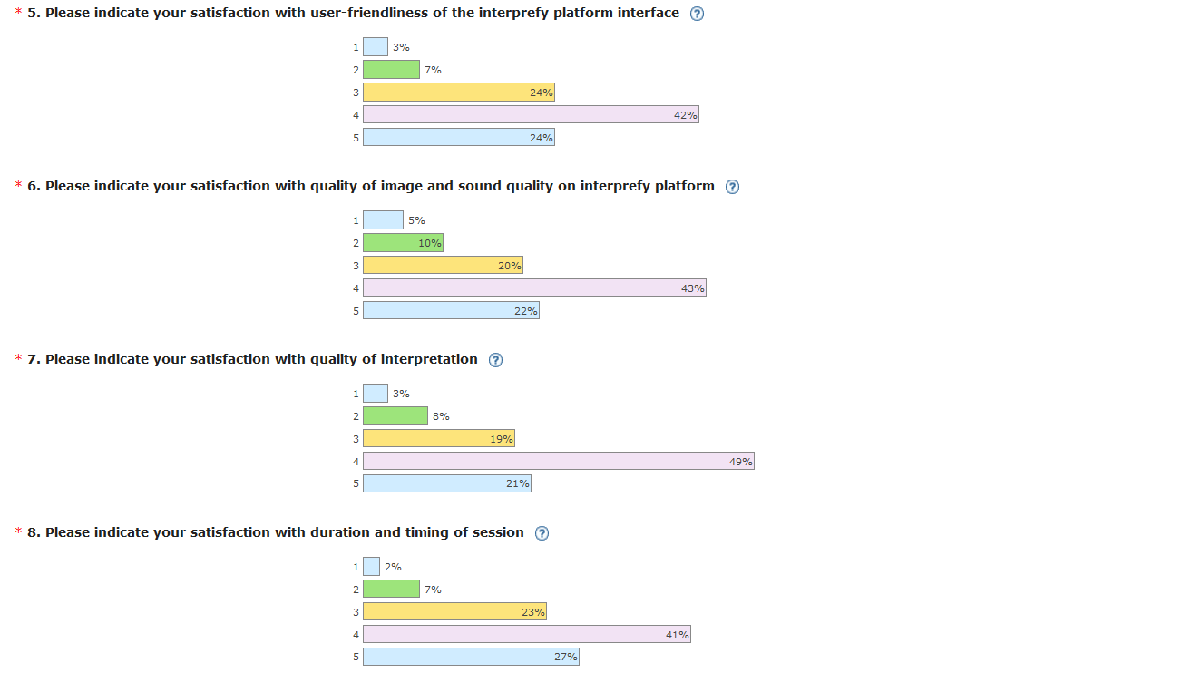

Slide 7
Cost comparison for virtual meetings vs in person meetings.
6 language meeting |  |  | In-person (20 interpreters) |  |  | Virtual with Interpretation (56 interpreters)
No. of Days | No. of Meetings | Hours | Interpretation | Other conference staff | Total | Interpretation | Other conference staff | Virtual Platform | Total
1 | 2 | 6 | 25,775 | 1,845 | 27,620 | 39,368 | 1,788 | 6,500 | 47,656
The above is a daily cost of a 5 day conference with 6 languages.

