Slide 1

Implementation tools for FDES
Session 3: Data collection, compilation of indicators and quality control National Workshop on Climate Change and Disaster-related Statistics

Slide 2

Content
Manual on the Basic Set of Environment Statistics Environment Statistics Self-Assessment Tool (ESSAT) SDG indicators + Basic Set (FDES) matrix
2

Slide 3
Manual on the Basic Set of Environment Statistics (1/2)
https://unstats.un.org/unsd/envstats/fdes/manual_bses.cshtml
The objective of the Manual is to produce and disseminate a set of methodology sheets or metadata for the collection or compilation of all environment statistics of the Basic Set of Environment Statistics embedded in the FDES 2013. These methodology sheets offer detailed and in-depth methodological guidance including definitions, classifications, statistical methods for collection and/or compilation, dissemination and main uses of the sets of the respective environment statistics. These aspects are provided by the standards and guidelines established by lead agencies in the relevant fields, such as FAO, UNFCCC, UN-HABITAT, UNEP and others.
3

Slide 4
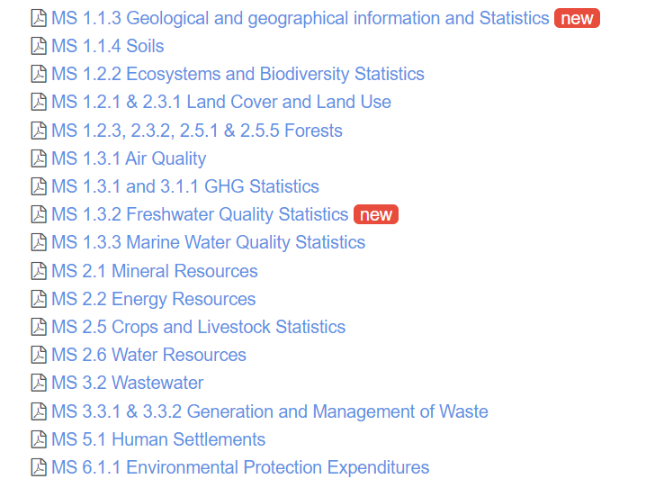
Manual on the Basic Set of Environment Statistics (2/2)
https://unstats.un.org/unsd/envstats/fdes/manual_bses.cshtml
4
As there are 458 environment statistics identified in the Basic Set of Environment Statistics, their methodology sheets are being developed in a modular and progressive manner

Slide 5
Environment Statistics Self-Assessment Tool (ESSAT) (1/5)
https://unstats.un.org/unsd/envstats/fdes/essat.cshtml
UNSD, in collaboration with the Expert Group on Environment Statistics, has developed the Environment Statistics Self-Assessment Tool (ESSAT) in support of the FDES 2013. The purpose of the ESSAT is to assist countries in both developing their environment statistics programmes and collecting their own data on the environment, and to assess the state of environment statistics and the needs for their development at the national level consistent with the scope of the FDES 2013. Introduction English, Arabic, Chinese, French, Portuguese, Russian, Spanish Part I: Institutional dimension of Environment Statistics English, Arabic, Chinese, French, Portuguese, Russian, Spanish Part II: Statistics Level Assessment English, Arabic, Chinese, French, Portuguese, Russian, Spanish
5

Slide 6
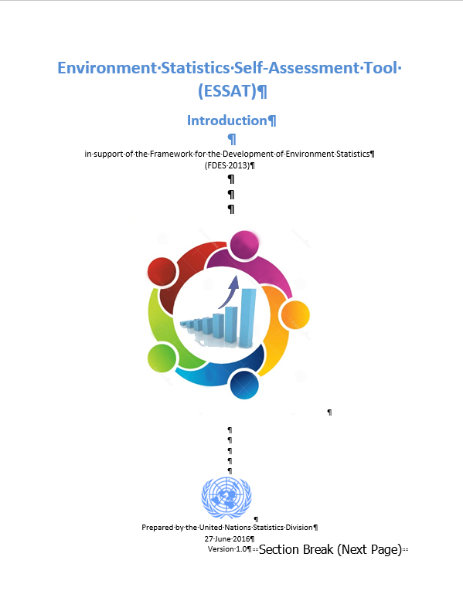
Environment Statistics Self-Assessment Tool (ESSAT) (2/5)
https://unstats.un.org/unsd/envstats/fdes/essat.cshtml
 | Introduction: Background Use of the ESSAT The structure of the ESSAT Key concepts from the FDES 2013
6

Slide 7
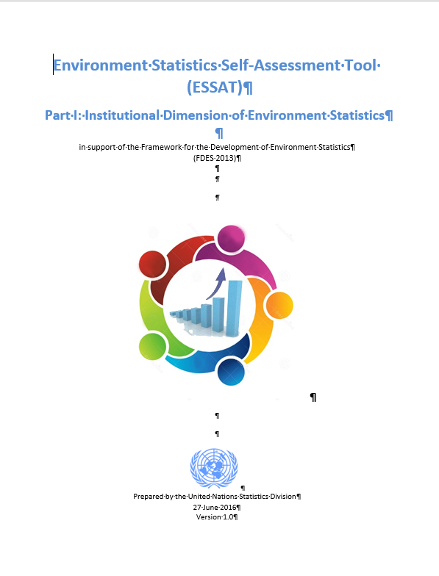
Environment Statistics Self-Assessment Tool (ESSAT) (3/5)
https://unstats.un.org/unsd/envstats/fdes/essat.cshtml
 | A. Identification of institutions B. Existing national policies relevant to the environment C. Mandate and organization of national statistics D. Mandate and organization of environment statistics E. Production of environment statistics F. Uses of environment statistics G. Inter-institution collaboration for the production of environment statistics H. Existing and required resources for environment statistics I. International and regional work J. Technical assistance and training K. The way forward in environment statistics
7
Part I: Institutional Dimension of Environment Statistics focuses on the overall statistical organizational structure and on specific information regarding environment statistics in terms of organization, collaboration, resources, international cooperation, uses, etc.

Slide 8
Environment Statistics Self-Assessment Tool (ESSAT) (4/5)
https://unstats.un.org/unsd/envstats/fdes/essat.cshtml
Part II: Statistics Level Assessment goes in more detail and it captures information concerning the whole Basic Set of Environment Statistics, up to the individual environment statistics level. It is a diagnostic tool, designed to allow nations to assess the status of their own Environment Statistics production/systems. The Self-Assessment Tool consists of a set of questions comparing the statistics in the Basic Set with available national environment statistics, environmental policy objectives and international reporting requirements. These questionnaires are not intended for international statistic compilation.
8

Slide 9
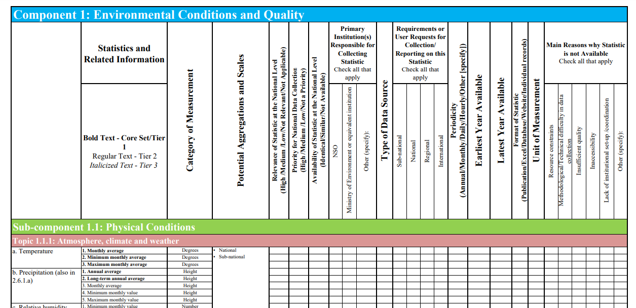
Environment Statistics Self-Assessment Tool (ESSAT) (5/5)
https://unstats.un.org/unsd/envstats/fdes/essat.cshtml
9

Slide 10
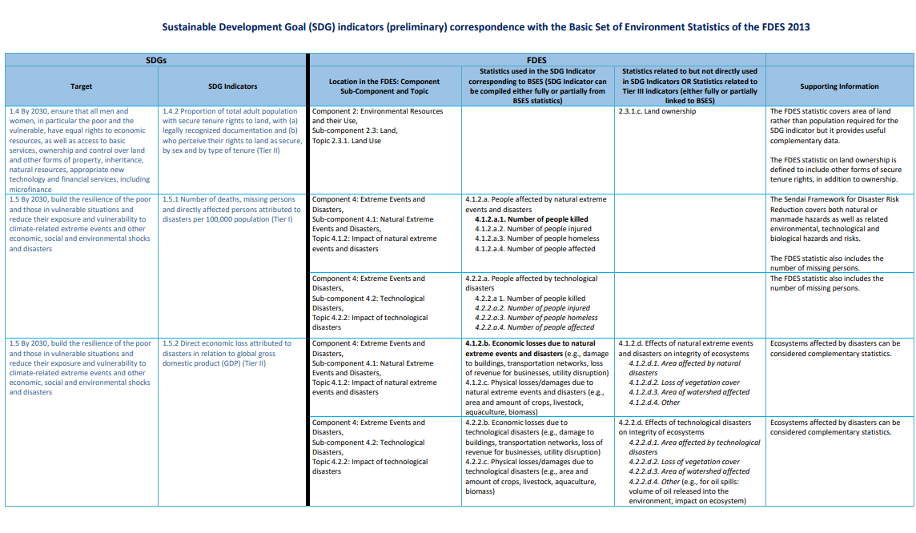
SDG indicators + Basic Set (FDES) matrix
https://unstats.un.org/unsd/envstats/fdes/SDG_FDES%20matrix.pdf
10
Covers 94 SDG indicators
Indicates:
Location in the FDES with information:
  Either Statistics used in the SDG Indicator corresponding to BSES (SDG Indicator can be compiled either fully or partially from BSES statistics)
  Or Statistics related to but not directly used in SDG Indicators or Statistics related to Tier III indicators (either fully or partially linked to BSES)
As well as supporting Information

Slide 11
Thank you
Ekaterina Poleshchuk Programme Management Officer / Statistician, UNEP ekaterina.poleshchuk@un.org Emil Ivanov Statistician, UNSD envstats@un.org

