Slide 1





Workshop “Elements to consider when designing a Global Monitoring Plan for Mercury”
13 – 14 February 2018, Rome, Italy
Pilot survey: monitoring sites and experimental design for air sampling
Alessandra Fino, Nicola Pirrone,
F. Sprovieri, A. Macagnano, G. Esposito,
E. Zampetti, P.Papa
National Research Council of Italy -Institute of Atmospheric Pollution Research
CNR-IIA

Slide 2





Contents
Sampling site selection
Plan for air sampling campaigns
Sampling scheme for each campaign
Main difficulties faced during air campaigns
Final considerations for Hg Global Monitoring Plan
Workshop “Elements to consider when designing a Global Monitoring Plan for Mercury”
13 – 14 February 2018, Rome, Italy
Notes:
During the air sampling period, the CNR-IIA has involved many experts around the world asking them to perform mercury measurements by conventional instruments and the new devices developed by the CNR-IIA.
A selection of sampling sites was done in collaboration with UN Environment and WHO.
Then a detailed sampling plan using the passive samplers have been developed for all GMOS and WHO sites involved and a sampling scheme was elaborated for each campaign.
During the implementation many logistic and technical problems were faced and thanks to a great cooperation they were overcome.

Slide 3

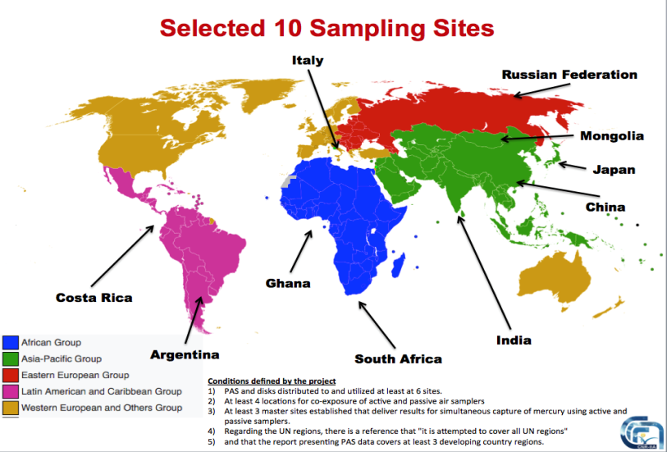
Workshop “Elements to consider when designing a Global Monitoring Plan for Mercury”
13 – 14 February 2018, Rome, Italy
Notes:
The CNR-IIA has a big experience gained trough the GMOS project, that provides consistent and high-quality mercury measurements worldwide.
The chosen sites for air monitoring belong to the GMOS network of monitoring stations and to WHO sites (for human-biomonitoring).
It was attempted to cover all UN regions.
The CNR-IIA defined a set of final air monitoring stations composed by two groups:
the first, at GMOS stations, the second, defined in the region where WHO carried out its human-biomonitoring.

Slide 4

Selection of monitoring sites
From GMOS & WHO networks
GMOS – Selected monitoring sites
Background sites
Monte Curcio (Italy)
Bariloche (Argentina)
Cape Point (Sud Africa)
Cape Hedo (Japan)
WHO- Selected sampling sites
Hotspot sites
Ghana
Mongolia
India
Costa Rica
China (*Mt. Ailao *substituted site)
Russian Federation (*Listvyanka - substituted site)
All GMOS sites are located in background locations in order to obtain measurements that are representatives of a large region (important for trend analysis)
Some sites have been located at more polluted sites for a co-monitoring with WHO
Workshop “Elements to consider when designing a Global Monitoring Plan for Mercury”
13 – 14 February 2018, Rome, Italy
Notes:
The CNR-IIA defined therefore a set of final air monitoring stations composed by two groups:
the first, at GMOS stations, mostly background/rural sites - for co-exposure of active and passive air samplers;
the second, defined in the region where WHO carried out its human-biomonitoring, at highly polluted sites, for exposure of passive air samplers.

Slide 5

Hg Monitoring Program:
3 Intensive Sampling Campaigns have been planned
2016
2017
First campaign
(February-March 2017)
Second campaign
(May-August 2017)
Third campaign
(September- November 2017)
Carried out and completed in:
- Mongolia
- Ghana
- India
- China
- Italy
- Argentina
- South Africa
- Japan
- Russian Federation
→COSTA RICA (na)
In progress in:
- Italy
- Argentina
- South Africa
- Japan
To be carried out in:
- Mongolia
- Ghana
- India
- China
- Italy
- Argentina
- South Africa
- Japan
- Russian Federation
- Costa Rica (started late)
Workshop “Elements to consider when designing a Global Monitoring Plan for Mercury”
13 – 14 February 2018, Rome, Italy
Notes:
The sampling campaigns have been performed over two campaigns at WHO sites, in winter and summer seasons, and over three seasons at most of GMOS stations.
The data are then representative of seasonal mercury concentrations at all site.
The air sampling campaigns have been scheduled over one month and half during the selected seasons.

Slide 6

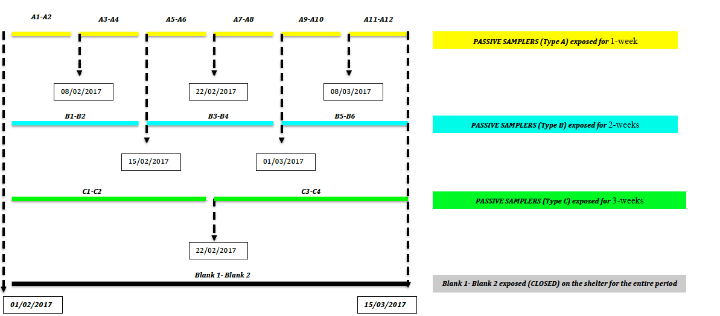
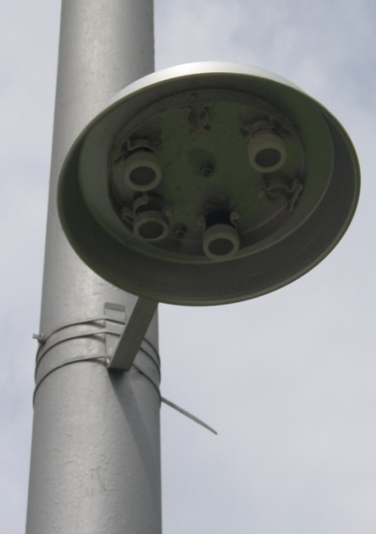
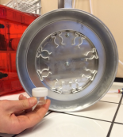
Sampling schemes at WHO sites
Workshop “Elements to consider when designing a Global Monitoring Plan for Mercury”
13 – 14 February 2018, Rome, Italy
Notes:
The novel Hg passive samplers have been firstly tested in the CNR-IIA labs and then a plan to share them among a selection of monitoring sites in different environmental and meteorological conditions was developed.
The pilot survey within this project was aimed to perform a global scale validation of sampling devices (PAS) and gather ambient mercury data for exposure assessment along with WHO HBM campaigns in the same regions.
Therefore the sampling campaigns have been structured using a much higher number of samplers that have been exposed for 1, 2 and 3 weeks in parallel ; this has allowed to cross check the following key parameters for the QA/QC:
linearity over time,
reproducibility
behaviour of samplers at different climate conditions.
The gathered data will be representative of seasonal Hg concentration levels at all site.

Slide 7
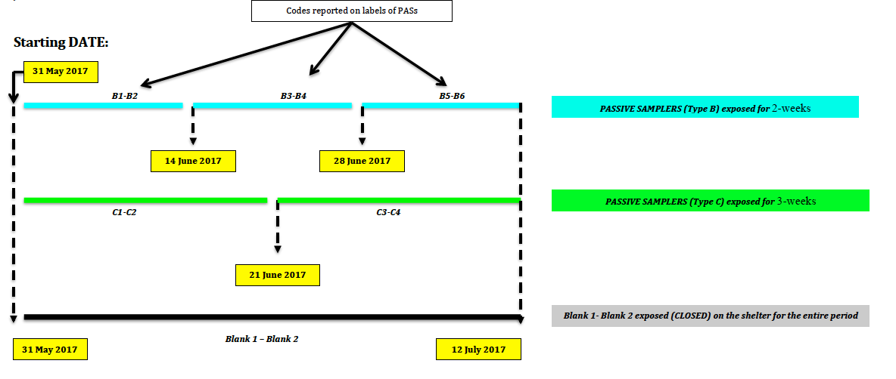
Sampling schemes at GMOS sites
Workshop “Elements to consider when designing a Global Monitoring Plan for Mercury”
13 – 14 February 2018, Rome, Italy
Notes:
At GMOS sites the samplers have been co-located with active air samplers and have been exposed for 2 and 3 weeks in parallel to allow us to cross check the same QA/QC key parameters as at WHO sites.

Slide 8

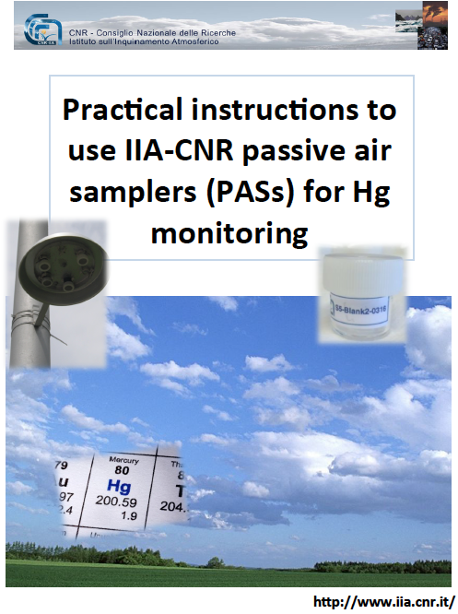
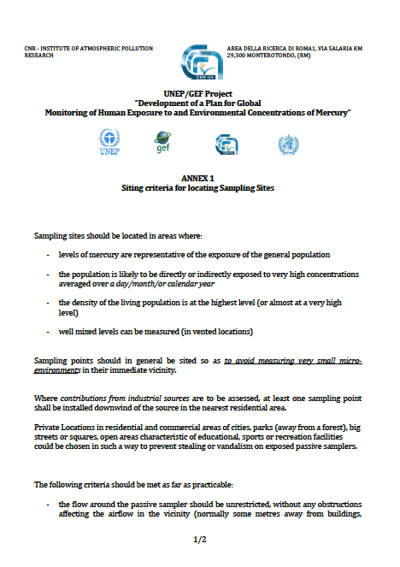
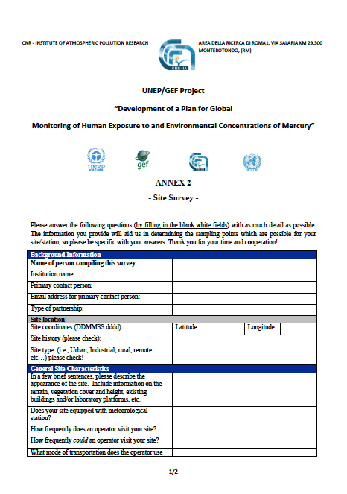
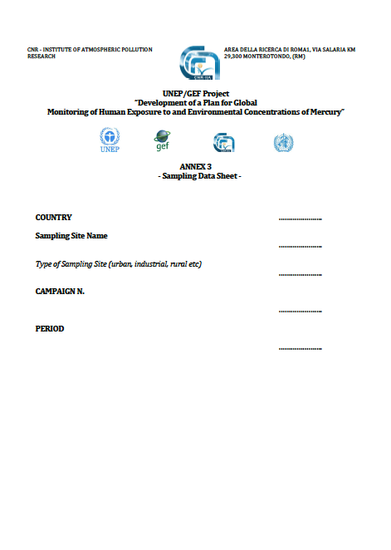




Tools developed for site managers and national coordinators
An instructive Video on Practical instructions for Mercury Air Passive Samplers (PAS) has been realized and shared with UNEP and WHO trough the following link:
https://drive.google.com/open?id=0B-ireFSFTkqKS2c0ckNDdXJ4OVk .
Practical instructions and criteria to use mercury Passive Air Samplers (PASs) for air monitoring campaigns together with specific forms to be filled in, were developed by CNR-IIA and sent to all partners involved in the campaigns.
Workshop “Elements to consider when designing a Global Monitoring Plan for Mercury”
13 – 14 February 2018, Rome, Italy

Slide 9
Main difficulties faced during air campaigns
Delay in the implementation of the first campaign
Many problems due to custom clearance and to the export of technical material
Meteorological adverse conditions
Contamination of some samplers /blanks
Necessity to improve training in the future campaigns
Workshop “Elements to consider when designing a Global Monitoring Plan for Mercury”
13 – 14 February 2018, Rome, Italy

Slide 10

Elements to be considered for GMP
Recognizing the urgent need for a framework for research, development and monitoring (Art. 19) and for the effectiveness evaluation (Art. 22) of the Minamata Convention on Mercury that includes a strategic, cost-effective approach that provides appropriate and sufficient comparable data (harmonized methodologies), we should consider:
Sites to be considered (Monitoring should focus as a priority on background mercury levels whilst providing an understanding regarding the existence of hotspots, e.g. through provision of information on likely magnitude and frequency of variation in hotspots);
Hg Compounds to be monitored (Data availability differs from region to region. It will be necessary to define a minimum level of monitoring efforts necessary worldwide)
Available methodologies to be used and their possible advantages and disadvantages
QA/QC considerations to assure data comparability
Training programmes for all future air managers.
Workshop “Elements to consider when designing a Global Monitoring Plan for Mercury”
13 – 14 February 2018, Rome, Italy

Slide 11
Thanks to:
UN Environment and WHO teams
Our project coordinator and all the CNR-IIA team
All GMOS site managers and WHO national coordinators!
Workshop “Elements to consider when designing a Global Monitoring Plan for Mercury”
13 – 14 February 2018, Rome, Italy

