Slide 1


Notes:
‘0’ This lecture explains steps in mercury mass flow development.

Slide 2

Notes:
‘1’ This part describes sector definitions, identification and quantification of flows.

Slide 3

Notes:
‘2’ This section guides the sectors defined by the UNEP Inventory Toolkit.

Slide 4
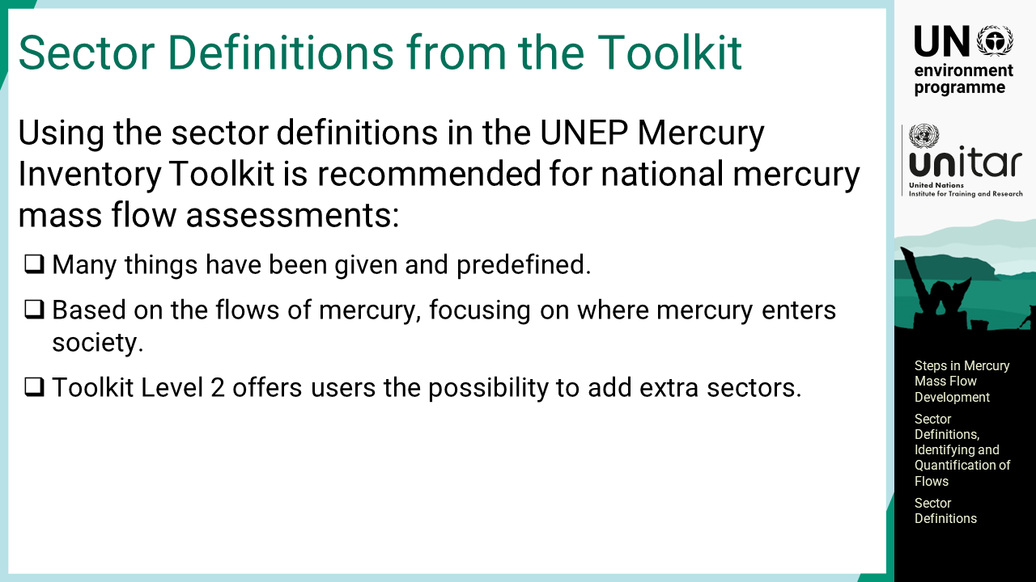
Notes:
‘3’ Using the sector definitions in the UNEP Mercury Inventory Toolkit is recommended for national mercury mass flow analysis. Many things have been given and predefined in the Toolkit, and it is therefore practical to use the sector definitions given therein. They are based on the flows of mercury focusing on where mercury enters society, and therefore it is practical to use them. Inventory Level 2 offers users the possibility to add extra sectors.

Slide 5
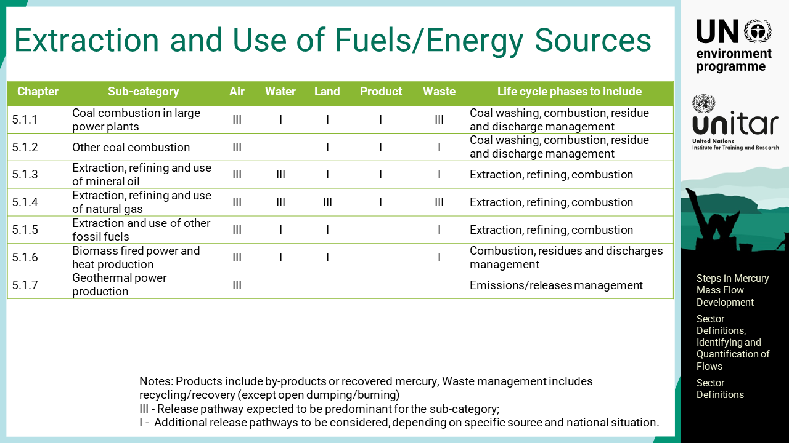
Notes:
‘4’ This table shows the definitions, or sub-categories, of the Toolkit for extraction and use of fuels and other energy sources. The first column refers to the Toolkit Reference Report chapter number, which also serves as the subcategory number. The next column shows the subcategory name, such as coal combustion in power plants. The output pathways are described in the following five columns starting from air, water, land, product, and waste. In the output estimations, waste is further subdivided into two sub-outputs: general, or municipal, solid waste and sector-specific waste. They are assessed in two ways, either the release pathway expected to be predominant for the sub-category, or additional to be considered depending on the specific source and national situation. The last column is the information on the life cycle phases to be included in the mass flow assessment. Coal combustion includes coal washing, coal combustion, and residue and discharge management. Coal washing is often done at the coal mine and may not be the case at the plant site. There will be a flow to the atmosphere from the power plant. There may be discharges to water if the facility has wet flue gas cleaning. There will also be a mercury flow to land if fly ash containing mercury is deposited directly on land or used as a construction material contacting land. If there is a wet or semi-dry de-sulphurisation filter, they sometimes produce gypsum for wall boards as by-products, which may contain trace mercury. Solid waste residuals from the filters and the slags may be sent to a general landfill, to a special depot, or whatever is appropriate in the specific circumstances.

Slide 6
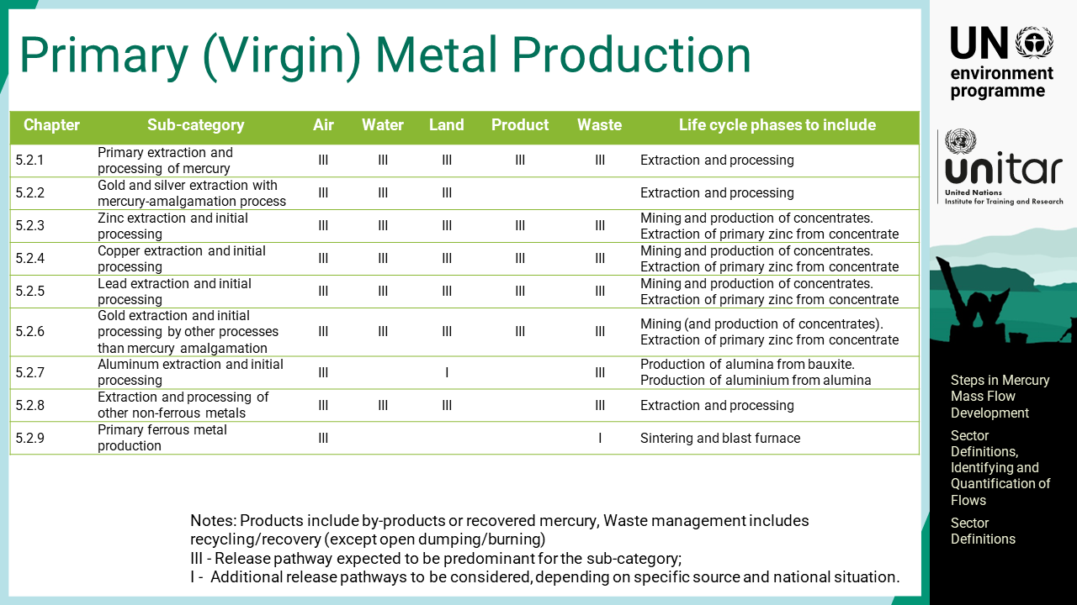
Notes:
‘5’ This table presents the primary metal production sectors, or sub-categories that produce virgin metal, which are categorized in 5.2 series.

Slide 7
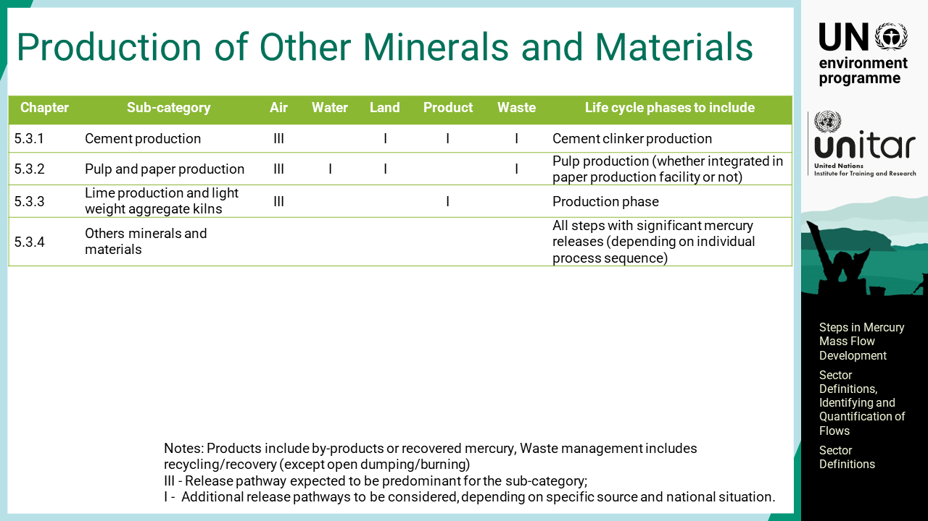
Notes:
‘6’ This table presents the production of other minerals and materials with mercury impurities, where cement clinker production is one of the major ones.

Slide 8
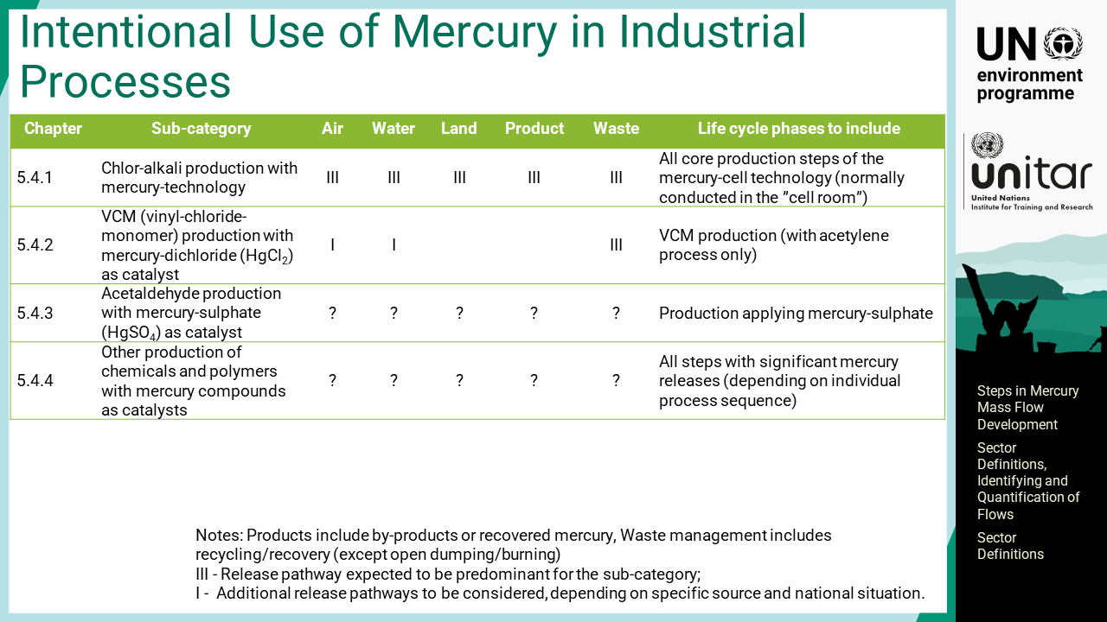
Notes:
‘7’ This table presents the intentional use of mercury in industrial processes. It includes chlor-alkali plants with mercury cells, VCM production with mercury containing catalysts, and so on.

Slide 9
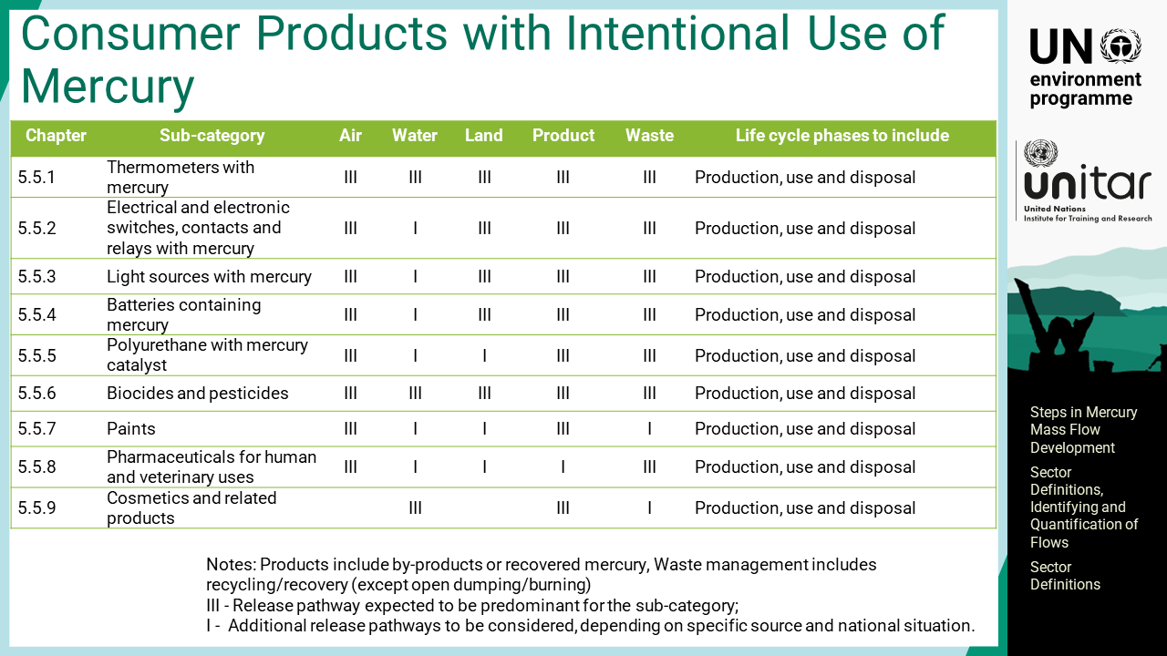
Notes:
‘8’ This table presents consumer products with intentional use of mercury, which are called mercury-added products. There may be significant mercury outputs from the production, use and disposal of such products.

Slide 10
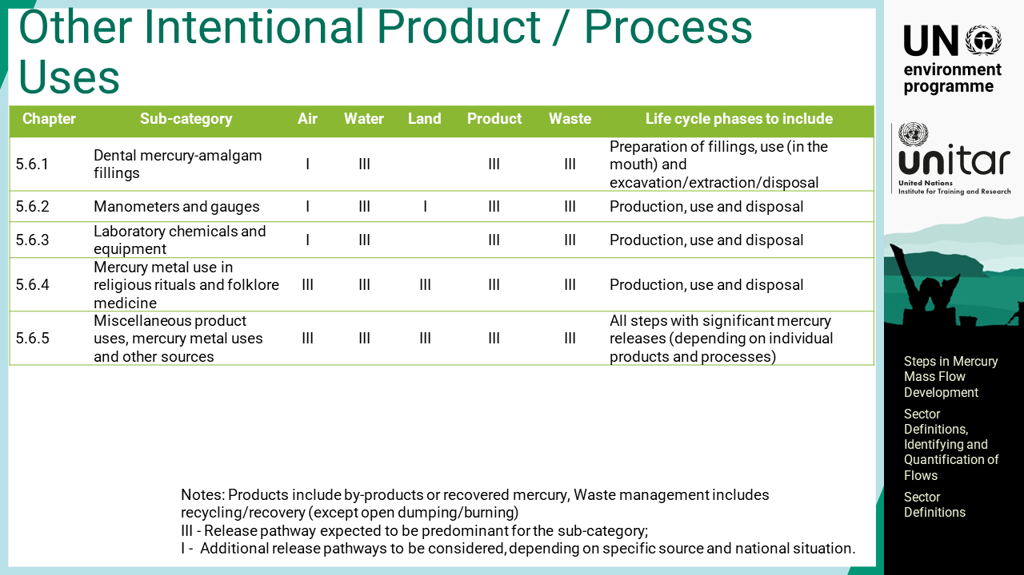
Notes:
‘9’ This table presents other intentional products and process uses. The prominent ones in this sub-category are dental amalgam, manometers, and gauges, which are not considered other products in the Toolkit’s Level 2 because mercury may be sold separately for these purposes. Manometers, for example, may be sold empty for refilling with mercury after purchase. For simplification, the Toolkit’s Inventory Level 1 does not have this distinction.

Slide 11
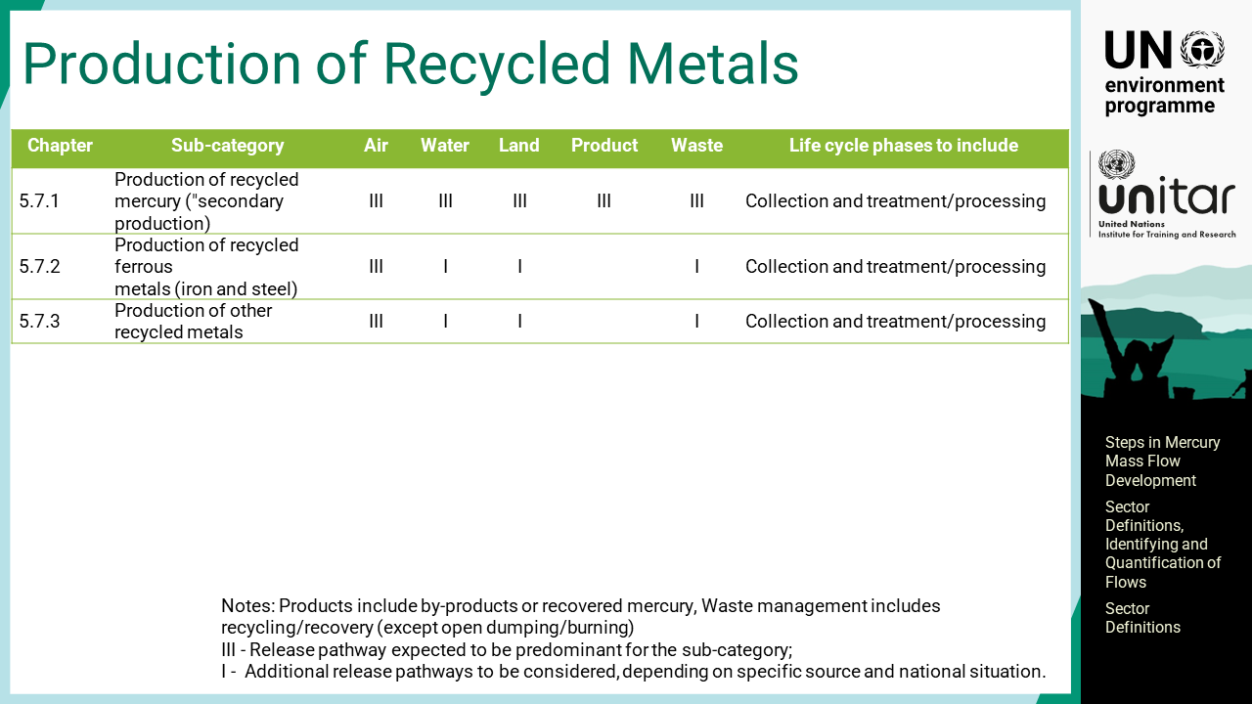
Notes:
‘10’ This table presents the production of recycled mercury and other recycling industries, or secondary metal production.

Slide 12
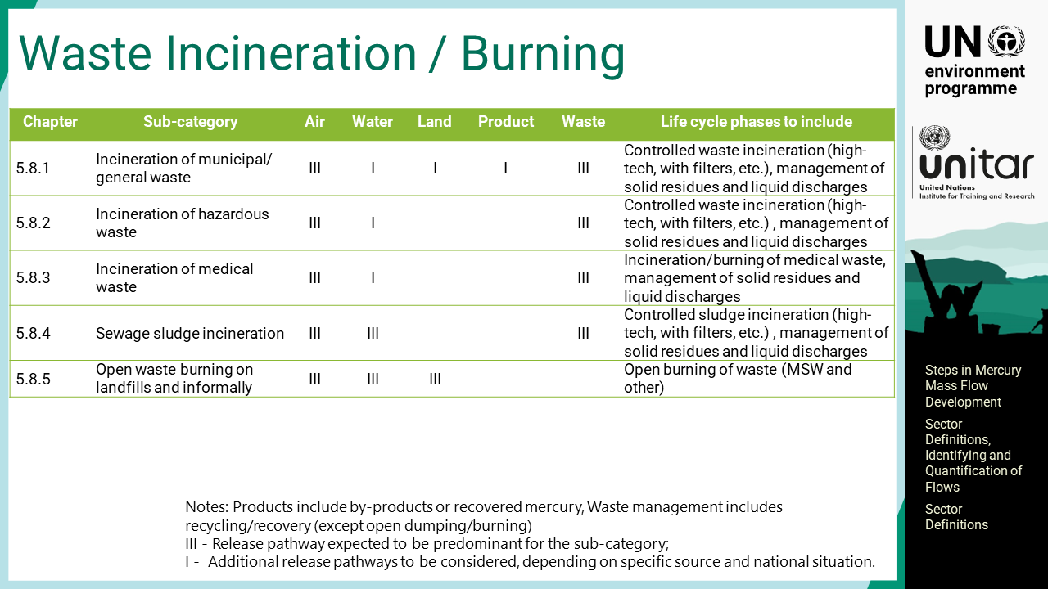
Notes:
‘11’ This table presents the waste incineration and open waste burning of different waste fractions.

Slide 13
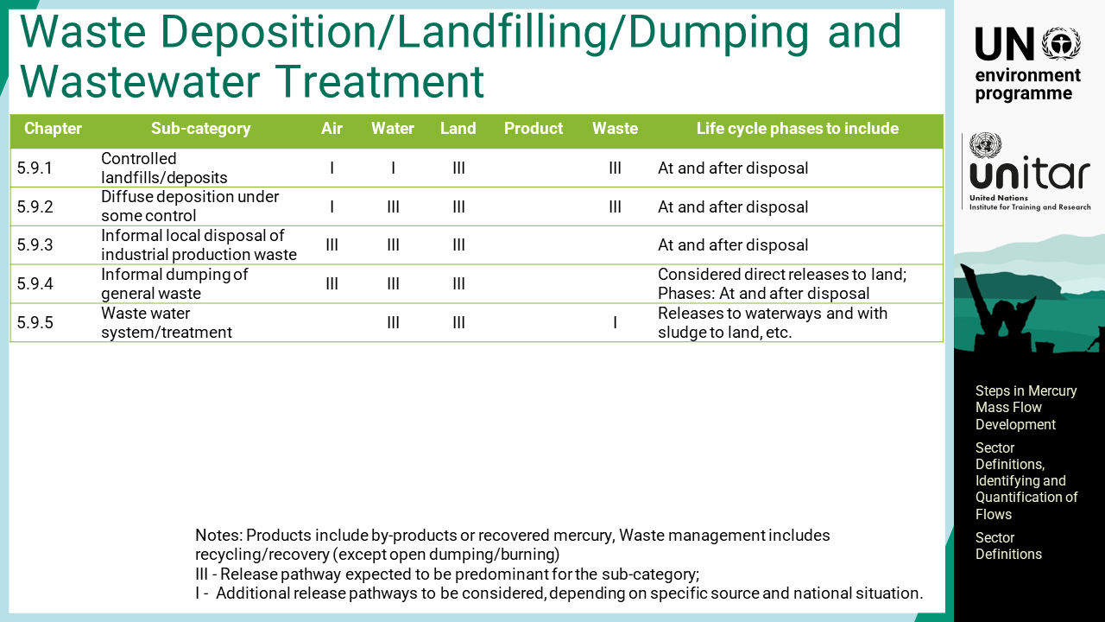
Notes:
‘12’ This table presents waste deposition, landfilling and dumping, as well as wastewater treatment.

Slide 14
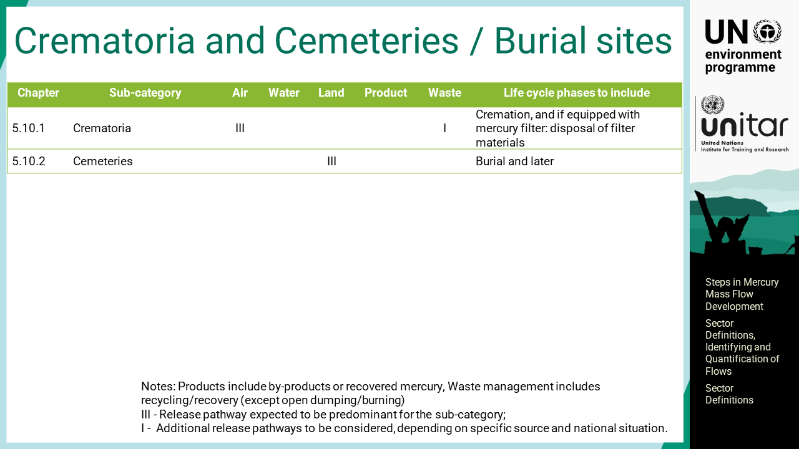
Notes:
‘13’ This table presents crematory and cemeteries, or burial sites.

Slide 15
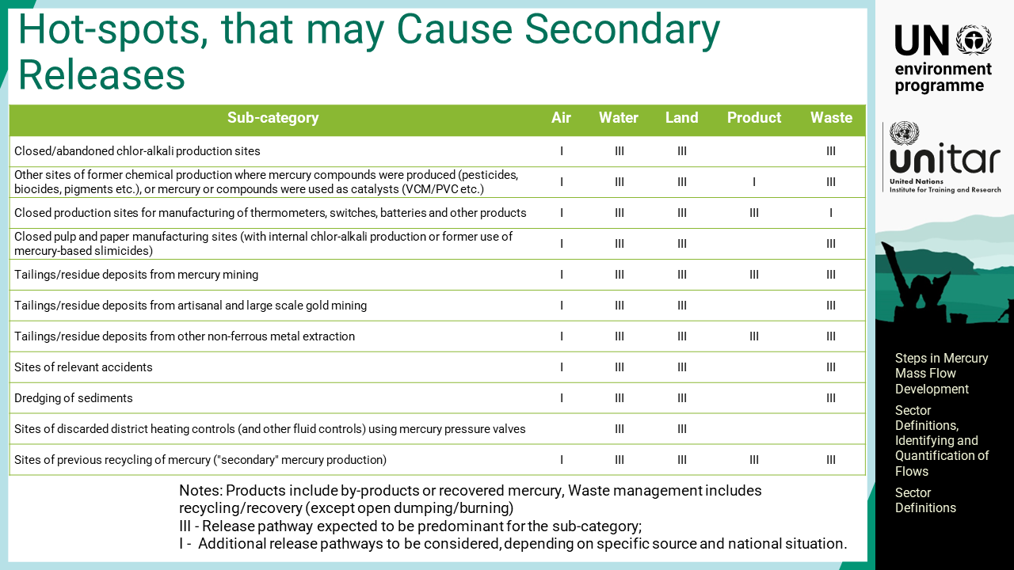
Notes:
‘14’ This table lists mercury hot spots that may cause secondary releases or may be called contaminated sites. Basically, they are closed or abandoned sites where building materials, underground, or the surroundings are often polluted. Mine tailings are also potential secondary sources of mercury if they are handled, dumped or deposited in larger amounts.

Slide 16

Notes:
‘15’ This section introduces the steps for identifying mercury flows in comparison with the mercury inventory.

Slide 17
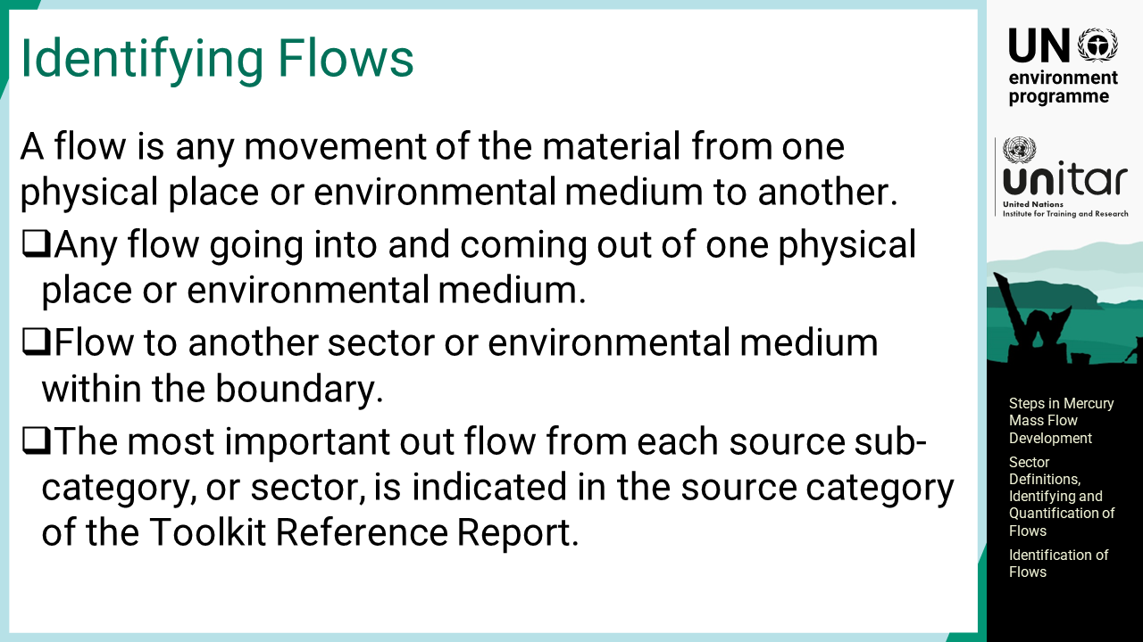
Notes:
‘16’ A flow is any movement of the material, that is, mercury in this case, from one physical place or environmental medium to another. There is any flow going into and coming out of one physical place or environmental medium. It also includes the flow to another sector or environmental medium within the boundary. For example, onsite dumping of waste in an industrial facility does not cross the boundary, but it is considered a flow. The most important outflow from each source sub-category, or sector, is indicated in the source category of the Toolkit Reference Report. Other output flows may exist, but they are usually considered insignificant.

Slide 18
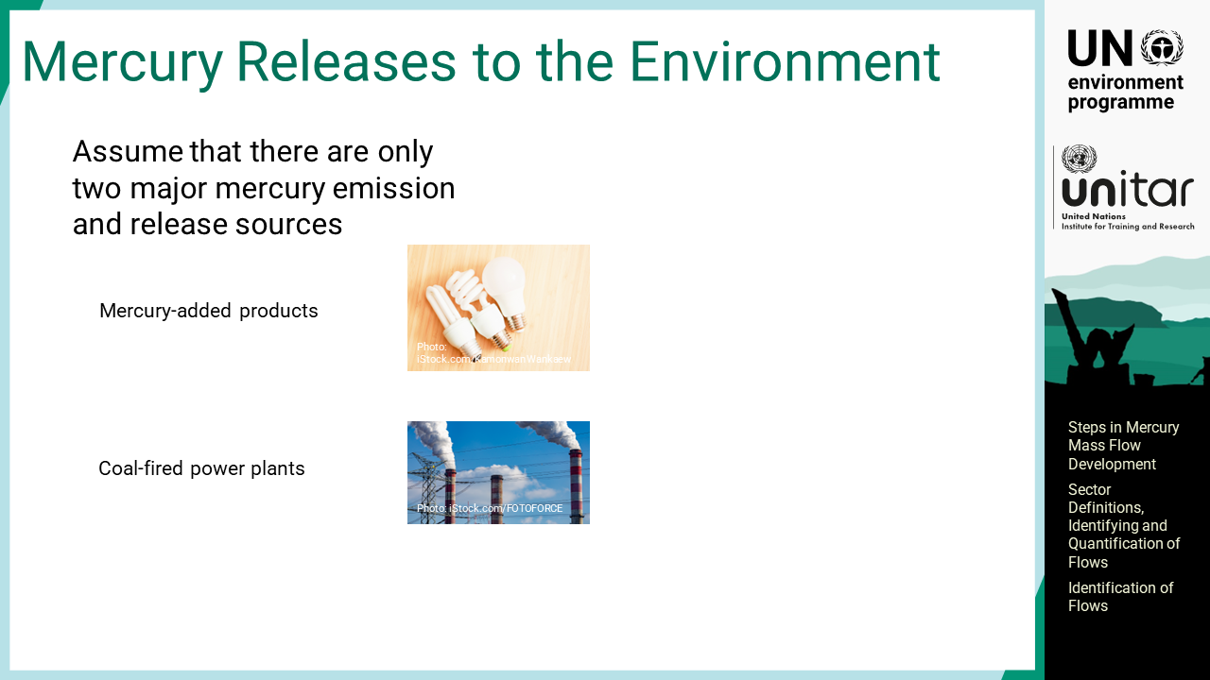
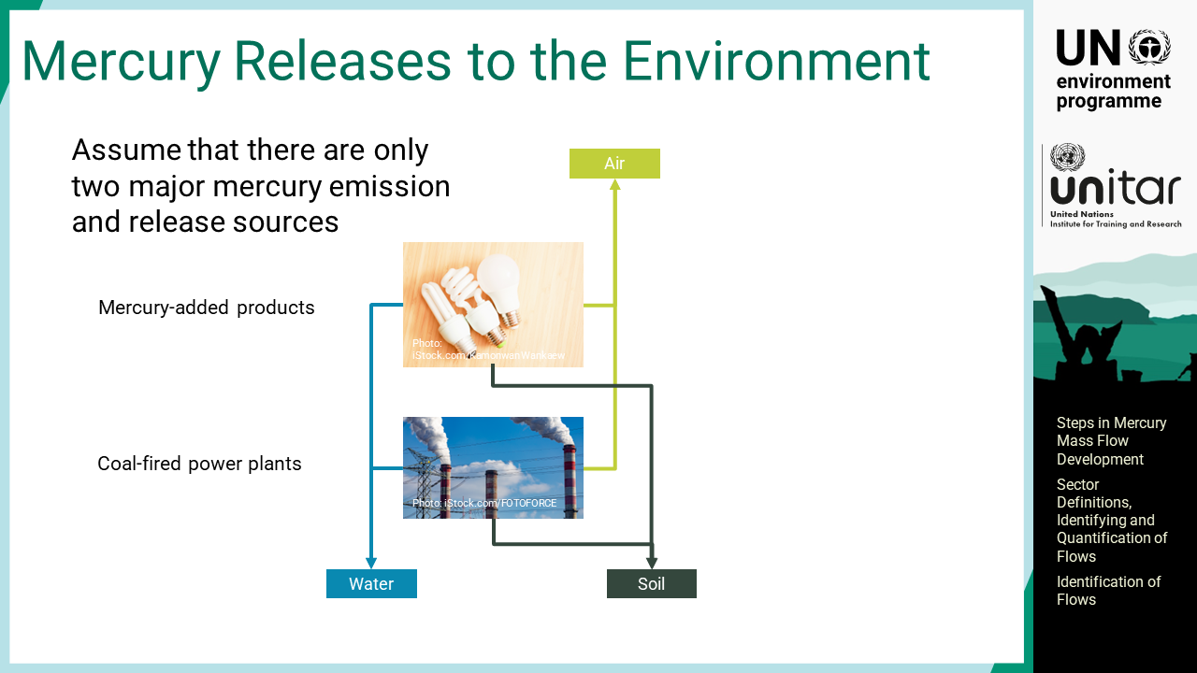
Notes:
‘17’ The following slides show a simple example to develop a flow diagram by assuming that only two major mercury emission and release sources exist in the system, namely, mercury-added products, and coal-fired power plants. Once the sectors are identified, the mercury flows are visualized with arrows.
For the mercury inventory concept, mercury emissions and releases into the environment are identified flows and the amount of mercury may be estimated for each flow.

Slide 19
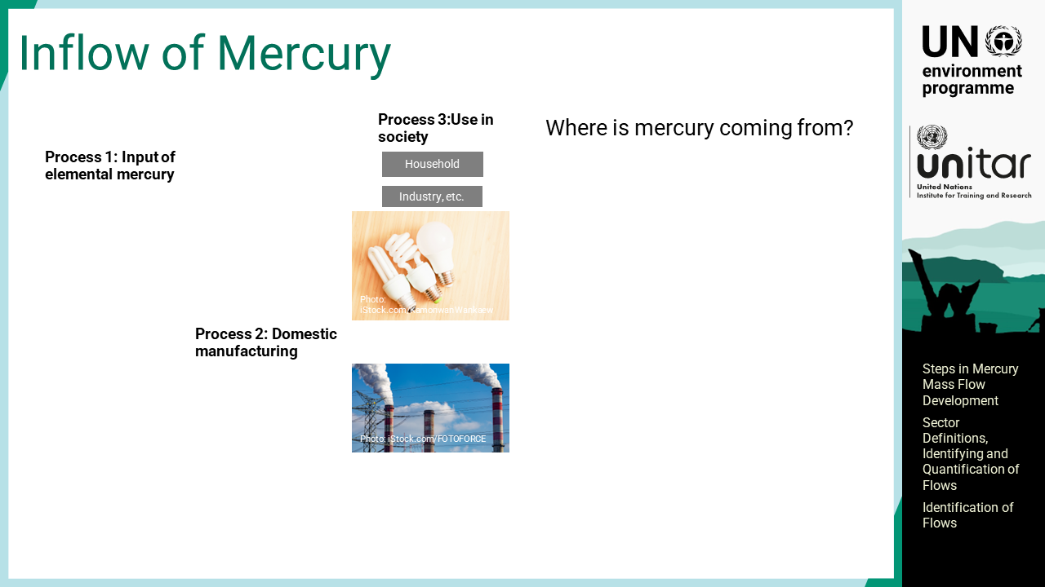
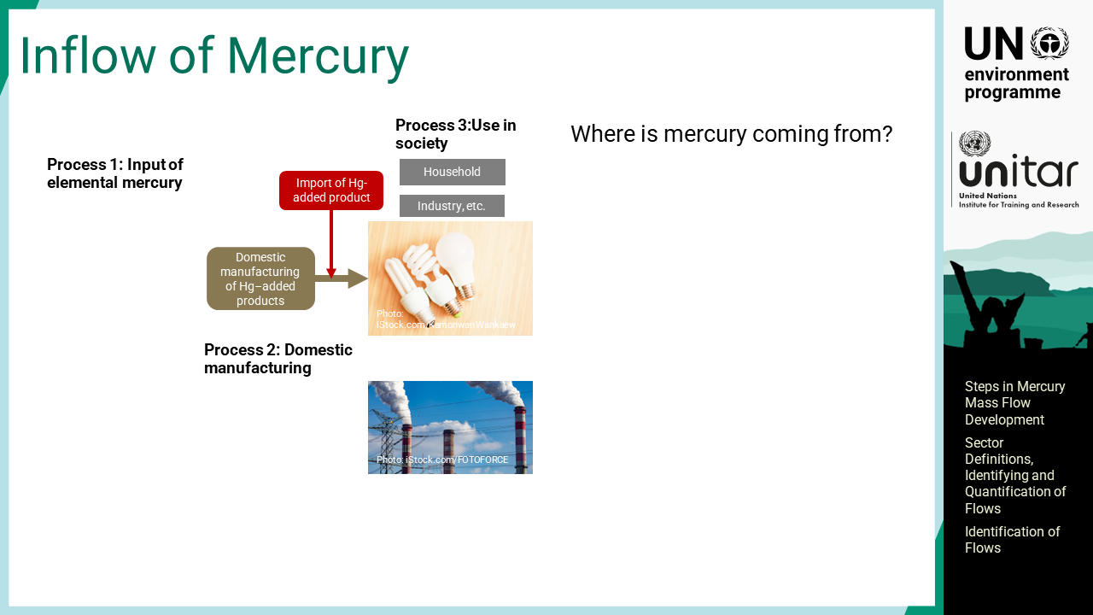
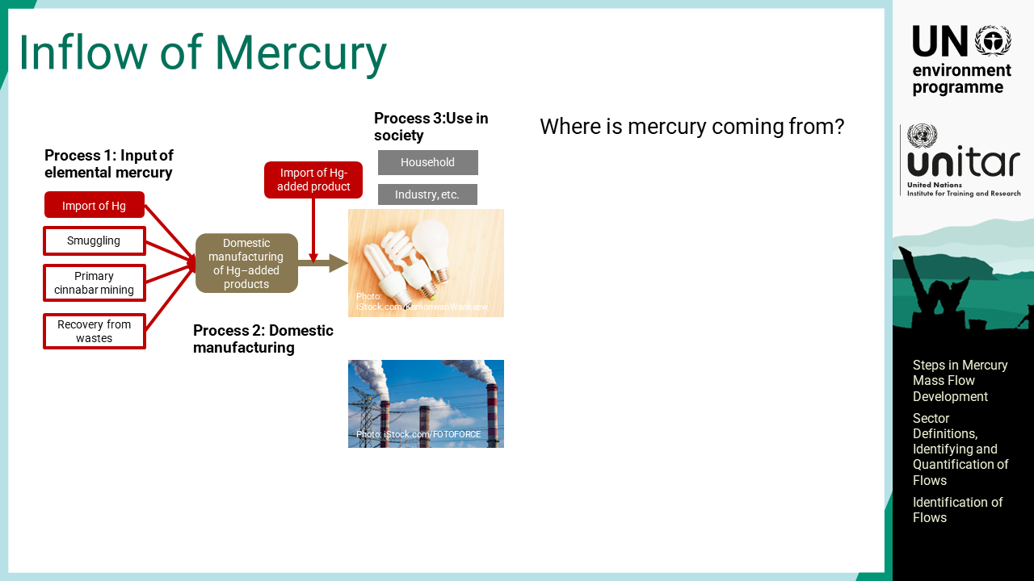
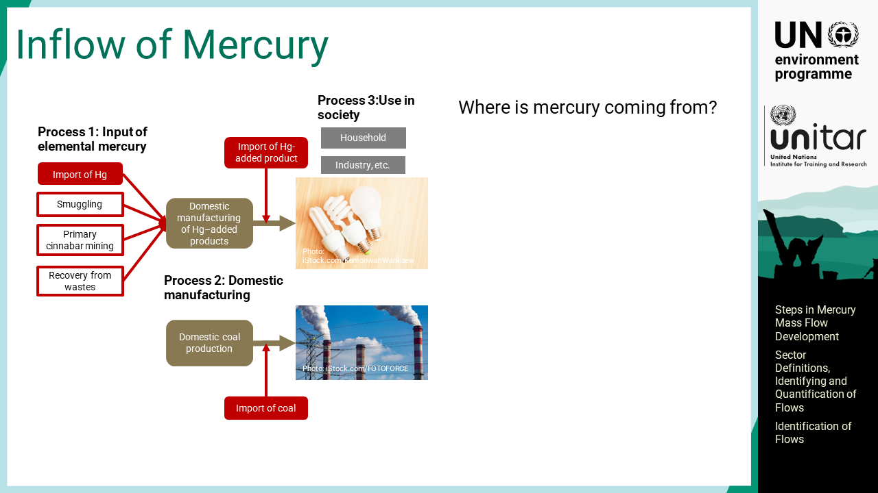
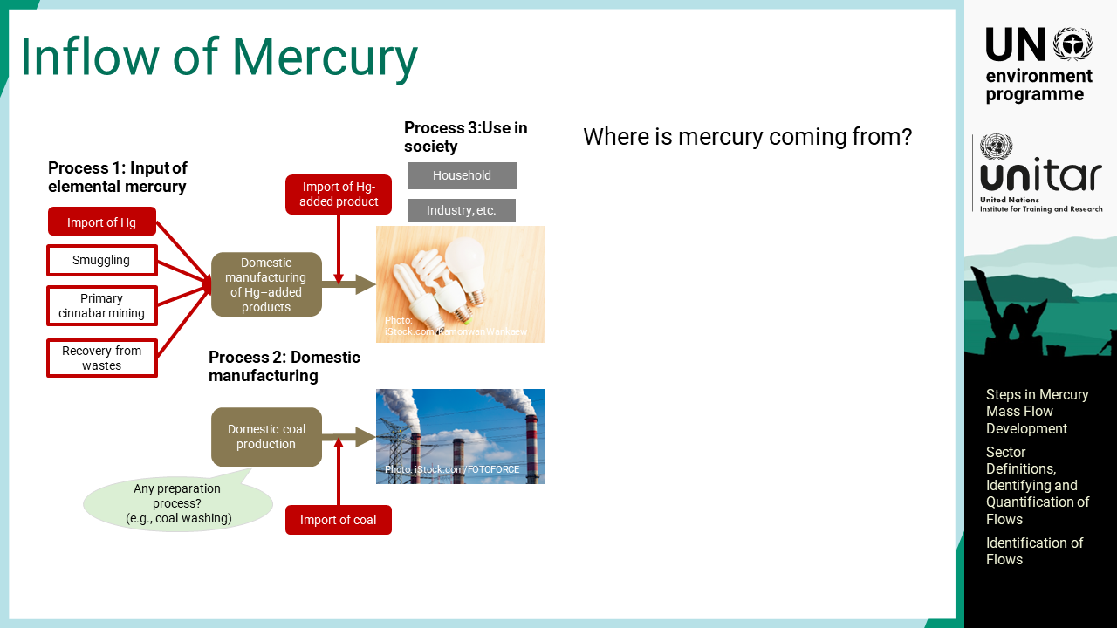
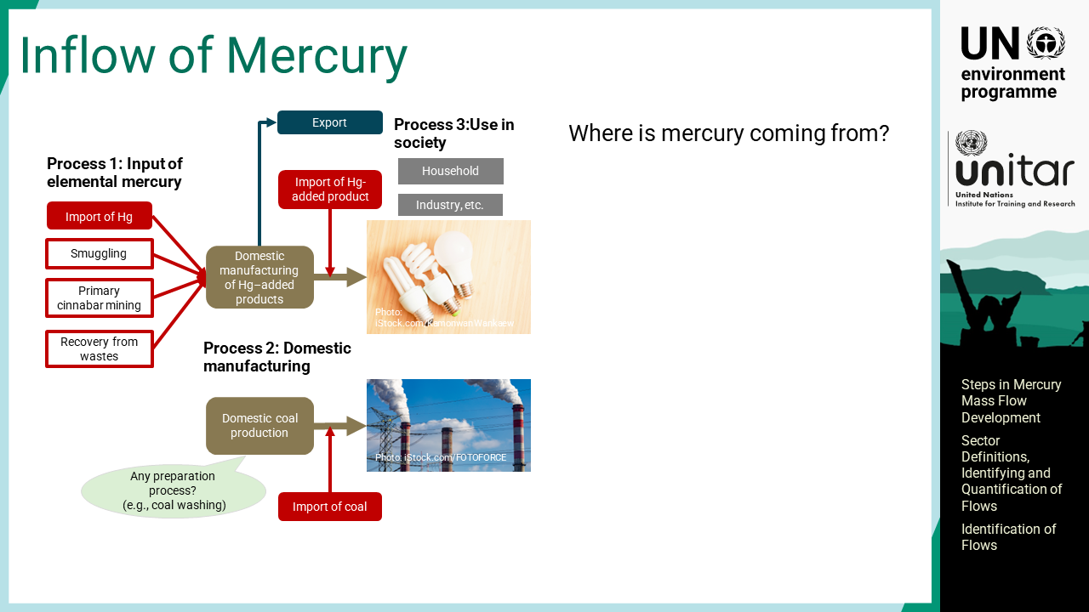
Notes:
‘18’ The first question to be addressed is “where is mercury coming from?” Mercury inflow to the system is composed of at least 3 processes, which are input of elemental mercury, domestic manufacturing or production, and use in society.
Mercury-added products are supplied to households or industries by either domestic manufacturing or import of the products.
Elemental mercury for domestic manufacturing of mercury-added products is either imported or domestically produced. For most countries, importing mercury is still legal, but illegal import may also exist. It may come from primary cinnabar mining although it is not prevalent, or it may come from recovery or recycling from mercury waste.
For the coal-fired power plants, there may be domestic coal production or import of coal, which is fed to the coal-fired power plant.
If any preparation process for coal, such as coal washing, occurs in countries before being fed into the power plants, it should also be incorporated into the diagram.
It should be noted that some mercury-added products manufactured domestically may be exported.

Slide 20


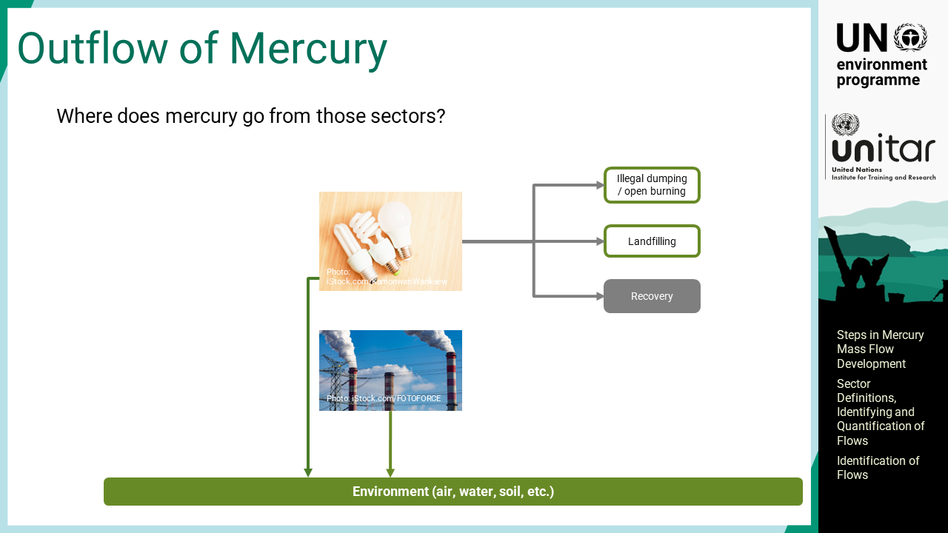



Notes:
‘19’ The second question is “Where does mercury go from those sectors?”.
Mercury emissions and releases to the environment from these sectors could be already identified when developing a mercury inventory.
When mercury-added products become waste, they may be dumped or burned in open air, landfilled, or collected and treated to recover mercury if a separate collection system is in place.
Recovered mercury may be reused if there is still a market for allowed use both domestically and internationally.
Mercury from coal-fired power plants is trapped by pollution control devices. Fly ash may be used in cement production as an auxiliary material added into the cement for construction.
From all these processes, there are emissions and releases to the environment as well.

Slide 21
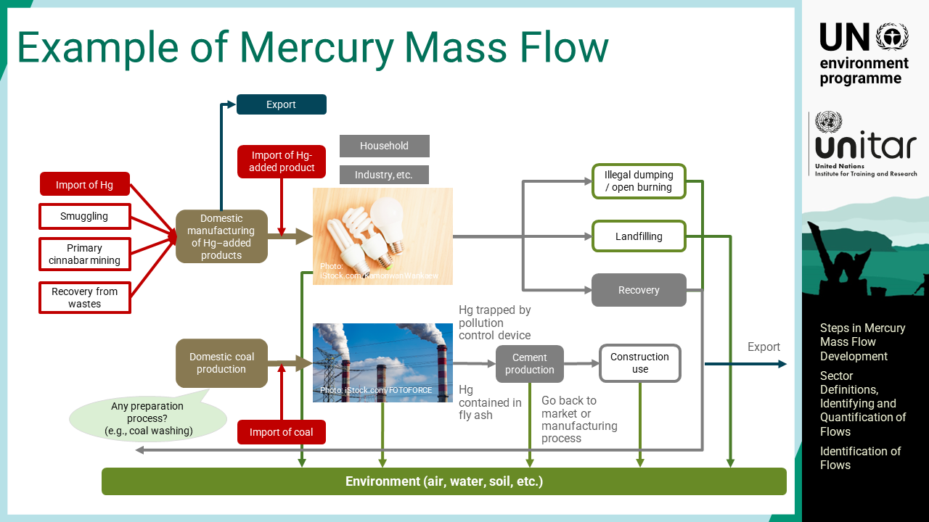
Notes:
‘20’ The complexity of mercury mass flow is significantly different in appearance from that of the mercury inventory. Mercury mass flow is inclusive of the inventory information but is much more comprehensive because it describes the relationship between sectors and the fate of mercury.

Slide 22
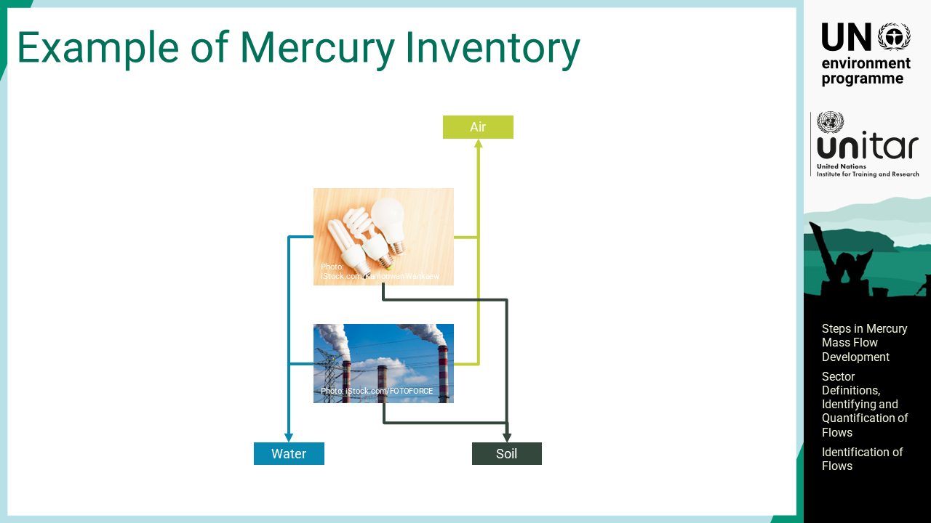
Notes:
‘21’ The information that the UNEP Inventory Toolkit provides is limited to the emission and release data only.

Slide 23

Notes:
‘22’ This section describes the necessary data types for quantifying mercury flows, which means how much mercury follows each flow path.

Slide 24
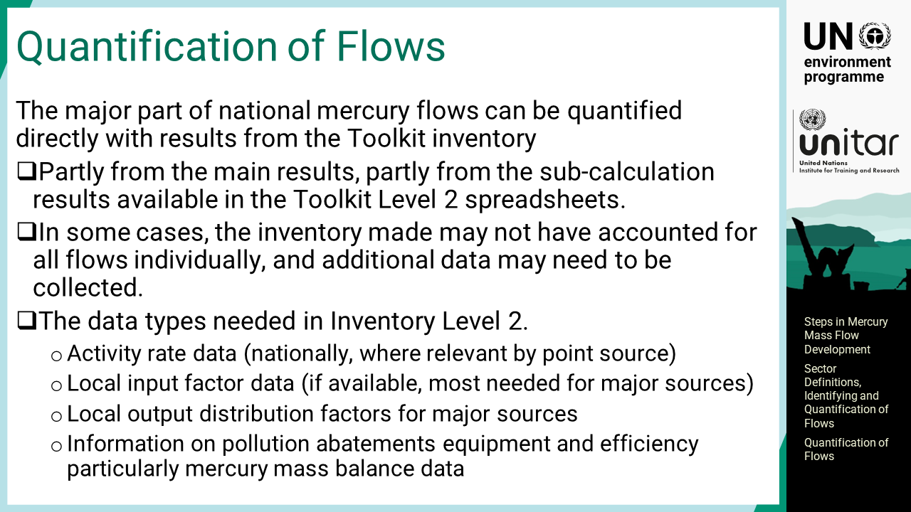
Notes:
‘23’ The major part of national mercury flows can be quantified directly with results from the Inventory Toolkit, partly from the main results and partly from the sub-calculation results available in the Toolkit Level 2 spreadsheet. In some cases, the inventory made may not have accounted for all flows individually, and additional data may need to be collected. The data types needed in inventory Level 2 are, the activity rate at the national level, local input factors, and local output distribution factors for major sources. Mercury content in the coal mix used in the country is one of the important local input factors to improve data quality. When the higher level of refinement of the mercury inventory is required, local output distribution factors for major sources are critically important. For setting such distribution factors, information about the pollution abatements equipment in place and its efficiency regarding mercury retention would be helpful.

Slide 25
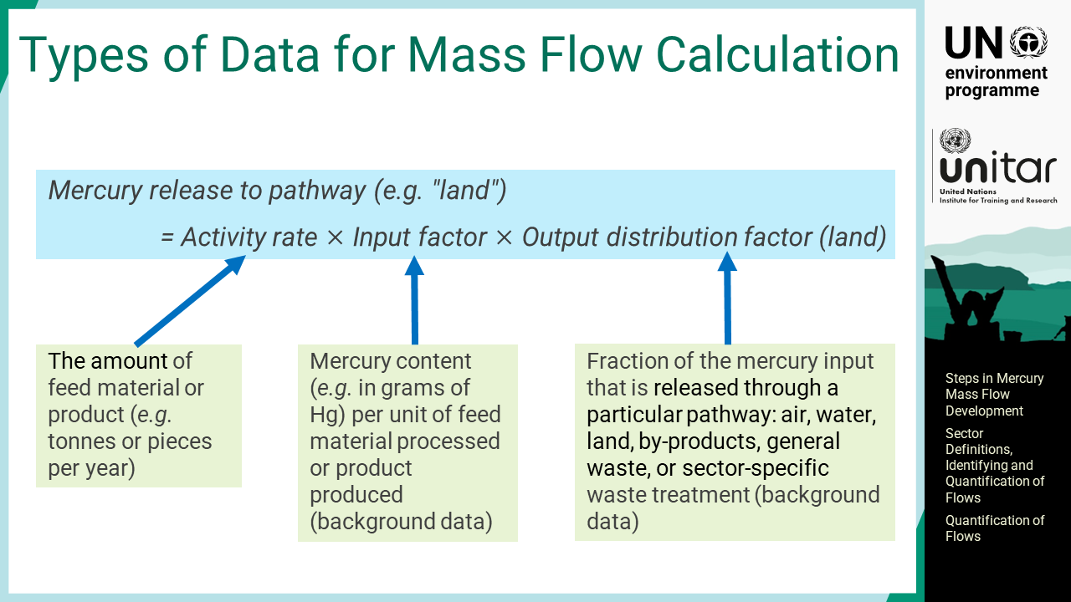
Notes:
‘24’ The amount of mercury flow is calculated as the product of the activity rate, input factor, and output distribution factor. The input factor is the mercury content per unit of feed material processed or product produced, and the output distribution factors are the fraction of the mercury input that is released through a particular pathway such as air, water, land, by-products, general waste and sector specific waste. The default set of input and output distribution factors are available in the Toolkit, but it is good to have their own factors relevant to the local context. The activity rate is always needed for calculation.

Slide 26
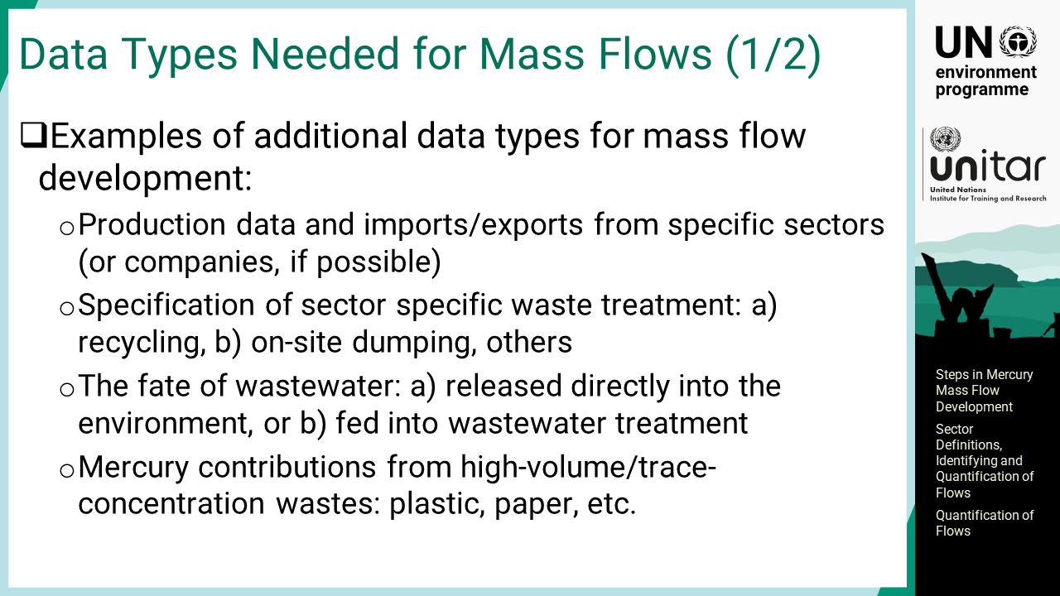
Notes:
‘25’ Additional data are also required for developing mercury mass flows. The first example is the production data, import and export data from specific sectors or from individual companies, if possible, taking note of confidentiality. Another example is the data on the sector specific waste treatment, what is actually done with the waste, for example, in the non-ferrous metal production. How much mercury is recycled from the waste in the sector and put into the market, or how much mercury is contained in the waste that is landfilled. The way waste is treated varies greatly among countries and even among individual facilities. To address sector-specific waste properly, the waste treatment sector should be subdivided, and additional information should be obtained from the facilities involved in each of the sub-sectors. The fate of wastewater is also commonly missing information. Wastewater released directly into the environment has a different fate in terms of mercury flow from wastewater fed into wastewater treatment facilities. Waste with high-volumes but trace mercury, such as paper, plastic, wood, and other metals is often left out of the mass flow calculation, as it is not classified as mercury waste.’

Slide 27
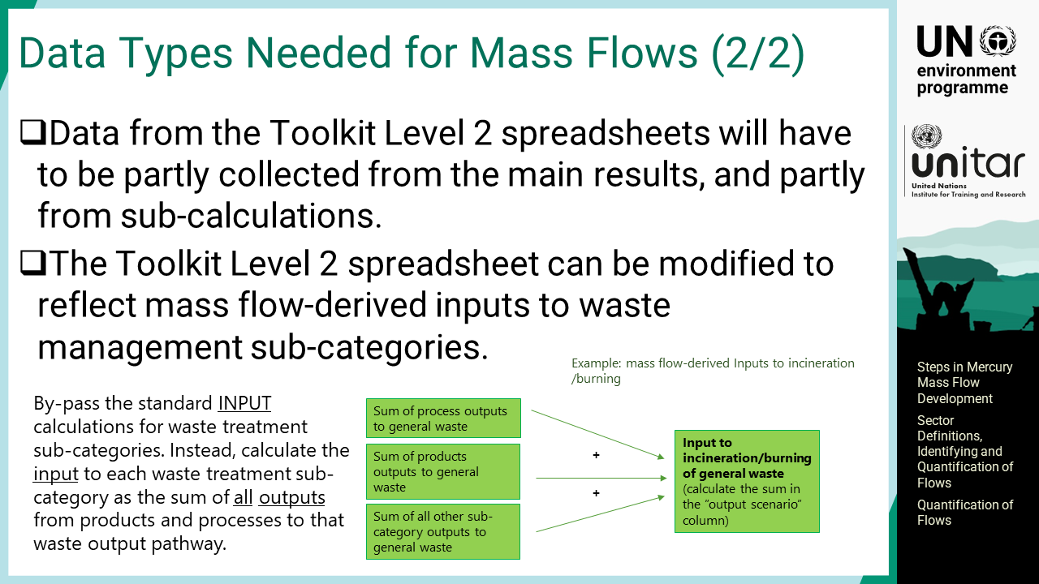
Notes:
‘26’ Mass balance results from the Inventory Toolkit Level 2 spreadsheets will have to be partly collected from the main results, and partly from sub-calculations. There is currently a standard calculation of mercury inputs to waste treatments in the Level 2 spreadsheet. For re-connecting the outputs to waste from products with inputs to waste management, the spreadsheet needs some modification. The spreadsheet can be modified to reflect mass flow-derived inputs to waste management sub-categories. What can be done for mass flow quantification is to bypass this standard input calculation for waste treatment. Instead, calculate the input to each waste treatment sub-category as the sum of all outputs from products and processes to that waste output pathway.

Slide 28
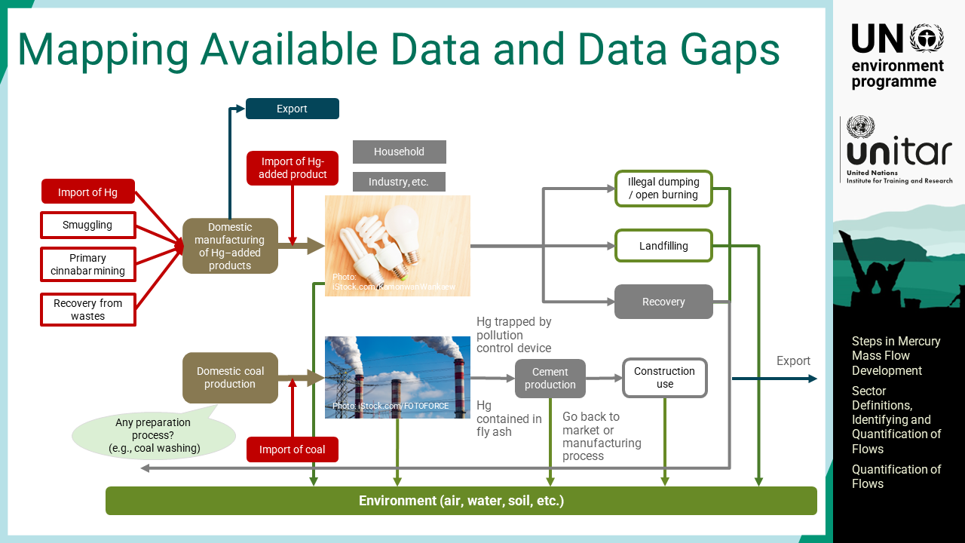

Notes:
‘27’ The mercury mass flow for mercury-added products and coal-fired power plants has identified the flows of mercury. Then, the amount of mercury in each pathway will be added to the diagram.
For the flows where the amounts are unknown, a question mark should be added to indicate that this is a data gap for later follow-up based on a prioritisation of the most important flows in terms of quantities or political priorities.

Slide 29

Notes:
‘28’ This section shows the examples of sector flows that illustrate the complexity and the data types needed.

Slide 30
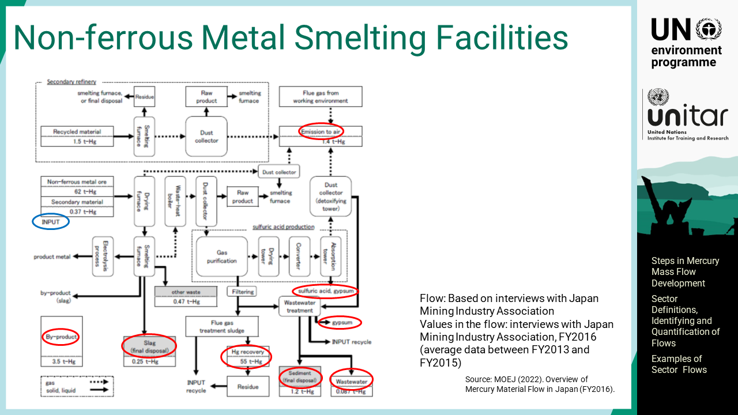
Notes:
‘29’ This diagram shows mercury flow for non-ferrous metal smelting facilities in Japan. The inputs and outputs are marked with blue and red ovals respectively. The diagram has many process steps because of the need to separate the different fractions of outputs.

Slide 31
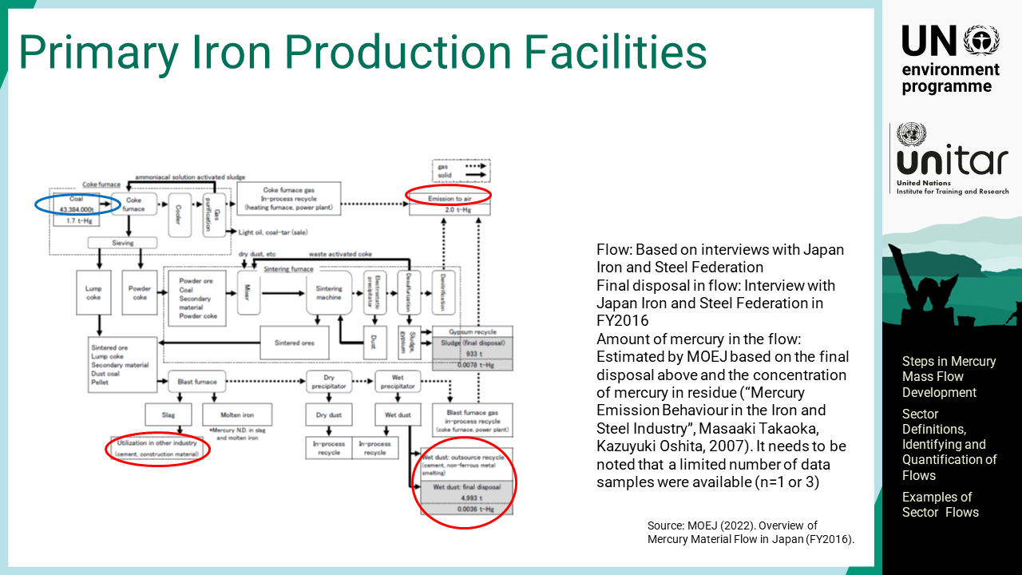
Notes:
‘30’ This diagram shows mercury flow for primary iron production facilities. Compared to that for non-ferrous metal production facilities, the diagram has fewer outputs because primary iron production has a somewhat simpler process, and mercury comes in with the coal and other minerals used.

Slide 32
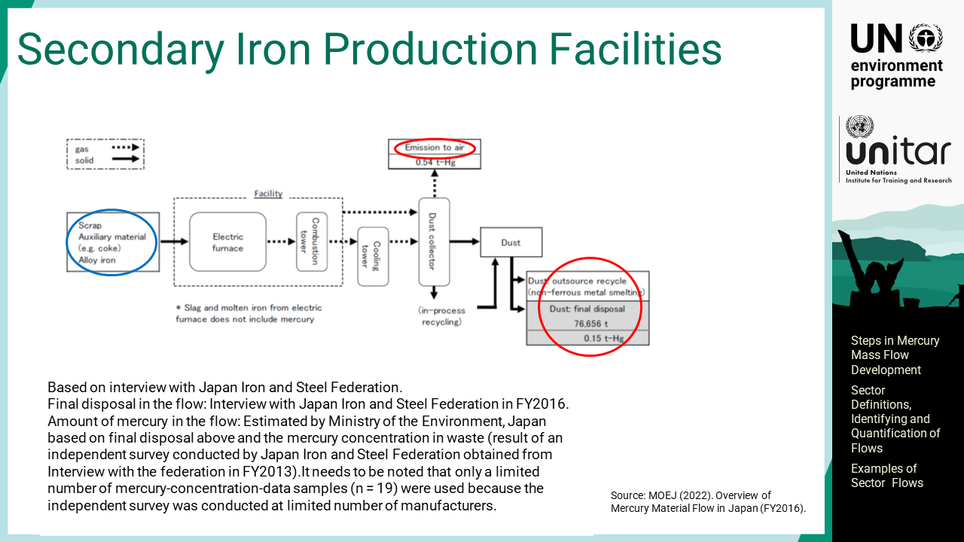
Notes:
‘31’ This diagram shows mercury flow for secondary iron production facilities, or iron and steel scrap processing where mercury also must be handled. There may be mercury switches and mercury-containing lamps in scrap cars, etc., so these are inputs of mercury that result in emissions and disposal of collected dust.

Slide 33
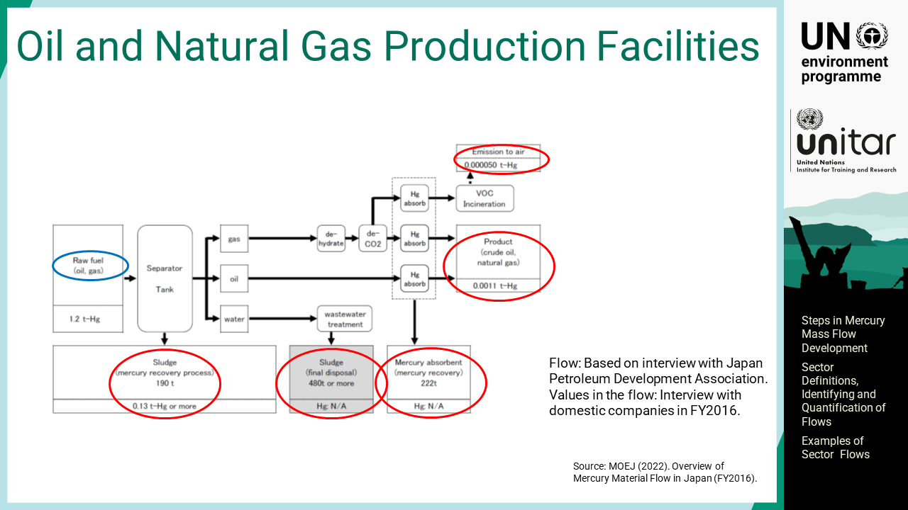
Notes:
‘32’ This diagram shows mercury flow for oil and natural gas production facilities. Mercury is present in oil and gas from the nature, and if the mercury concentrations are low at the production site, no special treatment may be performed to remove mercury. However, in some areas, mercury concentrations are quite high, for instance, in the Gulf of Thailand, some places on the west coast of the United States of America and in the Mediterranean region, where natural concentrations of mercury underground are elevated. The area is called the geological mercury belt. Mercury concentrations may also be elevated elsewhere and may vary significantly within even smaller areas.

Slide 34
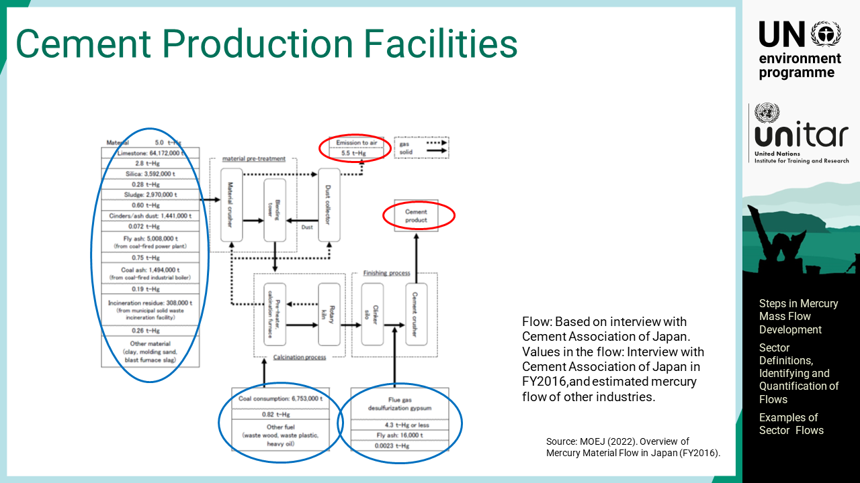
Notes:
‘33’ This diagram shows mercury flow for cement production facilities. All raw materials and fuels used for cement production contain mercury at low concentrations, which results in mercury emissions to the atmosphere unless properly managed. If there are effective air pollution control systems, mercury captured in the dust will be purged into the final cement product. However, generally, much mercury evades dust filters and is emitted into the air.

Slide 35
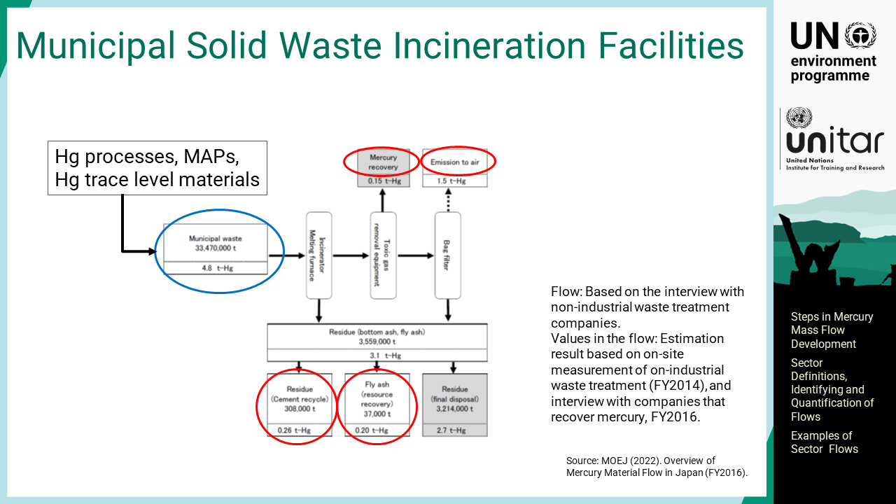
Notes:
‘34’ This diagram shows mercury flow for municipal solid waste incineration facilities. The waste includes the products and materials containing mercury. Unless captured by air pollution control systems, mercury goes to air. Solid residues contain the captured mercury.

Slide 36
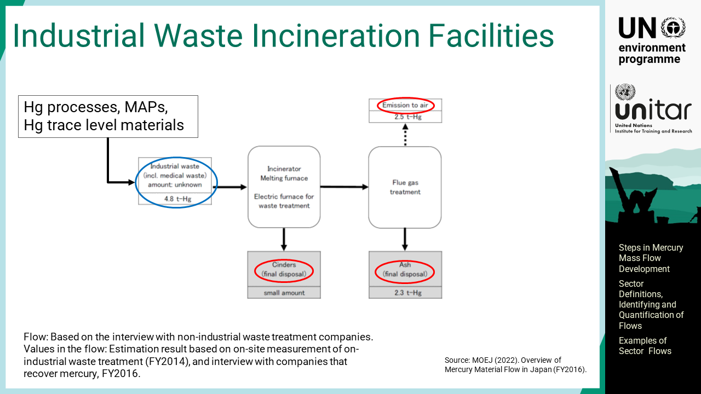
Notes:
‘35’ This diagram shows mercury flow for industrial waste incineration facilities. Similar to municipal solid waste incineration facilities, mercury is emitted to air or captured in the residue.

Slide 37
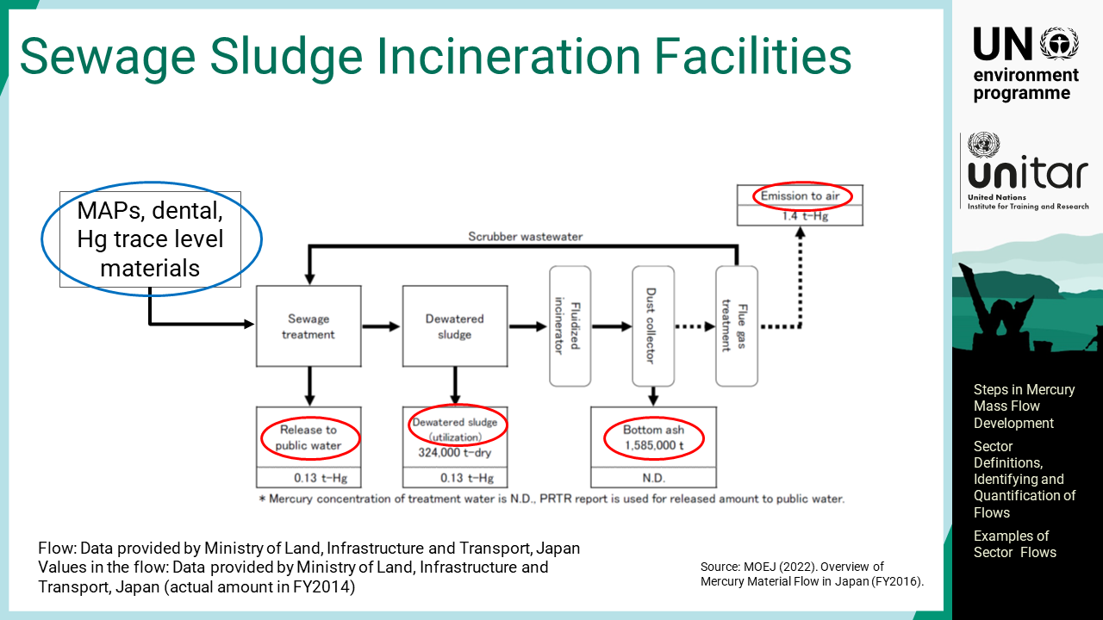
Notes:
‘36’ This diagram shows mercury flow for sewage sludge incineration facilities. Where this process takes place, the mercury sources are similar to the solid waste brought to the incineration facilities.

Slide 38

Notes:
‘37’ This part describes the quantification of stocks, collection of supplementary data, working with intervals, and available online tools and resources.

Slide 39

Notes:
‘38’ This section describes the recommended data collection steps to quantify mercury stocks.

Slide 40
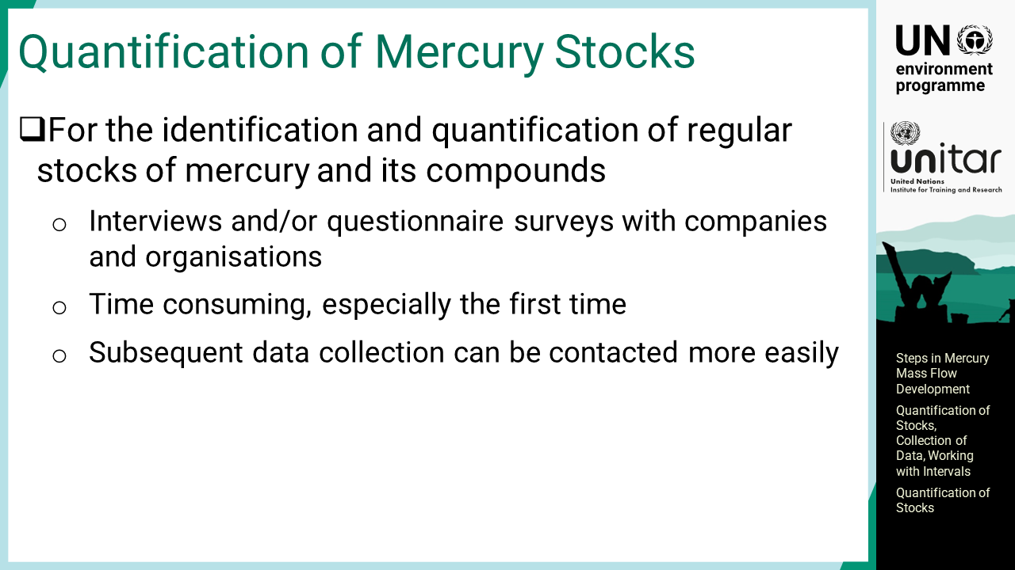
Notes:
‘39’ For the identification and quantification of physically confined stocks of mercury and its compounds, the general method is to conduct interviews and questionnaire surveys with companies or organizations that may have such stocks. This is a time-consuming exercise but is normally shorter and easier during the second time or follow up once such process was completed. This is because most of the relevant stakeholders are already identified, and the inquiry items are usually the same.

Slide 41
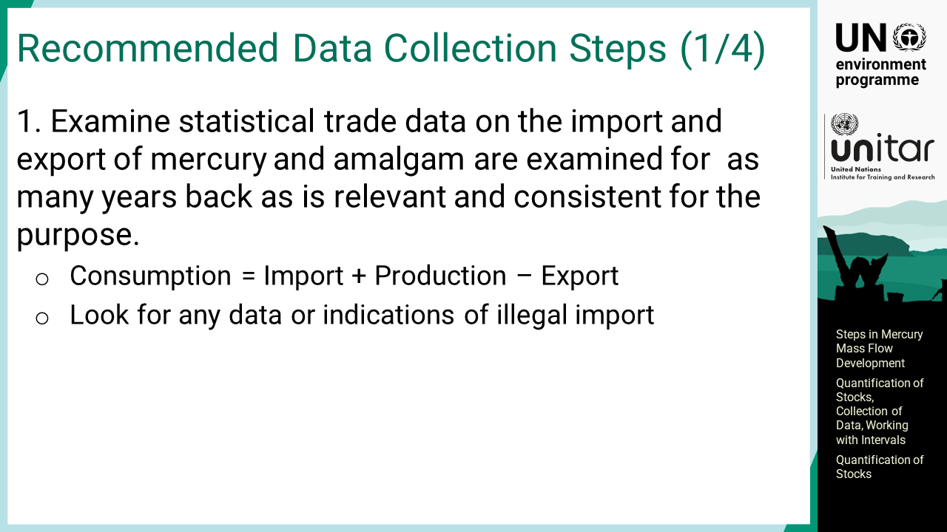
Notes:
‘40’ The following steps are recommended to collect mercury stock data. First, statistical trade data on the import and export of mercury and amalgam are examined for as many years back as is relevant and consistent for the purpose. The consumption is then calculated with import plus production minus export. If possible, the amount of mercury illegally imported may be estimated as an indicative value. Illegal import of mercury may take place, especially in countries with small-scale gold mining, and where the borders may be porous.

Slide 42
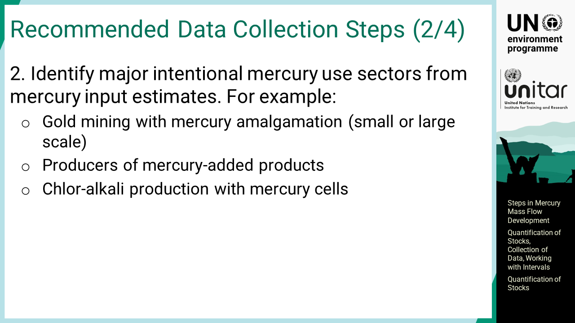
Notes:
‘41’ The major intentional mercury use sectors are identified from mercury input estimates. This could be artisanal and small-scale gold mining, producers of mercury added products, chlor-alkali production with mercury cells, etc. For chlor-alkali production, technology applied for the facility is important. The mercury cell plant contains a large amount of elemental mercury, which accounts for several tons per facility, used as the electrode. If technology conversion takes place at a mercury cell plant, then the mercury in the electrode will become unnecessary and disposed of, sold, or stored in the facility.

Slide 43
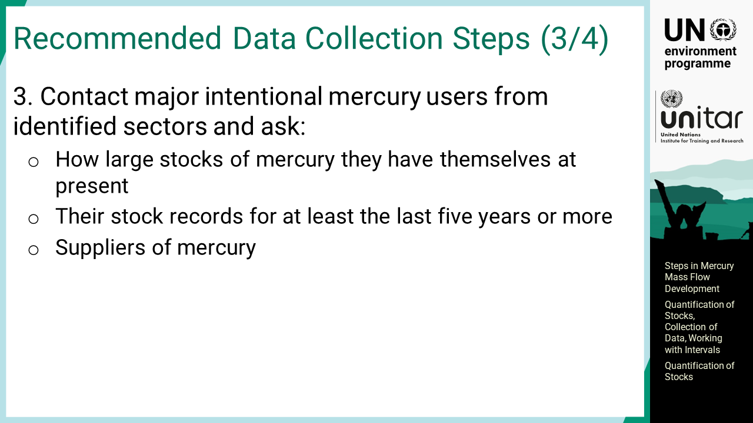
Notes:
‘42’ Once major intentional mercury users are identified, information on mercury stock will be asked. It includes the amount of mercury stocks in their custody at present and, preferably, their stock records for at least the last five years or more if they are willing to share. Traders, producers, or recyclers could be mercury suppliers; therefore, they can be contacted for obtaining relevant information. Non-ferrous metal smelters are also important stakeholders as they have the by-product mercury.

Slide 44
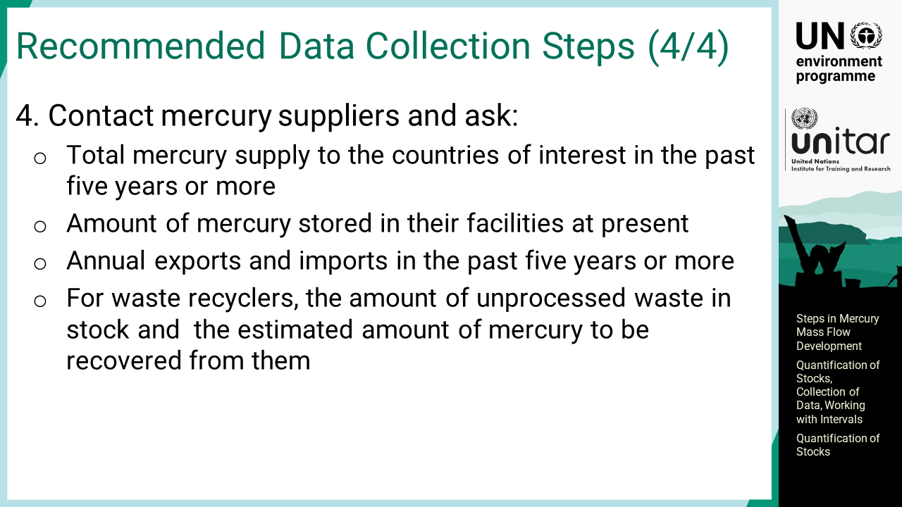
Notes:
‘43’ Mercury suppliers are asked for providing their information. They could be mercury traders or producers. The inquiry will include the total mercury supply to the countries of interest in the past five years or more. The amount of mercury stored in their facilities at present, and, if possible, annual exports and imports in the past five years or more are also asked. For waste recyclers, the amount of unprocessed waste in stock by waste types and the estimated amount of mercury to be recovered from them will also be asked, which may constitute significant amounts.

Slide 45
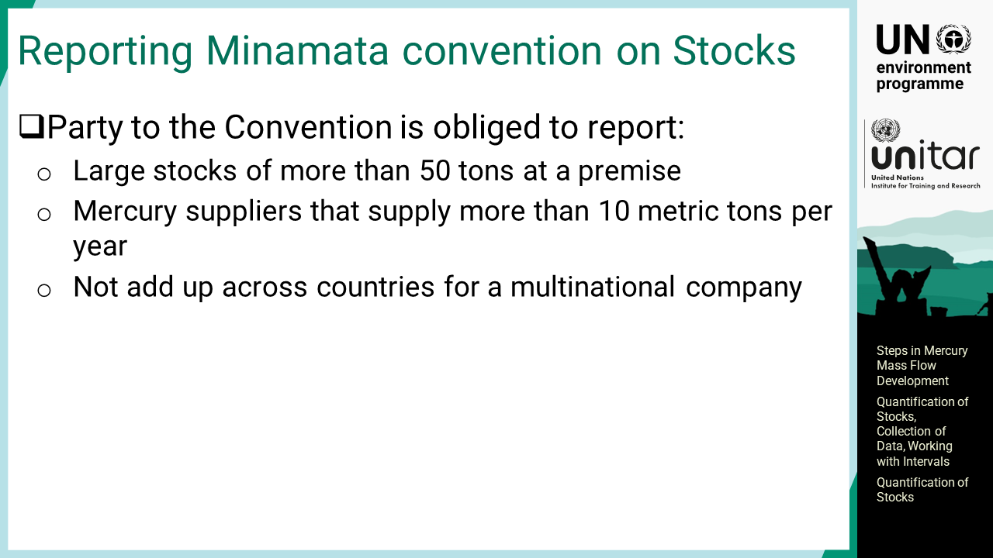
Notes:
‘44’ There are two types of stocks requiring attention for reporting under the Minamata Convention. They are large stocks of more than 50 tons at a premise, and mercury suppliers that supply more than 10 metric tons per year. Reporting obligation falls on to each Party to the Convention, which will not add up across countries for a multinational company.

Slide 46
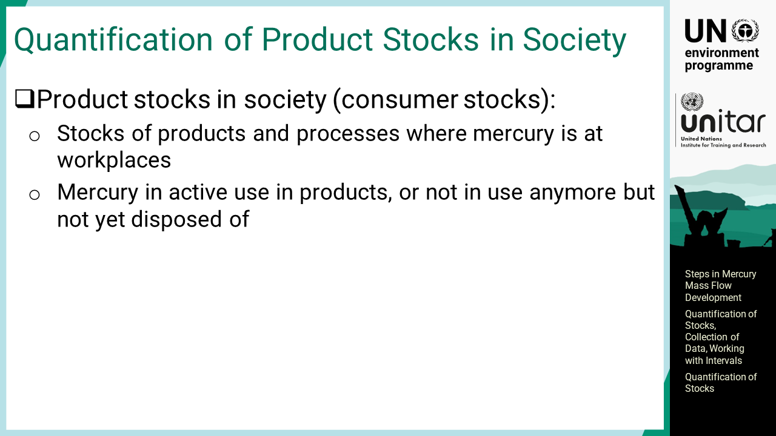
Notes:
‘45’ Another type of stock needs to be investigated to make mercury mass balances. These are stocks of products and processes where mercury is at workplaces, which is sometimes called consumer stocks. They include the amounts of mercury in active use in products, or not in use anymore but not yet disposed of, which is also called hoarded products.

Slide 47
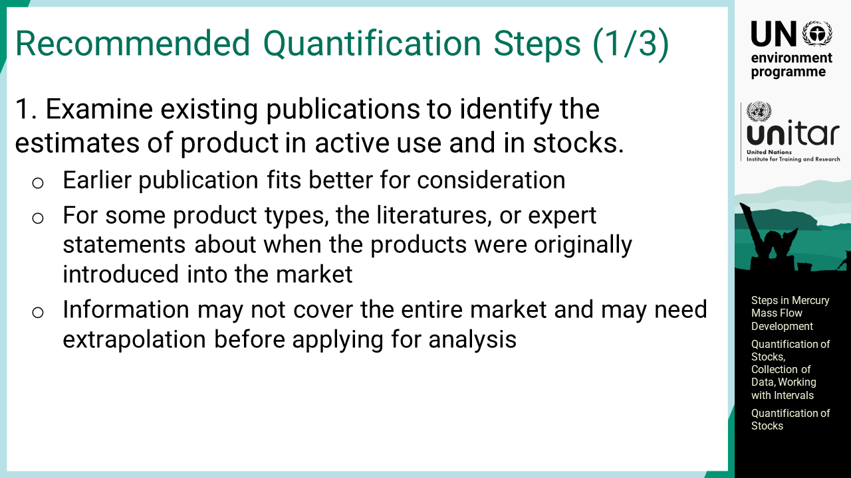
Notes:
‘46’ First, existing publications are examined to identify the estimates of product in active use and in stocks. Earlier publication fits better for consideration. For some product types, the literatures, or expert statements about when the products were originally introduced into the market could be found. It is important to be aware that the information found may not cover the entire market and may need extrapolation before applying for analysis.

Slide 48
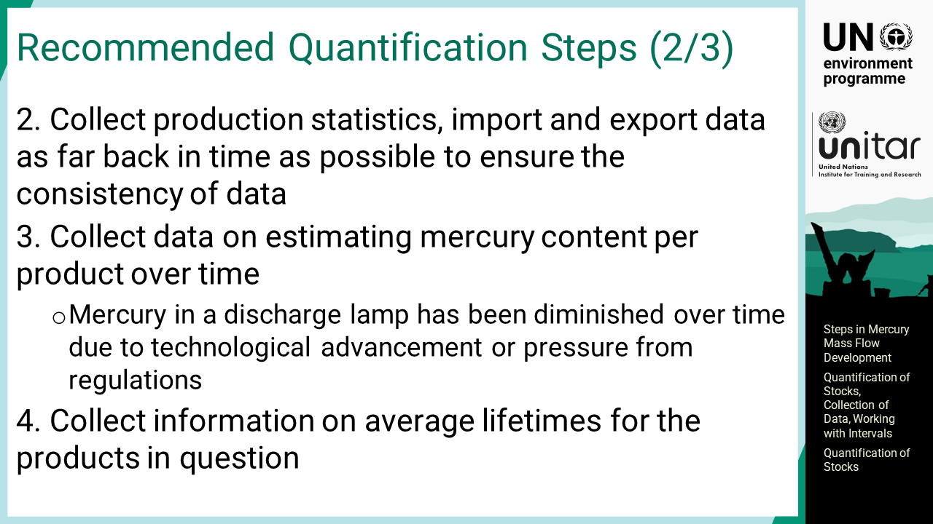
Notes:
‘47’ Any production statistics, import and export data are collected as far back in time as possible to ensure the consistency of data. Any changes in the HS coding system, if they exist, should be taken note of to capture older coding numbers for the same items. The UN COMTRADE database, for example, allows the use of generic search words such as ‘lamp’ to extract all relevant customs codes relating to lamps. It is also beneficial to collect data on estimating mercury content per product over time. It is particularly useful, for example, for discharge lamps. They always use mercury but the amount per lamp has been diminished over time partly due to technological advancement or pressure from regulations. Mercury content in a fluorescent lamp today is approximately one-fourth to one-fifth of the one several decades ago. Information on the average lifetimes of the products in question is also needed. This is important in terms of obtaining an idea of the time gap between the time of sales of a product and the time of disposal of a product.

Slide 49
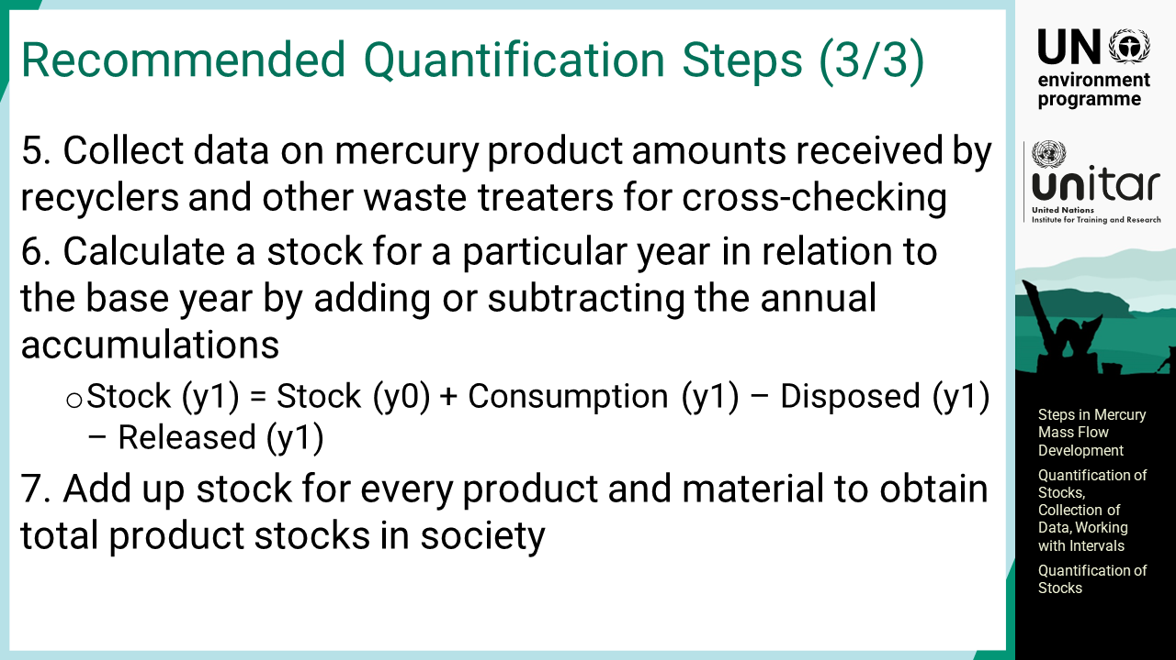
Notes:
‘48’ Data on mercury product amounts received by recyclers and other waste treaters will be used for cross-checking. The amount may likely be underestimated especially in such countries where recycling is performed in the informal sector. A stock for a particular year, Y1, will be calculated in relation to the base year, Y0, by adding or subtracting the annual accumulations. Consumption is also called as supply from producer side which is the input to the society. Disposal or release to the environment is the output from the society. By making this calculation for every product, the total product stocks in society will be obtained. There is a lot to do, especially for the first time, to obtain the results, and it is a complex exercise. Thus far, it is understood that no quick answer will be available for it. Estimated amount of product stocks in society is important information for making forecasts of mercury waste.

Slide 50
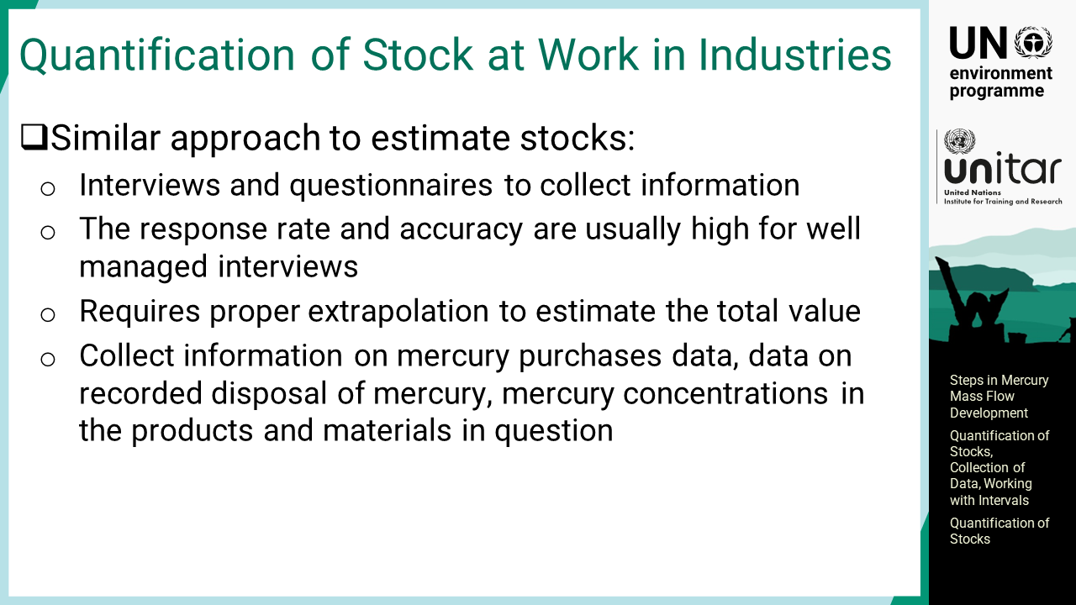
Notes:
‘49’ Mercury is also used in some production facilities, and sometimes with a significant amount at workplace. A similar approach should be used for estimating mercury stocks in the industries. Interviews and questionnaires are two major methods used to collect information. The response rate and accuracy are usually high for well-managed interviews. When using questionnaires, what is reported is often not the full picture and requires proper extrapolation to estimate the total value. The relevant information for estimation includes the mercury purchase data for the last 5 or 10 years, if possible, data on the recorded disposal of mercury for the same time frame and the mercury concentrations in the products and materials in question. It should be noted that there is a hidden stock in the facility as mercury may be absorbed in building materials, process lines, etc. that will become mercury waste when dismantling such a facility.

Slide 51

Notes:
‘50’ This section introduces available and possible data sources for mass flow development.

Slide 52
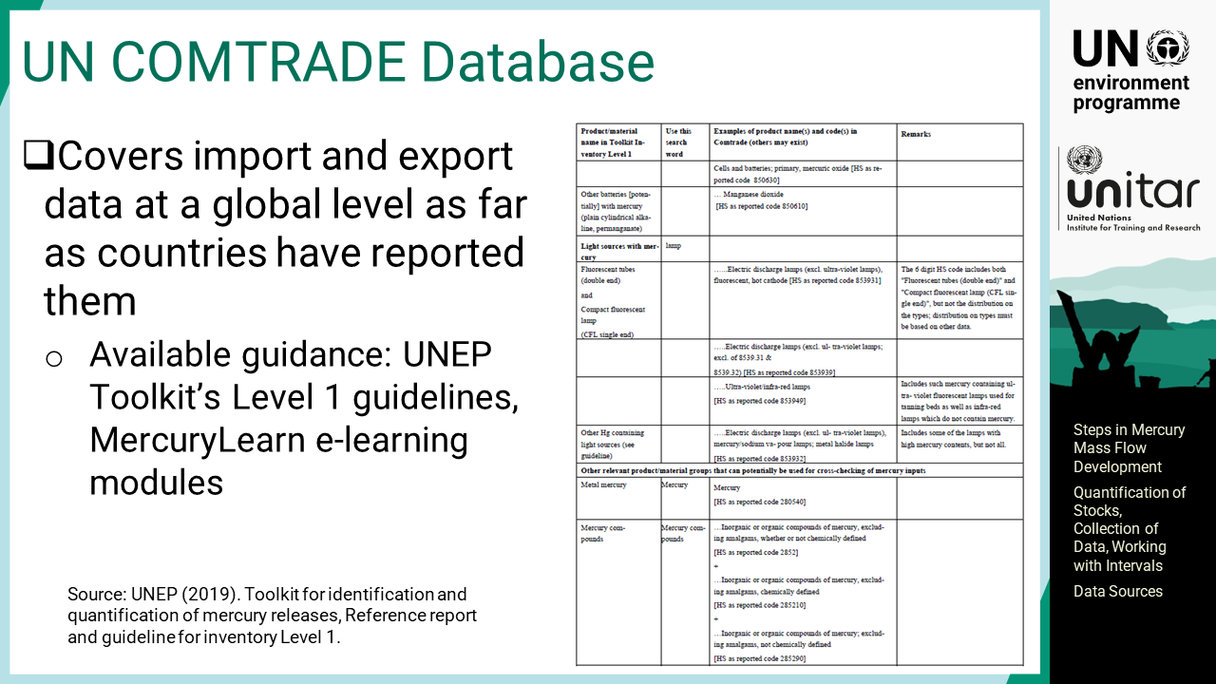
Notes:
‘51’ There are useful internet sources for many people and countries. One of the very important data sources is the UN COMTRADE database, which covers import and export data at a global level as far as countries have reported them. Guidance on how to extract relevant data is given in the Toolkit Inventory Level 1 guidelines annexes as well as in the ‘MercuryLearn’ e-learning platform. The guidance in the Inventory Level 1 guidelines is relevant for both levels. It includes names of the relevant products that are used in the Toolkit, suggestions for search words, and some examples of product codes in the table. Product codes may have more than what are provided. Extracting data is easy but the information is not always perfect.

Slide 53
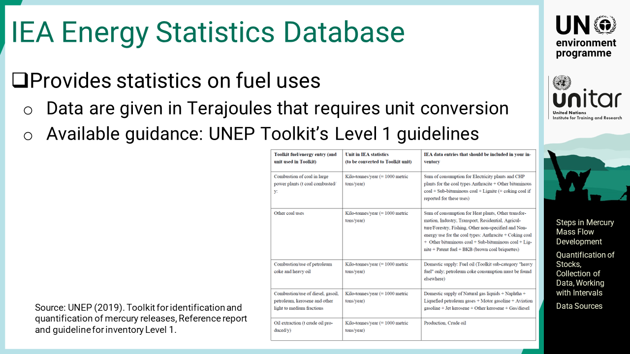
Notes:
‘52’ The International Energy Agency database provides statistics on fuel uses. Data are given in terajoules, not in tonnes of fuels, that requires unit conversion. The Toolkit Level 1 guideline annex also gives a table on how to use the IEA data.

Slide 54

Notes:
‘53’ The United States Geological Survey website provided mineral yearbooks for most of the countries in the world, which are freely available. Sometimes countries are pooled together in one report. The reports give key data on mining and minerals production, and sometimes semi-quantitative information, for example on how much gold is from small scale mining and how much is from large scale mining.

Slide 55

Notes:
‘54’ The international databases can provide many easily available data. However, they can provide only a number of important source categories. There are many other mercury sub-categories that are not addressed in these databases. That is where research for national data is needed. First, easily available existing data sources such as national literature on the relevant sectors will be examined. It may not be a publication on mercury but may give some relevant data. For example, it may contain the amounts of coal, tonnes of diesel fuel used, etc. relevant to developing an inventory for the energy sector. Sometimes national economic surveys may also be used. They provide information on trade volumes or monetary values, which requires unit conversion, but indicative data such as those can be useful. Another good data source is dioxin and furan inventories, which many countries have developed as a part of the obligations under the Stockholm Convention. They could contain information about the amounts of waste generated and how the waste is treated. Pesticide inventories or other POPs inventories could also be useful in some cases. Greenhouse gas inventories are also developed by many countries. They could contain the amounts of waste burnt, coal used, oils used, etc. Although the estimation methodology for greenhouse gas inventories is sometimes slightly less precise than that for mercury emissions, they also have very useful information. The guidance document on GHG inventories provides the advice on data collection and estimation. Some countries also have waste inventories and detailed waste characterization studies where some quantitative information is available. There are a number of other information available on the internet, universities and other knowledge centres as potential sources.

Slide 56

Notes:
‘55’ Public statistics can also provide good insights for mercury flow development. Some countries periodically produce commodity statistics that include production data in addition to import and export. Access to detailed customs statistics may be restricted, but customs departments may provide a special dataset without confidential data. PRTRs are very useful, if available; however, most PRTRs have cut off thresholds for reporting; therefore, mercury information is often left out. If certain sectors have many facilities with a low mercury release level below the threshold, then the mercury amount could be underestimated in the PRTR system.

Slide 57

Notes:
‘56’ For the market situation, trade and industry associations can be very important partners and should be invited for mass flow development. Sometimes, such associations are not well-known but individual companies may introduce them for obtaining information to the survey team. Public service providers may be important sources of information. They would include waste collectors and hazardous waste treatment facilities. Large producers or users of products or processes in which mercury is used can also be possible information sources. When analysing mercury emissions and releases from large point sources, producers or suppliers of emission and release reduction equipment may have valuable data. Retailer chains represent a large part of the consumer market and may provide a good overview of the domestic flow of mercury-added products. The survey may be conducted at the headquarters level for overall figures, or the shop level to determine the products on the shelves.

Slide 58

Notes:
‘57’ If financially and technically feasible, the measurement of mercury concentration of input and output is another option. It can make a breakthrough in the mass flow development by providing information never existed before. As the measurement is an expensive exercise, it should be prioritised to identifying the most significant part of the information. Therefore, it is recommended to first examine the existing data sources as much as possible. Identifying the key data gaps and key uncertainties will be examined by sensitivity assessment. Examples of prioritised measurements could typically be mercury concentration of inputs to and outputs from cement kilns, such as raw materials, fuels, and flue gas because the concentrations vary locally. Another frequent data gap is the mercury concentration in nationally manufactured or imported products with little information available in the literature such as skin lightening creams and soaps, and button cell batteries. Water-based paints that may sometimes contain mercury compounds as preservatives. Artist paints can also contain mercury in the form of cinnabar pigment although they are usually not large in volume. Additionally, very little is known about the production of polyurethane elastomers that uses mercury catalysts that remain in the final products. As mercury is one of the catalysts used for polymerization, special attention should be taken in case large quantities are produced or used.

Slide 59

Notes:
‘58’ Measurements made should be on a mass balance basis, meaning including all inputs and outputs from a facility or process. However, output distribution factors of the Toolkit may be strategically applied for effectiveness reasons, and the actual measurement can be focused on the mercury inputs, such as the raw materials and fuels for cement kilns. If needed, supplementary output measurements, such as air emissions, can be performed. Then, the other outputs can be estimated with the default output distribution factors of the Toolkit. Alternatively, another strategy could be employed to measure less costly media such as solid materials compared to sampling and analysis of flue gas.

Slide 60

Notes:
‘59’ Unit conversion is a necessary pre-treatment of data. An incorrect unit means an inaccurate result. The Inventory Toolkit spreadsheet provides a unit conversion tab for some data types where conversion is often needed.

Slide 61

Notes:
‘60’ This section introduces the data collection principle and methods.

Slide 62

Notes:
‘61’ Getting inventory data cannot be a one-go process. First, it could result in just a fraction of information and then will be narrowed down to more precise information by follow up actions. Creativity and flexibility are rather important to dive deeper into the matter. Generally, data collection approaches vary significantly and case-by-case arrangements to whom to talk or how to address need to be developed. It is important to collect data for the same base year, if possible, to develop an inventory and mass flow for a specific year. If data for the target year are not available, use data for adjacent years and report this explicitly. It is good to look at the average value of the data for a few years before and after the base year, which can also give the recent trend and degree of variations. An interview can include supplementary questions about the other informants to be asked. Once data are collected, the relevance will be verified before use. Liquid-filled thermometers may include both mercury-filled and alcohol-filled thermometers under the same customs code. One approximation method could be simply asking the importers of thermometers about an impression of the share of mercury-filled thermometers. In the case of mercury compounds, their weight should be converted to that of mercury of the compound. Triangulation, which is the land surveying method to check one location from two different checkpoints, is a good practice to qualify collected data. For example, producers’ data and consumers’ data may be compared.

Slide 63

Notes:
‘62’ It is common that national data are missing for some mercury source types and that they are incomplete; therefore, if data are available from one part of the country, an attempt to extrapolate such data using the national situation, based on population, for example, or some other relevant extrapolation basis. If data are available for some of the companies in one sector, their market share can be asked to extrapolate the value. If data are available for a part of the domestic market, the extrapolation can be done with available indicators of the national situation. For example, in the case of blood pressure gauges with mercury manometers, one possibility is to ask a few major hospitals and large private clinics. The questions will include the numbers of devices in stock and annual purchase subdivided by mercury-contain and mercury-free. The hospital beds will be supplementally asked to extrapolate it to the total number of hospital beds in the country. Although extrapolation introduces uncertainties, mercury inventories, or mass flows of any kind, have the strength of seeing the overall picture. Instead, the individual numbers are always associated with uncertainty, which needs to be lowered by getting more data. Describing clearly about the approximation method applied and dataset used for the approximation is recommended. Such an explanation in the report will be helpful especially when revisiting a few years later for the next inventory.

Slide 64

Notes:
‘63’ This section explains uncertainties and working with intervals.

Slide 65

Notes:
‘64’ All data are in fact associated with some degree of uncertainty including the data of measurements. It is therefore recommended to work with intervals, based on the variation in the real data in society for the same item. In cases where there are significant amounts of data, statistical analyses may be conducted to form a distribution function. The uncertainty and confidence intervals can be calculated with these distribution data. A much simpler way is to use minimum to maximum ranges, or the best estimate plus or minus with self-judgement. Proper explanation of how to reach the uncertainty estimation is always necessary in the report.

Slide 66

Notes:
‘65’ Crosscheck improves the credibility to a great extent. It may be asked for example, “does the supply of raw materials or semi manufactured goods registered in the statistics correspond to the amounts used at manufacturers?” A few more examples are presented in the slide. Some of them look difficult, but creative thinking is important to crosschecking between two different types of data as much as possible.

Slide 67

Notes:
‘66’ It is recommended to show values of mercury mass flow in a range, based on the observed variation in the data used. The summation can be simply done by adding up all minimum values to get the low end and all maximum values to get the high end. Although it overestimates the uncertainty, it is the easy way for readers to understand. It is also possible to use stochastic variables, which reduces the uncertainty intervals for the results, but it is a long process and becomes more “black box” to readers. Many of such numeric datasets form famous distribution patterns such as log-normal distributions, or Weibull distributions.

Slide 68

Notes:
‘67’ This section briefly introduces some online helper tools when the inventory and mass flow development is performed online.

Slide 69

Notes:
‘68’ ‘Work together online’ is the new business style, which will likely become more common in the future. There is a rapid development of interactive online business tools that help collaborative work from a distance. The internet ‘whiteboard’ is a non-text-based online tool that is suitable for drawing up the process flows and illustrating them during the process. MIRO and MURAL are some of the typical applications that provide practical platforms. Real-time document sharing services, including Google Docs and Microsoft Office 365, work for common real-time multi-user text authoring and editing. The service includes common share folders and files accessible among inventory development team members. To make more sophisticated mass flow charts such as a Sankey diagram, several applications including Rawgraph or Sankeymatic are available on the internet.

Slide 70

Notes:
‘69’ This part focuses on identifying and reducing uncertainties, closing and calibrating the mass balance, reporting and review.

Slide 71

Notes:
‘70’ This section describes identifying and reducing uncertainties and gaps.

Slide 72

Notes:
‘71’ To check the accuracy of mass flow, the numbers that affect the overall results the most should be carefully identified. High numbers with medium or high uncertainties are particularly of concern. If possible, an actual sensitivity analysis will be conducted. In addition, all identified data gaps should be carefully listed and reported. Additional data with priority on the most important ones may be collected this time, or next time when updating the mass balance for quality improvement.

Slide 73

Notes:
‘72’ Estimated values of mass flow may present discrepancy, and it is necessary to investigate its cause and improve the estimation. The figure assumes the case where a chain of mass flow subject to the analysis has different amount of the input and output. There are several possibilities. It could be a real change in accumulation within the process, or some differences may be due to incompleteness or errors in the data although the input and the output were balanced in reality. If the difference comes from incompleteness or errors, additional data collection is necessary. Once the reasons for the observed difference are identified, appropriate interpretation and possible modification are expected in reporting.

Slide 74

Notes:
‘73’ If the output from process 1 is the direct input to process 2, the figures of the input and the output are expected to be identical. If a difference is found, a possible cause may be incomplete or erroneous data, although the output and the input are actually equal. Alternatively, the output and input may be truly different due to some other processes, which was not identified at the time of the study, but is influencing the flow between process 1 and process 2. Alternatively, the flow tends to fluctuate, and the data may have been taken at different times. In any case, it should be investigated to determine the cause.

Slide 75

Notes:
‘74’ More frequently, such a case will be encountered in which information on input to process 2 is not available or difficult to estimate. Theoretically, efforts should be made to obtain independent data that can qualify the estimates, but the most commonly applied option would be to assume the output from process 1 as an input to process 2 without substantial information for the input to process 2. Making the numbers fit together could sometimes be complicated but it is always recommended to explore other ways to bridge the data gap, whenever possible.

Slide 76

Notes:
‘75’ Once the data are collected and examined, the next step is to close the mass-balance, that is, to make the numbers fit together into one big picture. First, the estimation of all emissions and releases as well as data on mercury outputs from waste treatment are needed for this exercise. Many countries at this moment do not have reliable mercury data from waste treatment. If it is confirmed that the sum of all the inputs to the economy matches the sum of all the outputs from the economy, it gives a strong indication that the mass flow is balanced. If they do not, some of the numbers may be missing, wrong or misinterpreted. When re-assessing the estimate, the most uncertain numbers or the largest numbers could be examined first. If additional data will be collected to improve the balance, such data may influence the whole mass balance as all the flows are interconnected. Therefore, the additional data collection process stops the entire process until the mass flow is fully reinstated.

Slide 77

Notes:
‘76’ This section describes the reporting principles and review.

Slide 78

Notes:
‘77’ It is important to highlight the key data needed for mass flow in the report. The activity rates coming from import, production, and export data, as well as any local input factors and output distribution factors should be presented. Associated information may be annexed to the main report. Data uncertainty should be discussed in the report as transparent as possible. It is a good scientific principle to discuss the uncertainty for the benefit of the readers. The best available approximation is much better than omitting data with uncertainty. The data gaps should also be reported so that the readers can differentiate between assessed zero and no data obtained. In the report, explicit expression of ‘no data’ should be placed instead of leaving tables cells empty. Finally, full references to all the data used are presented in the report. This is important for following up the results and updating the information. It also informs the global community that the data in the report are valuable and reliable.

Slide 79

Notes:
‘78’ Once the report is drafted, it is recommended to have it reviewed by stakeholders and incorporate useful feedback into the report. Selected resource persons with relevant expertise in key internal stakeholders such as organizations composing of the mercury mass flow developing team will be invited for review. In some cases, external key stakeholders such as industrial associations may also be invited for review before publication. They may provide additional useful information or at least their standpoints to the results. The feedback does not have to be reflected in full, but useful and reliable feedback can be incorporated into the report.

