Slide 1


Notes:
‘0’ This lecture explains the analysis of methylmercury. There are several methods for analysing methylmercury. The method found in the Mercury Analysis Manual in Japan is described here.

Slide 2

Notes:
‘1’ This section explains the key features of methylmercury survey.

Slide 3
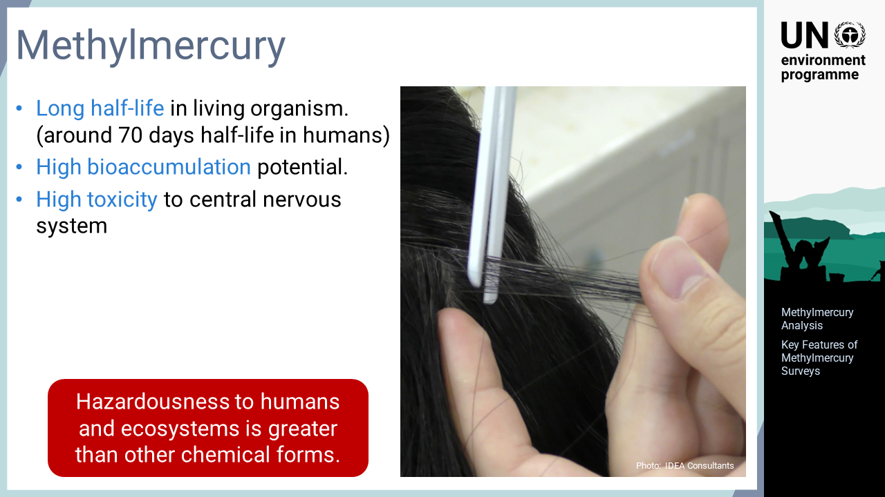
Notes:
‘2’ The biological effects of methylmercury are briefly addressed in this slide. Compared to inorganic mercury, methylmercury has a longer half-life in living organisms, which makes it highly bio-accumulative. Methylmercury is known for its strong toxicity to the central nervous system. Therefore, methylmercury in the environment is accumulated in the ecosystem and exhibits high loading levels and toxicity in humans and other organisms particularly in high trophic levels. For this reason, analysing methylmercury is sometime more relevant than analysing total mercury.

Slide 4
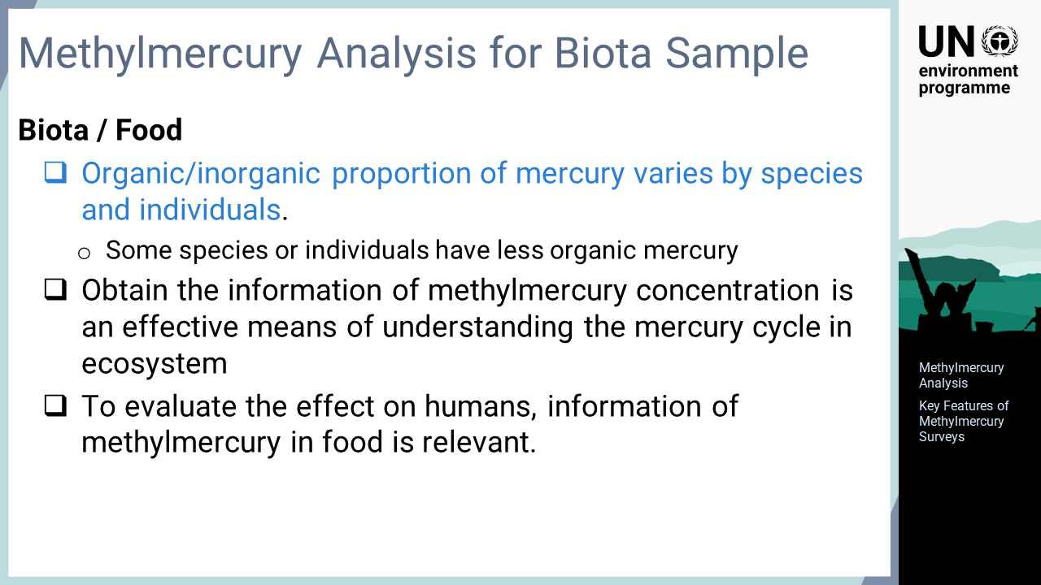
Notes:
‘3’ This slide highlights key features for the research and analysis of methylmercury in biota. The toxicity and bioaccumulation ability of methylmercury is significantly higher than those of other forms of mercury. The proportion of organic and inorganic mercury accumulated in the bodies of living organisms varies among species and individuals . Some species and individuals have a relatively low proportion of organic mercury in the body. Thus, assessing the methylmercury concentration in the target species is an effective means of understanding the behaviour of mercury in the ecosystem. Assessing methylmercury levels in food items is also relevant for evaluating the effect on humans accurately. The Codex Guidelines, which define food safety standards, set guideline values for methylmercury in some fish species.

Slide 5
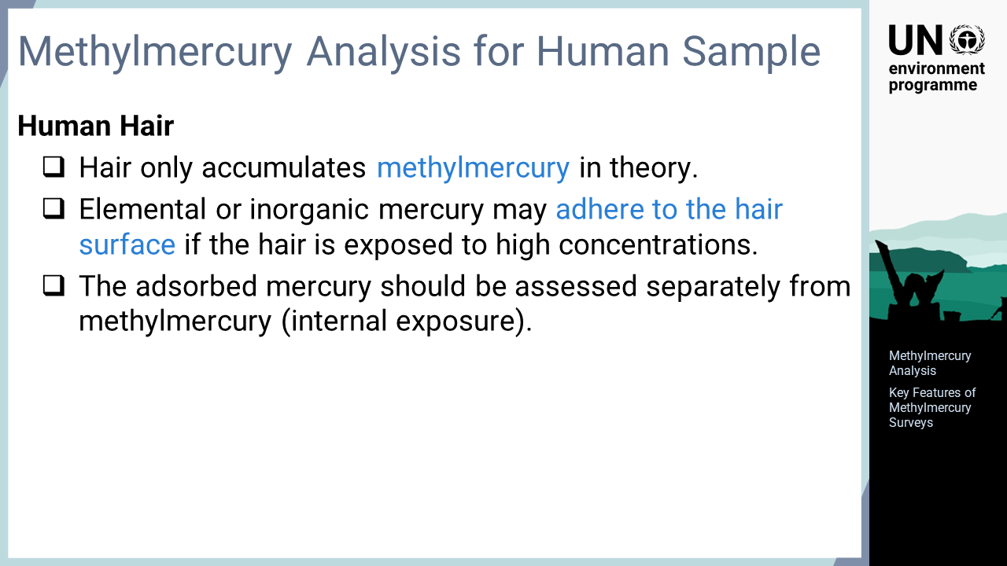
Notes:
‘4’ When surveying human hair, it is sometimes important to know the level of methylmercury. As hair only accumulates methylmercury in the body, all mercury in the hair should be methylmercury; however, some elemental or inorganic mercury may adhere to the hair surface if the hair is exposed to high concentrations. For example, atmospheric mercury at gold mining sites or mercury-using facilities and personal care products containing mercury are possible sources of such mercury. Mercury adhering to the surface is not accumulated by means of internal exposure to methylmercury; thus, analysing total mercury including this surface portion will provide misleading evaluation results. To assess the mercury exposure of the person subject to the survey property, methylmercury in the hair samples should be analysed if the adsorption of elemental or inorganic mercury is expected.

Slide 6

Notes:
‘5’ The actual analysis procedure for methylmercury is explained using fish as an example. The process employs alkaline digestion, dithizone extraction and finally analysis by gas chromatography, GC, with an electron capture detector, ECD.

Slide 7
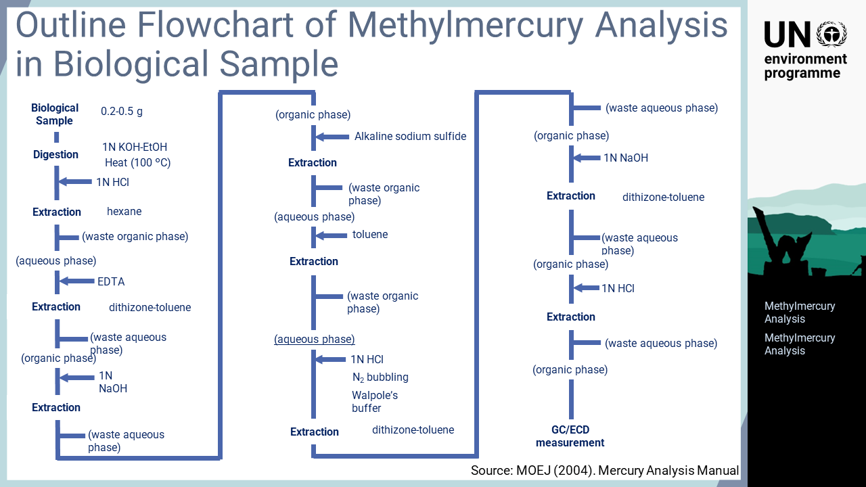
Notes:
‘6’ This slide shows the entire process of alkaline digestion, dithizone-toluene extraction, and GC/ECD analysis. The principle of this method is to digest the sample with an alkaline solution, and then to extract methylmercury into toluene as a dithizone complex. Organic substances other than methylmercury, which are also extracted in this method, will interfere with the analysis. The trick of this method is to remove most of the other organic substances coexisting in the sample by repeated extraction and back extraction at different pH values to refine methylmercury. The operation flow involves many steps, but this pre-treatment is normally completed in one to two days. The analysis is then performed using a GC/ECD instrument, which is cheaper than a mass spectrometer and has high sensitivity for specific substances such as methylmercury.

Slide 8
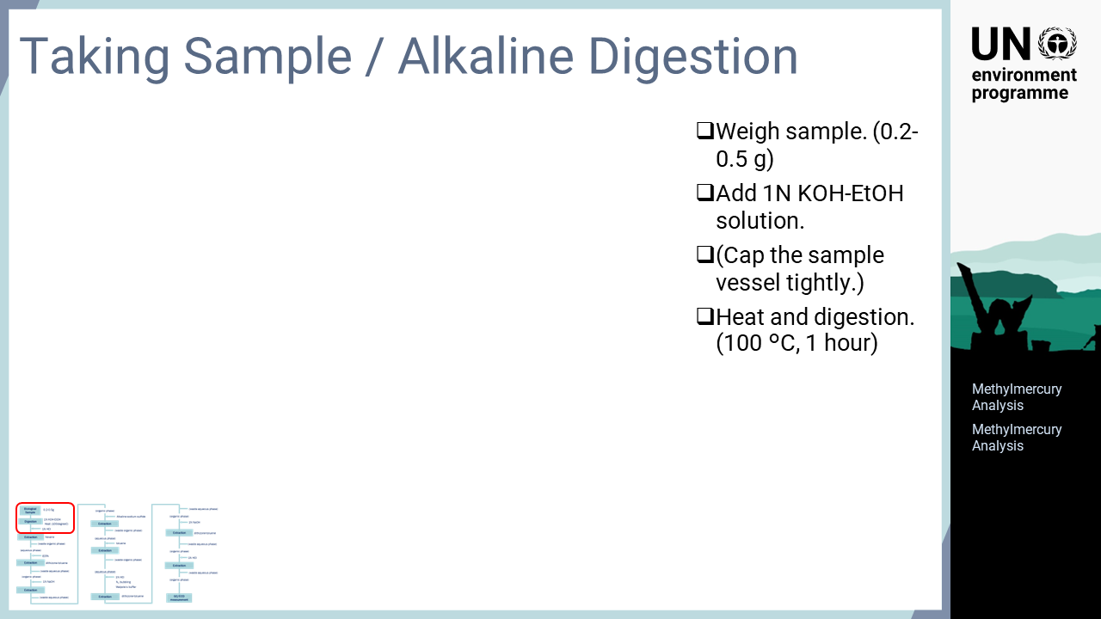
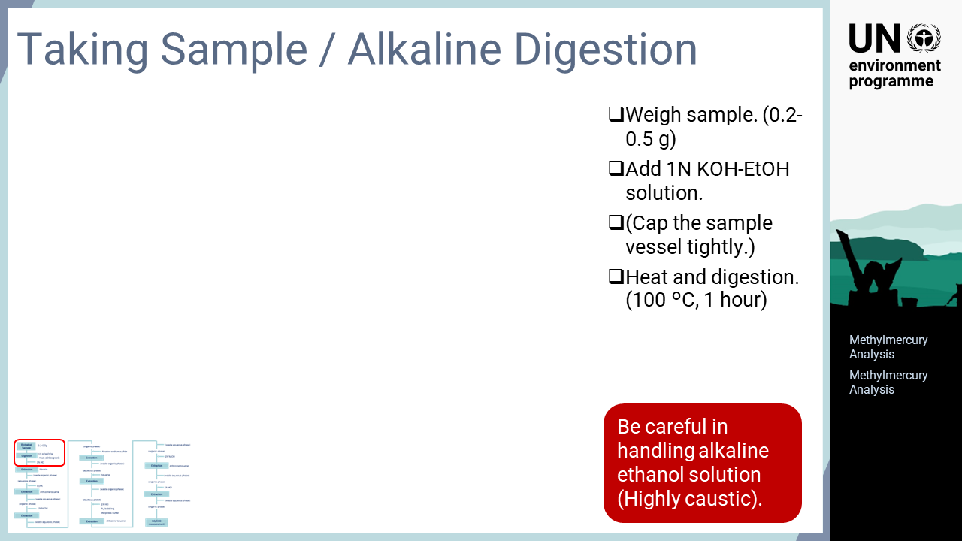
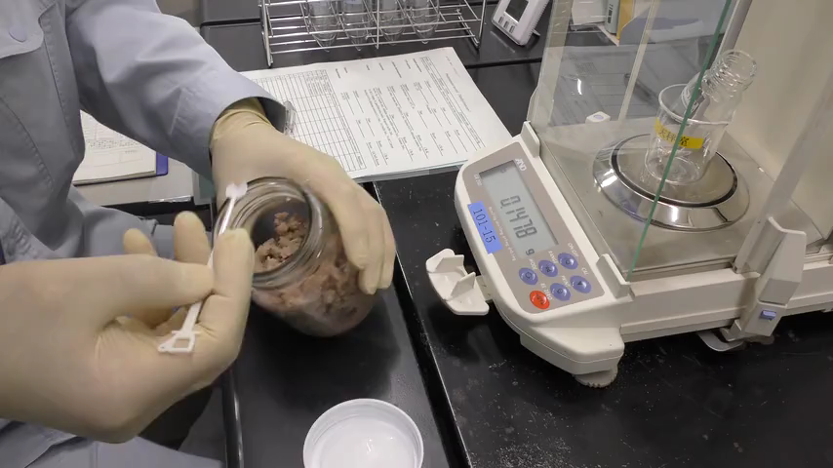
Notes:
‘7’ The actual operations are described in videos. There are many steps in this analytical process, but similar operations are involved, which will be explained together. Firstly, a sample is weighed, and a solution of potassium hydroxide in ethanol is added. Then, the sample vessel is capped and digestion proceeds in an oil bath heated for one hour at 100 °C. As alkali decomposes proteins very well, almost no solids remain after digestion. Deliberate care should be taken in handling the alkaline ethanol solution at high temperatures, which can cause severe burns.

Slide 9
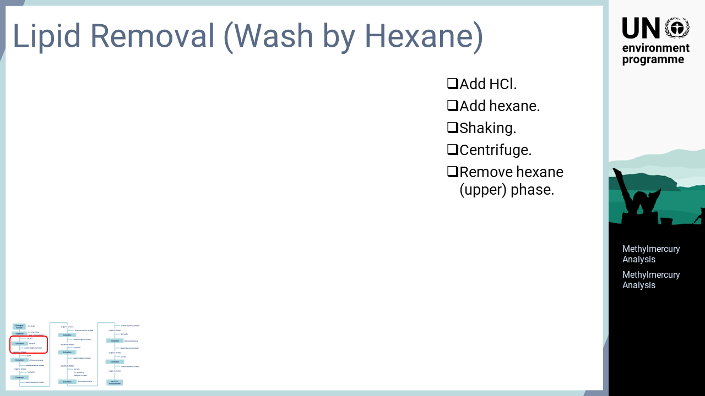
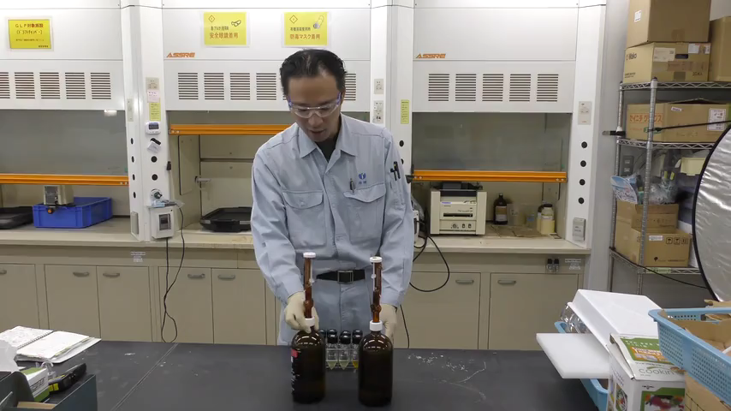
Notes:
‘8’ After alkaline digestion of the sample, the pH is adjusted to the acidic range to extract methylmercury into the aqueous phase and separate it from coexisting lipids. Hydrochloric acid and hexane are added to the sample, which is then shaken and centrifuged to separate the hexane and aqueous phases. Then, the upper hexane phase is removed.

Slide 10
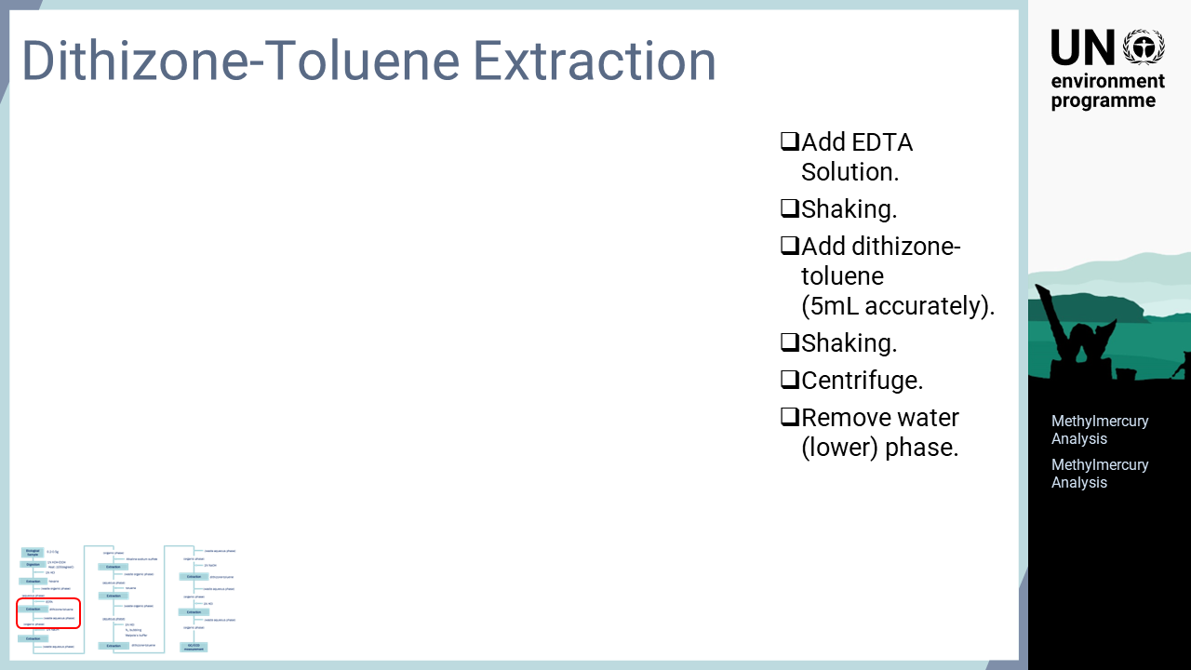
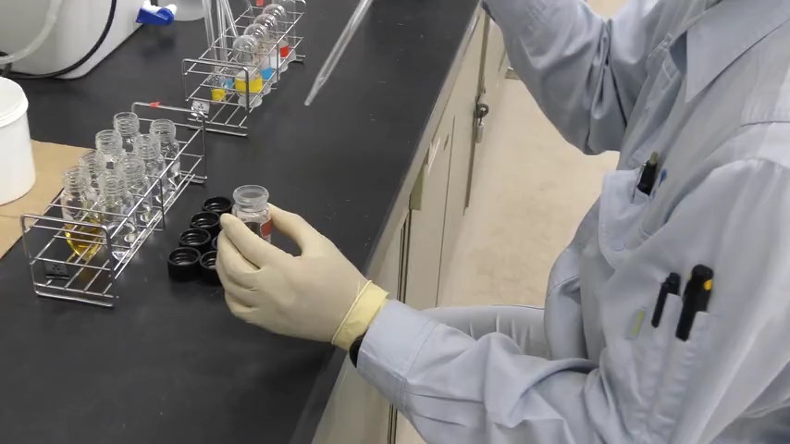
Notes:
‘9’ After removing lipids by cleaning with hexane, the sample is extracted with a dithizone complex. An EDTA solution and a precise amount of dithizone-toluene solution are added to move methylmercury back into the toluene phase. After shaking, the sample is centrifuged to separate the phases completely, and the lower aqueous phase is removed.

Slide 11
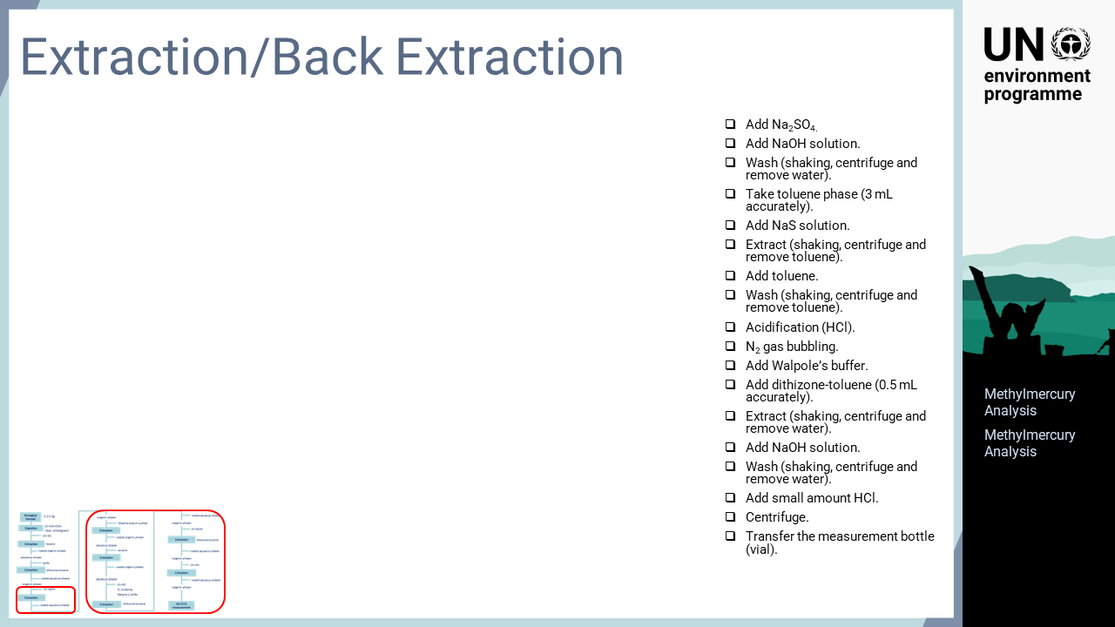
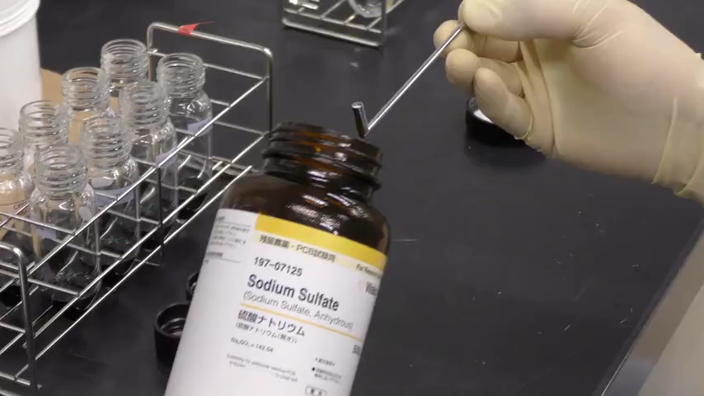
Notes:
‘10’ After extracting the methylmercury in the sample into toluene phase, the following steps are performed: cleaning with alkaline aqueous solution, back extracting with sodium sulphide, cleaning with toluene, acidifying and re-extracting, cleaning with alkaline aqueous solution, acidifying, and transferring to a measuring vial. These steps remove co-existing matrices by back-extracting into the aqueous phase and re-extracting into toluene. These individual operations are similar to the previous steps. Finally, the sample is prepared in a small amount of toluene and analysed by GC/ECD.

Slide 12
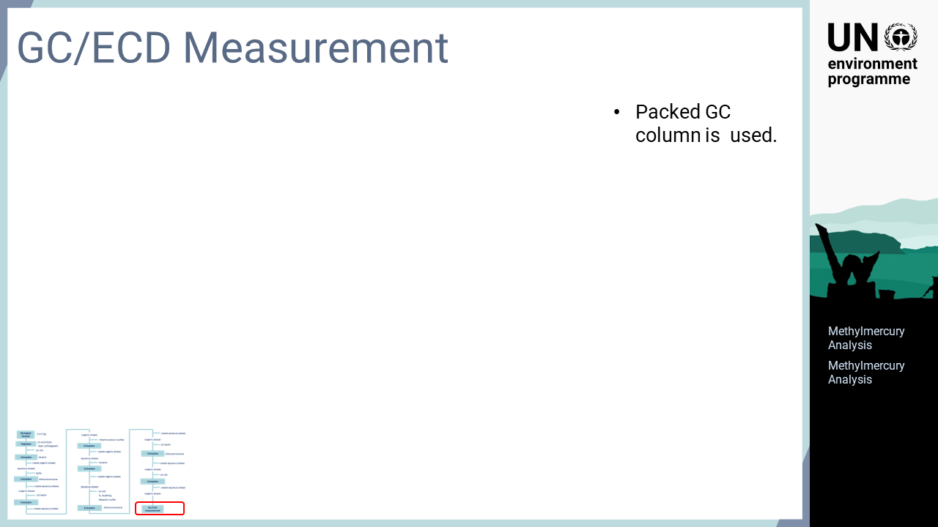
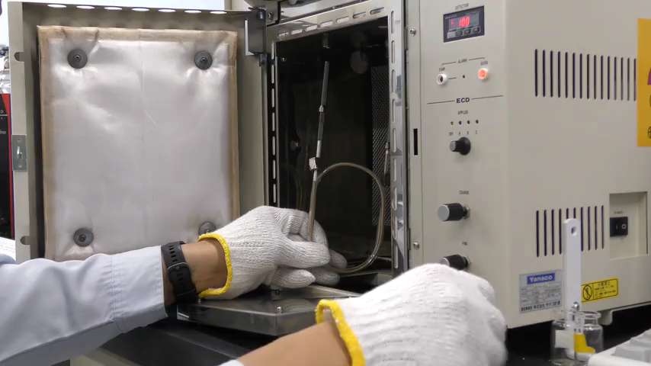
Notes:
‘11’ The sample digested by alkali and refined by extraction is analysed by GC/ECD. GC/ECD instruments are cheaper than mass spectrometers and have lower maintenance costs. In this method, a packed column is used for separating large amounts of sample to lower the detection limit.

Slide 13

Notes:
‘12’ In this section, the analysis of methylmercury in hair is explained.

Slide 14
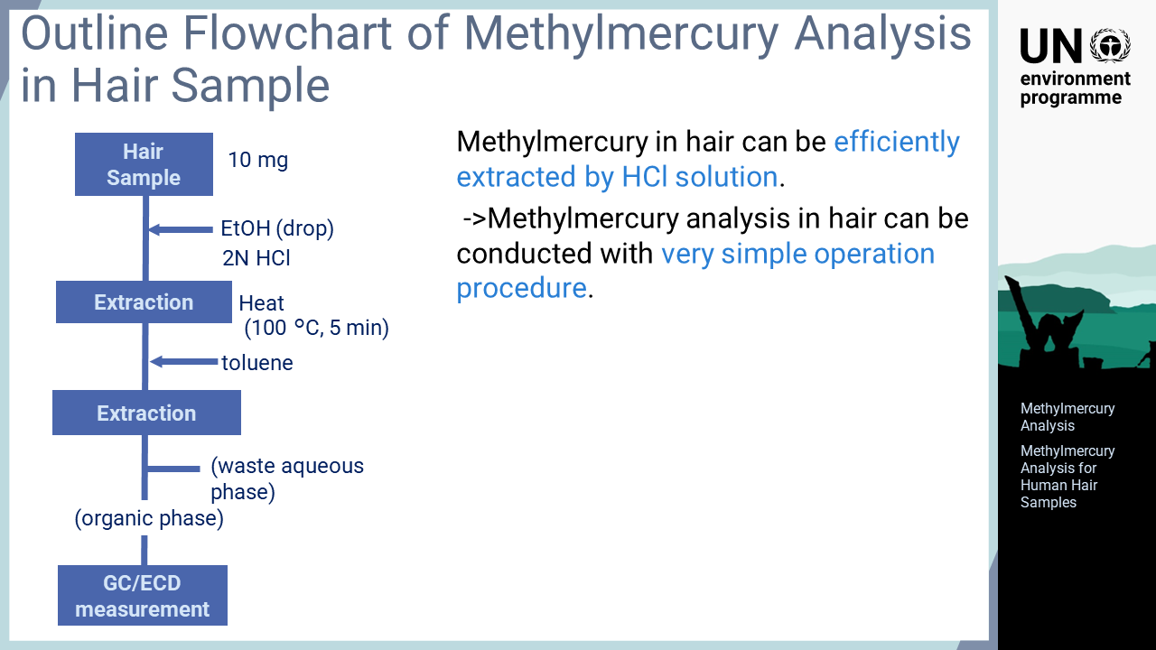
Notes:
‘13’ To analyse methylmercury in biological samples such as fish, a long pre-treatment involving digestion and extraction is required to remove interfering components before the sample is analysed by GC/ECD. For hair samples, methylmercury can be efficiently extracted by hydrochloric acid without digestion. Therefore, the analysis of methylmercury in hair can be conducted with a very simple operation procedure as shown in the flow.

Slide 15
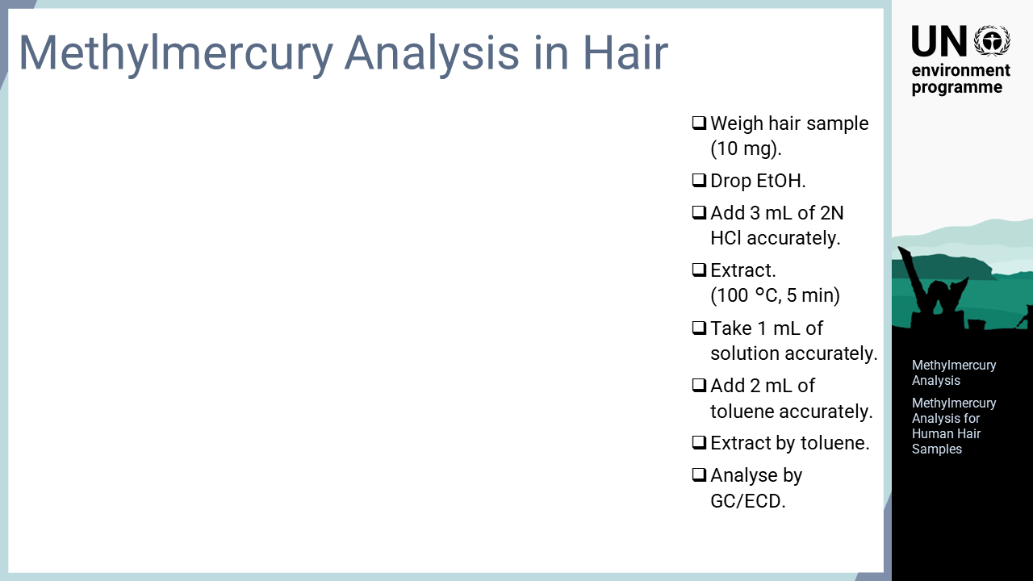
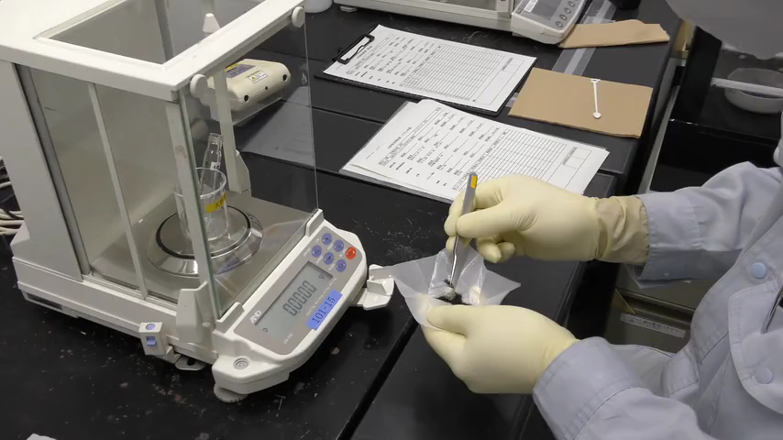
Notes:
‘14’ This slide explains the actual analytical process for analysing methylmercury in hair. Firstly, approximately 10 mg of hair is collected, and one or two drops of ethanol is added. Then, three mL of two-normality hydrochloric acid is added, and methylmercury is extracted into hydrochloric acid by heating for five minutes at 100 °C. After extraction, one mL of hydrochloric acid solution is taken from the sample, and toluene is added to transfer the methylmercury into the toluene phase. The toluene solution of extracted methylmercury is analysed by GC/ECD in the same way as other samples. Clearly, very few steps and a short time are required for hair analysis.

