Slide 1

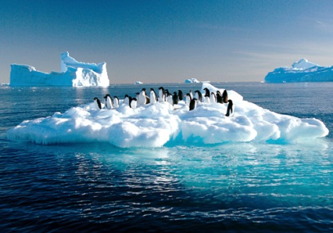
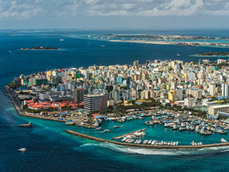
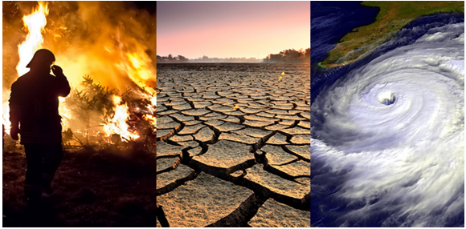
Data Sources in Environment and Climate Change Statistics

Slide 2




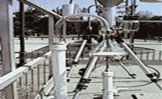
Sources of Data
Statistical surveys (e.g., censuses or sample surveys of population, housing, agriculture, enterprises, households, employment, and different aspects of environment management)
Administrative records (of government ministries, departments and agencies, utility companies, authorities of related areas such as water, land, energy, forest, fisheries, education, health, budget, etc.)
Remote sensing and thematic mapping (satellite imagery, forests or land use and/or coverage, water pollution levels in lakes and lagoons)
Monitoring systems (field monitoring stations for water quality, precipitation, air pollution, climate, soils, etc.)
FDES 2013, pg. 8
Notes:
Environment statistics synthesize data originating from various types of sources. The data used to produce environment statistics are not only compiled by different collection techniques, but also by various institutions. Types of sources include statistical surveys, administrative records from MDAs and other non-governmental agencies responsible for natural resources, remote sensing and thematic mapping; and monitoring systems e.g. Field-monitoring stations for water quality, air pollution or climate.
Source: FDES 2013 p 8

Slide 3


Sources of Data (2)
Scientific research, special projects and studies undertaken to fulfill domestic or international demand
FDES 2013, pg. 8
Other sources include Estimation, projections and modeling (e.g. regressions, simulation, extrapolation and interpolation).
Inventories applicable to GHG emissions and forest-related indicators and statistics
Notes:
Another source of data is scientific research and special projects undertaken to fulfil domestic or international demand.
Source: FDES 2013 p 8
In addition, other sources include statistical techniques such as estimation, projections and modelling. Another emerging source is Inventories related to GHG emissions and forest-related indicators and statistics.

Slide 4
Statistical surveys (including censuses and specialized surveys)
Notes:
Now the focus of the presentation is on Statistical surveys (including censuses and specialized surveys).

Slide 5
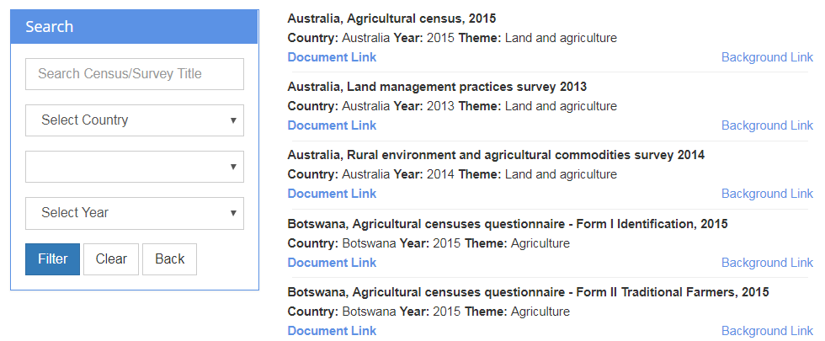
Exploring New Areas of data collection in Environment and Climate Change Statistics
UNSD has been reviewing existing Censuses and surveys for many years to support countries in adding new or expanding existing questions. There has been:
Substantial increase in the number of surveys and censuses available online (over 100).
Better outreach to countries who have provided surveys in several languages other than English (e.g. Arabic, French, Portuguese, Spanish).
Filterable by themes (13) separately or combined, country and year.
A range of 27 countries spanning six regions (Africa, Asia, Europe, North America, Latin America and the Caribbean, Oceania).
Relatively heavy focus on the themes of waste and water (32/90 surveys) but efforts are afoot to expand this selection to cover more themes including climate change
Notes:
UNSD has been reviewing existing Censuses and surveys for many years to facilitate mainstreaming of and foster the development of a separate section for Environment (including Climate Change) by adding new or expanding existing questions. However, UNSD remains cognizant of the fact that there continues to be heavy demands from various sectors to have additional questions included in the census at the national level.
Accompanying text for each country survey is provided via a background link to the (typically) NSO’s webpage

Slide 6
Exploring New Areas of data collection in Environment and Climate Change Statistics (2)
The Environment Statistics Section (EVSS) has been collaborating with the Secretariat of the Pacific Community (SPC) who are in the process of developing a module aimed at collecting Climate Change data. https://www.spc.int/
The Section is working in close collaboration internally with the Demographic Statistics Section in reviewing environment-related questions in the population and housing censuses(PHC).
https://unstats.un.org/unsd/demographic-social/census/document-resources/
Notes:
The Environment Statistics Section (EVSS) has a good history of collaboration and coordination. Recently this collaboration has extended to the Pacific Community (SPC), whom the Section would like to welcome and whom you’ll hear from directly during their presentation.
Further, the Section has been working closely with the Demographic Statistics Section (DSS) on reviewing census and surveys questions in past as well as the present round of PHCs.
As on the slide the link to all their country censuses are available on line. More censuses are expected to be uploaded as they are made available to UNSD.

Slide 7
Population and Housing Censuses (PHC)

Slide 8
Environment as a Separate Section
Censuses have traditionally included questions, and in some cases a separate section, on environmentally-related issues such as disposal of waste, water quality, toilet facility, source of energy, type of fuels used, etc.
Unique questions or separate sections, however, are still in the developmental stage or are very rare.
Although not exhaustive some examples of countries having separate Environment sections or unique questions are:
  In 2000 round of PHC Belize was the only country in the world found to have a separate section on environment in the census;
  In 2010 round Belize and Trinidad and Tobago each had a separate section on the Environment.
  In 2020 round Grenada and Tanzania each had a separate section on the Environment. Tanzania added several new questions, including on climate change, in this round.
Notes:
Censuses have traditionally included questions, and in some cases a separate section, on environmentally-related issues such as those on the slide.
Some examples of countries having separate Environment sections or unique questions are listed.

Slide 9
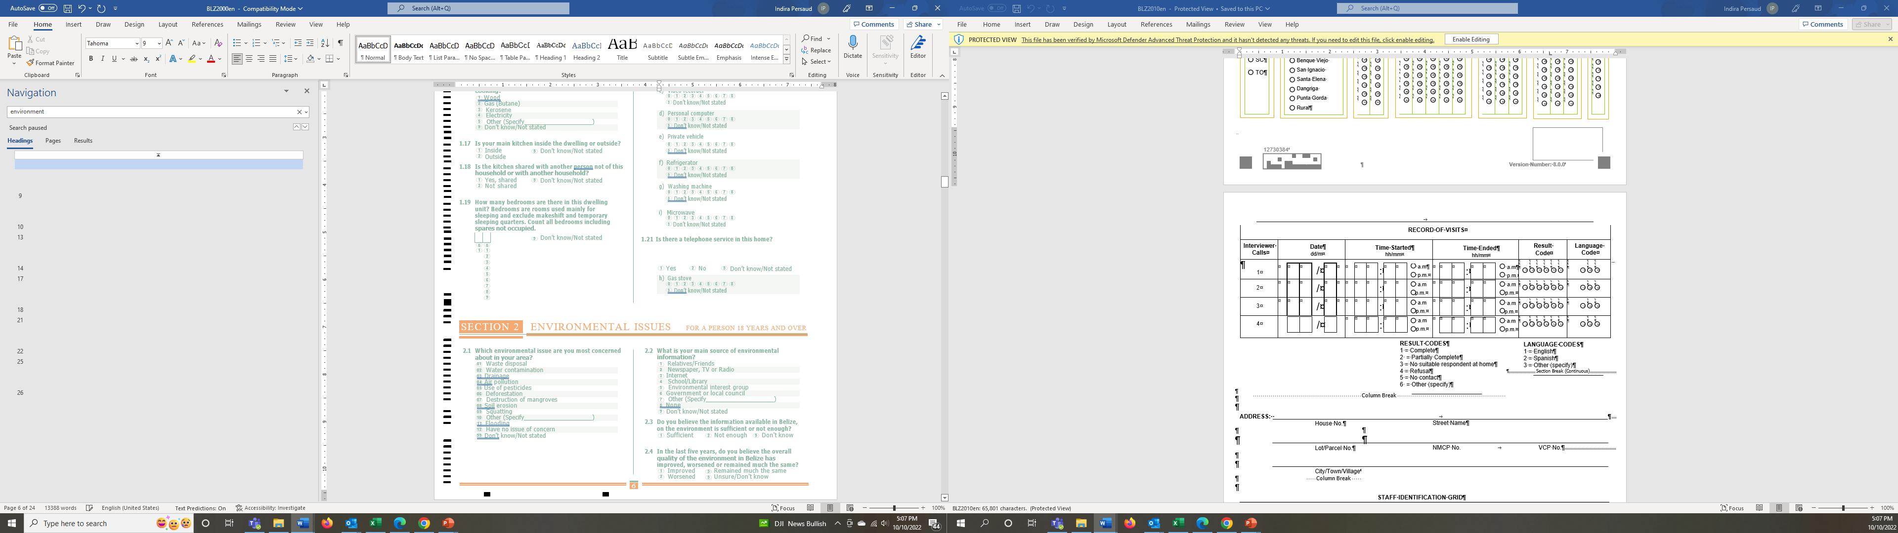
Examples of Environment as a Separate Section
Some countries have a separate section for environment in their PHC questionnaire.
For 2000 Round of Censuses Belize was the only country in the world at that time with a separate section for environment.
Notes:
Further, from the review it was found that some countries had a dedicated section on Environment in the PHC questionnaire. In the 2000 round Belize was the only country in the world to have done so.
Most questions are perception/opinion-based but they are still useful because they raise awareness of environmental issues.
For example, one of the questions is on “which environmental issue are you most concerned about in your area?”

Slide 10
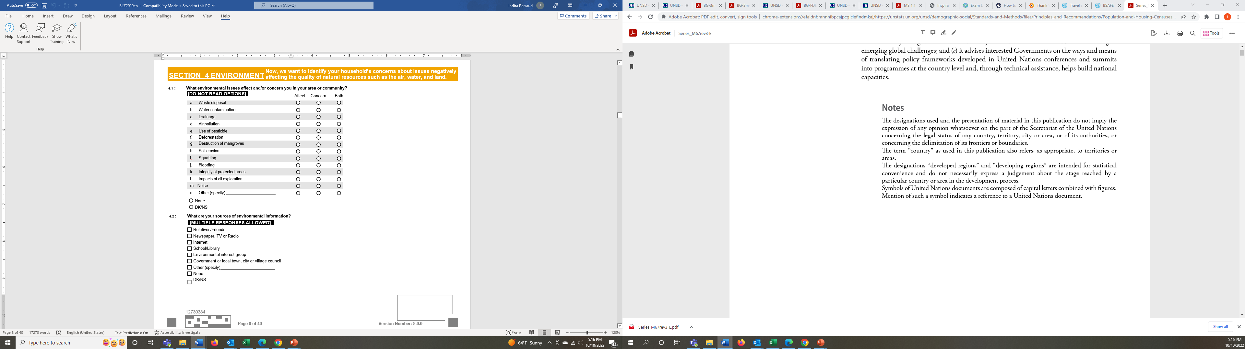
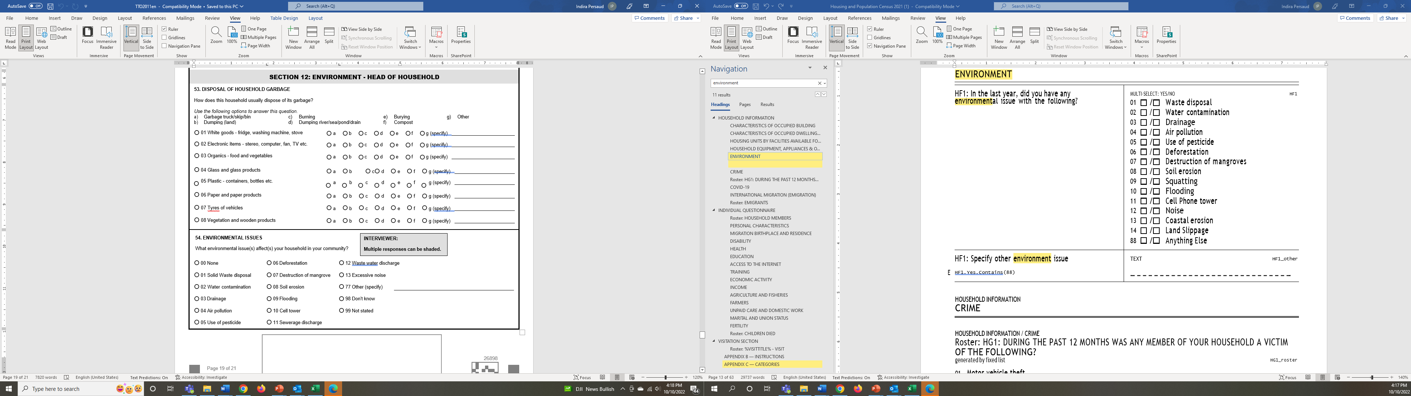
Examples of Environment as a Separate Section (2)
Belize maintained a separate section on environment in 2010 round.
In 2011 Trinidad and Tobago also had a separate environment section.
Notes:
In the 2010 round Belize and Trinidad and Tobago each had a dedicated environment section.
Both countries asked questions about which environmental issues the respondents were concerned about.

Slide 11
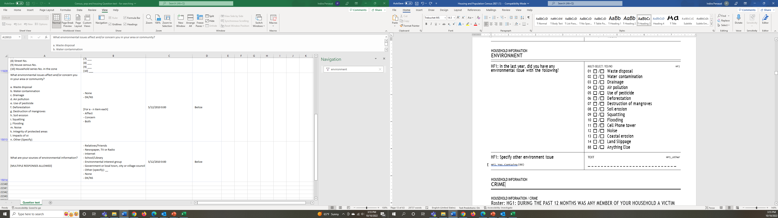
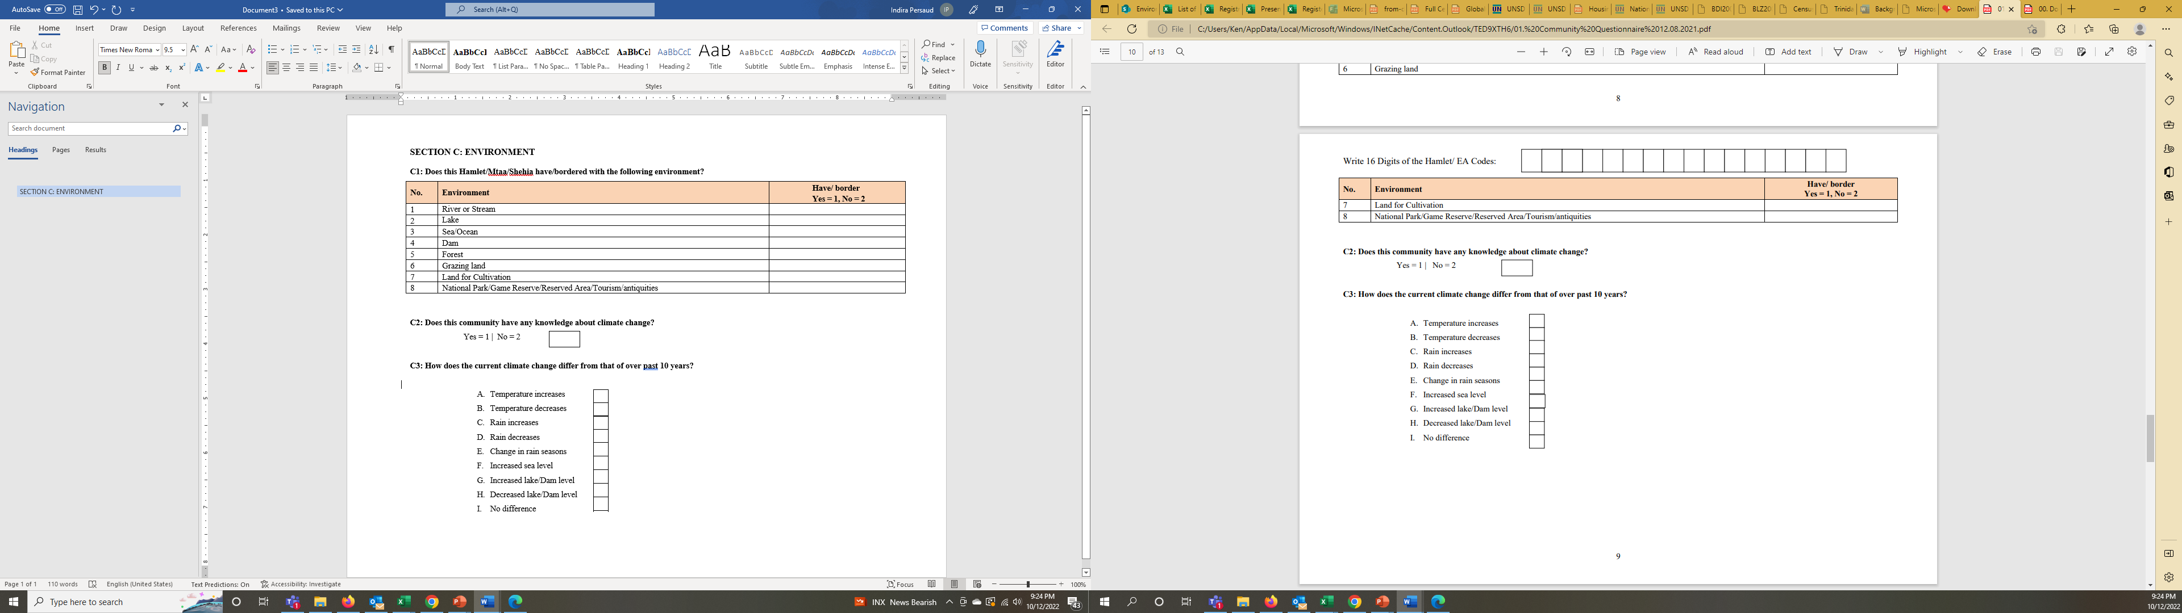
Examples of Environment as a Separate Section (3)
In 2021 Grenada had a separate section on the environment
In 2022 Tanzania has a separate section on the environment with new questions (not yet available publicly).
Notes:
In the 2020 round Grenada and Tanzania each had a separate section on the environment. Tanzania added new questions in 2022, however their questionnaire is not yet available publicly.
We will have a full presentation by our chair from Tanzania who will elaborate more on the details.

Slide 12
Examples of Some Unique Questions in the PHC
Niue, 2001 Census: [https://unstats.un.org/unsd/envstats/censuses/]
Chemical awareness: Do you or any member of your household use any of the following? Are you and your household aware of the harmful effects of chemicals to the environment and health? Are you prepared or willing to reduce the amount of chemicals
    ( ) herbicides
    ( ) pesticides
    ( ) fungicides used by your household?
    Kiribati, 2005 Census: https://unstats.un.org/unsd/demographic-social/census/document-resources/?search=&docType=&countryName=Kiribati
    Environmental Issues (Yes/No)
    Does this household dispose rubbish by
      Collection point (Council):___
      Recycle system:___
      Beach:___
      Ground Pit (marua):___
      Other places not defined:___
Notes:
For example, from Niue, a question was asked to households about their awareness on the use and effect of chemicals on the environment and health.
In the case of Kiribati, additional options for place of waste disposal were the beach, which is not usually listed.

Slide 13
Examples of Some unique questions
Kiribati, 2005 Census - https://unstats.un.org/unsd/demographic-social/census/document-resources/?search=&docType=&countryName=Kiribati
Environmental Issues (Yes/No);
Does this household have seawall:
    Hungary, 2001 Census - https://unstats.un.org/unsd/demographic-social/census/document-resources/?search=&docType=&countryName=Hungary
    What is the character of the environment of the building?
      1 Traditional urban
      2 Building blocks, housing estate
      3 Suburb of villas
      4 Family houses
      5 Rural
      6 Recreation district
      7 Industrial zone
      8 Sparsely built outskirt
      9 Grouped built outskirt
      10 Unsatisfactory from social point of view
      11 Other
Notes:
With sea level rise, it is interesting to see Kiribati asking a question in their census on whether the household has a seawall.
In the case of Hungary, they have included a question about the neighbourhood characteristics of the building.

Slide 14
Specialized surveys

Slide 15
Specialised Surveys
Surveys are an additional method of data collection
Questions/module on the environment can be added to existing surveys e.g. surveys e.g. Labour force Survey (LFS), Household Survey (HHS), Multiple Cluster and Indicator Survey (MICS) etc., etc.
Specialized Surveys can be developed -
  Several surveys can be found on UNSD’s website e.g. on water and waste and more are expected to be added including on Climate change.
  The Global Consultation conducted by UNSD in 2021 on the draft Global Set revealed information from a wide range of countries on specialised surveys or modules added to existing surveys.
Notes:
Surveys are an additional method of data collection
Questions/module on the environment can be added to existing surveys e.g. Labour force Survey (LFS), Household Survey (HHS), Multiple Cluster and Indicator Survey (MICS) etc.,
Nepal has conducted a specialized survey on the impact of climate change and they will elaborate on that in their presentation.

Slide 16
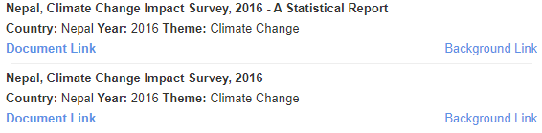
Specialized Surveys – Example of Nepal
Survey on Impact of Climate Change
The Central Bureau of Statistics (CBS) of Nepal developed a dedicated survey on the impact of climate change in 2016 and is conducting a second one.
Based on the experience and lessons from the first National Climate Change Impact Survey (NCCIS), CBS will discuss with wider stakeholders to agree on methodological framework and approach to be adopted in the next climate change survey.
The proposed questionnaire will cover impact of climate change including loss and damage information.
Both quantitative and qualitative data will be collected.
https://unstats.un.org/unsd/envstats/censuses/?selectName=&selectCountry=Nepal&selectYear=
Notes:
This is an example of Nepal which has pioneered in developing a climate change impact survey in 2016 and will soon be launching a second one based on experience gained from the first one.
The actual survey from 2016 is available on UNSD’s website, as well as a statistical report describing the results.

Slide 17
Methodology of the BDRS 2015 & 2021
Specialized Surveys
Example of Bangladesh Disaster-Related Statistics (BDRS)
A) OBJECTIVES: To collect data and information of ….
1) Socio-economic characteristics of Household in disaster prone area
2) Disaster-induced agricultural production losses (Crops, Livestock, Poultries), Damage and loss of cultivable land and useable land;
3) Damage and loss of residence (dwelling), cowshed, kitchen and Forestry;
4) Health and sanitation condition from the natural disaster prone area;
5) Vulnerability of the women, children, aged persons and person with disability; and
6) Perception and knowledge about climate , environment, and disasters.
B) SAMPLING FRAME
Survey Frame: A mauza/mahalla list of containing the dominant mauzas in terms of natural disaster prone mauzas under 64 district.
Two-Stage Sampling Frame with Kish Allocation formula:
Followed a systematic sampling of 30 Households from each of the selected Primary Sampling Unit (PSUs).
C) SCOPE AND COVERAGE
1) Geographically, covering the entire country.
2) To capture various data from the sample households pertaining to their livelihood activities in relation to the direct and indirect impacts of climate change and natural disaster.
3) It will not attempt to collect information on the climate parameters or components like temperature, rainfall or anything in relation to carbon emission, greenhouse gas etc.
D) The New Features of BDRS 2021 Questionnaire:
1) Aligned with SDGs, SFDRR, Nat. Five Year Plan and Other Successive Plans; 2) Based on UNESCAP’ DRSF and Bangladesh Disaster Management Act 2012 and Standing Order on Disaster (SOD) 2019; 3) Added new elements: a) Deaths b) Injured c) Disabilities d) Missing e) Climate Induced Migration f) unemployment g) Gender Integration h) GIS Integration etc.; and 4) Using Mobile and Web Application using MDM Software for data collection.
17
Notes:
Bangladesh conducted 2 surveys in 2015 and 2021. The slide outlines the main objectives, sampling frame, and the scope and coverage.
The new features of the 2021 Questionnaire are also illustrated.

Slide 18
Way Forward
Specialized Surveys
Example of Bangladesh Disaster-Related Statistics (BDRS)
BDRS Questionnaire should be adjusted for length and scope in future rounds of the survey. Some modules could be attached to other surveys (household data on various water, sanitation, health and safety issues), and key disasters, climate change and environmental livelihoods modules could remain as stand-alone.
There is room to improve it further with more focused and sex and age disaggregated data collection related to DRSF and UNSD Global Set statistics and indicators only to generate the BDRS in a better way.
Special attention needs in developing the BDRS Questionnaire with consideration of time required by the interviewer and interviewee as well. Long questionnaire should be tiring for both sides then respond rate will be satisfied.
A digital interactive platform needs to be developed in permanent basis for field level real time data collection before and after any disaster events incorporating disaster risks data along with geolocation or associated social, biophysical and geospatial parameters.
Notes:
This slide illustrates the way forward based on the experience gained from conducting the surveys in 2015 and 2021.

Slide 19
Conclusion
The PHC continues to be a major source of Environment/ Climate Change data.
  Where feasible, it is advisable as some countries are doing, to
    expand existing sections on Environment/ Climate Change in the PHC questionnaire by adding more relevant questions
    explore inclusion of a separate section in the PHC
    include a module on the environment/climate change in existing surveys
    develop specialised surveys as many countries have successfully done.
UNSD urges countries to use the search tool on our website and send us feedback; also feel free to send us any survey instruments you have used or are aware of to envstats@un.org
Notes:
Based on the presentation there are some of the key points for countries to undertake to expand data collection in the areas of environment and climate change via censuses and surveys. Your feedback would be very useful in helping us to improve and enhance our support and services to countries.

Slide 20
Thank You!​
​
UNSD Environment Statistics Section​
Website: unstats.un.org/unsd/envstats ​
Email: envstats@un.org ​

Slide 21
Other data sources

Slide 22




Administrative records
Administrative data kept by government agencies and other
organizations may be used for the production of environment statistics
Advantage:
Cost of collecting such data is significantly less than establishing and
conducting a survey
Level of response burden is minimized
Complete coverage is assured of units under administration
Possible Limitations:
Differences between administrative and statistical terms and definitions
Risk of deliberate misreporting
Data may not be checked or validated for statistical purposes; there may be restrictions of access to the data
Coverage of data, though complete for administrative purposes, might not match statistical requirements
Notes:
NGOs (e.g., industry or services associations, environmental associations and groups, etc.) may also be of use in environment statistics.

Slide 23
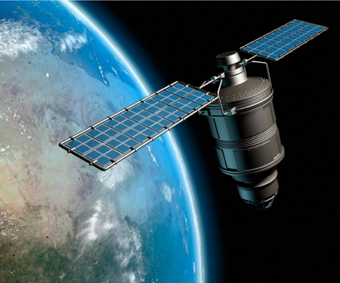
Remote Sensing and Thematic Mapping
Remote sensing is the science of obtaining information about objects or areas from a distance, typically from aircraft or satellites.
Remote sensing makes it possible to:
  Collect data on dangerous or inaccessible areas
  Replace costly and slow data collection on the ground, ensuring in the process that areas or objects are not disturbed
Uses: satellite, aircraft, spacecraft, buoy, ship, balloon and helicopter images
Result can be: mapped, imaged, tracked and observed
Example:
Remote sensing data can be captured and analyzed to measure forest cover, compare the impact of natural disasters, changes in the area of soil erosion, the extension of pollution, changes in land cover or population estimates of different animal species.

Slide 24
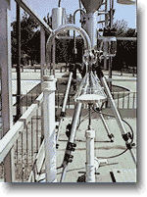
Monitoring systems
Typically comprised of field-monitoring stations which are used to describe the qualitative and quantitative aspects of environmental media, i.e. air, water or soil quality; hydrological or meteorological parameters and characteristics.
Main advantages of these data are that they are:
(i) Usually collected using verifiable scientific methods
(ii) Usually validated
(iii) Often available as time series
(iv) Frequently use modeling to improve data quality
Possible limitations of data from monitoring systems are:
  Field-monitoring stations are usually located in “hot-spot” areas where there are
    (i) high levels of pollution
    (ii) highly sensitive areas
    (iii) large numbers of the population are affected
Consequently, the measurements will be location-specific and due to the limitations of their representativeness, they are difficult to aggregate over space
Notes:
This is of most concern especially in areas monitoring concentrations of pollutants in the environmental media

Slide 25
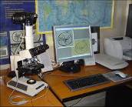
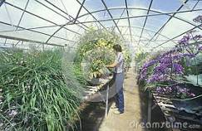
Scientific Research
Main advantages of using data from scientific research and special projects are:
(i) these data are usually available for free or for low cost
(ii) they minimize response burden
(iii) they can be used to fill in data gaps
(iv) they are useful for developing coefficients for models
Possible limitations of using these sources include:
(i) they often use terms and definitions that differ from those used in statistics
(ii) access to microdata may be limited
(iii) metadata may be missing
(iv) often data are available only for case examples
(i.e. limited areas or industries)
(v) often data are available on a one-time basis

