Slide 1
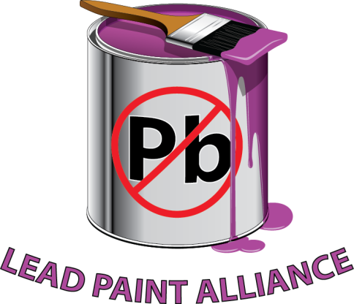
Health and Economic Consequences of Childhood Lead Exposure in Low- and Middle Income Countries
United Nations Environment Assembly
May 27, 2016
  Jane Nishida
  United States Environmental
  Protection Agency
Notes:
Good morning Ministers, partners, and colleagues and thank you for the opportunity to share with you this morning on an issue that is important to all of us in our efforts to protect human health and the environment.

Slide 2

Lead is a threat but we can avoid it
Lead is harmful to health, especially for children
Banning lead in gasoline is producing large health and economic benefits in low- and middle-income countries
Lead in paint is the major remaining source of childhood exposure worldwide
Governments can require use of alternatives
Notes:
Lead is a serious threat to human health and the environment and is especially dangerous for growing children. We have known this for a long time and countries around the world have been working together for years to reduce exposure to lead.
Through the Partnership for Clean Fuels in Vehicles, we banned lead in gasoline and this has produced tremendous health, environment, and economic benefits around the world.
However, lead exposure is still a problem and lead in paint is now the major source of childhood exposure to lead.
The good news is that we can do something about it. Governments can require the use of low-cost alternatives and both government and industry agree that laws are needed to eliminate lead in paint.

Slide 3
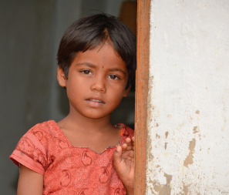
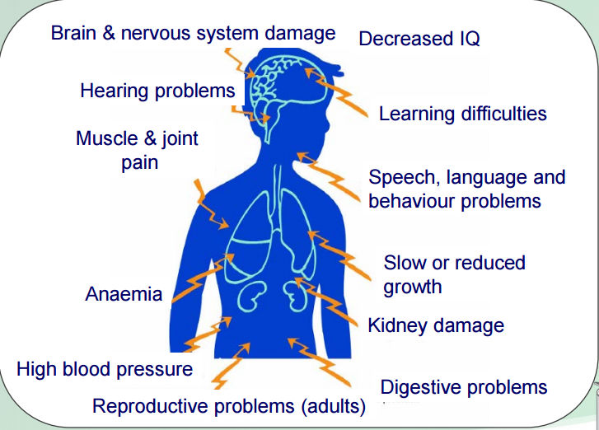
Lead is especially to harmful children
Neurological, cardiovascular, reproductive, renal, gastrointestinal and hematological effect
Children uniquely vulnerable
Life-long consequences in children including cognitive and behavioral deficits
No level of exposure is safe
Notes:
Lead is especially harmful to children, affecting their neurological, cardiovascular, reproductive, renal, gastrointestinal and hematological systems.
Children are uniquely vulnerable because, pound for pound, children drink more water, eat more food and breathe in more air than adults and because developing organ systems are more susceptible to the damaging effects of lead exposure.
Exposure to lead can carry life-long consequences. There is simply no safe level of exposure to lead.

Slide 4
Removal of lead from gasoline
Average child born to day 4-7 IQ points smarter than children born in the 1970s
One of major public health victories of past 50 years
Annual benefits ongoing and range from $1-$6 trillion/year, with a best estimate of $2.45 trillion/year (4% of global GDP)
Tsai and Hatfield J Environmental Health 2011
Notes:
Over the years, legal restrictions on lead have successfully decreased the use of lead in fuel, plumbing and other products and processes. These restrictions have effectively reduced the level of lead exposure in human populations.
These reduced exposure levels are correlated with an increase of 4-7 IQ points in children born today versus those born 40 years ago.
Getting the lead out of gasoline is one of the major health victories of the past 50 years and has lead to economic benefits ranging up to 4% of annual global GDP.

Slide 5
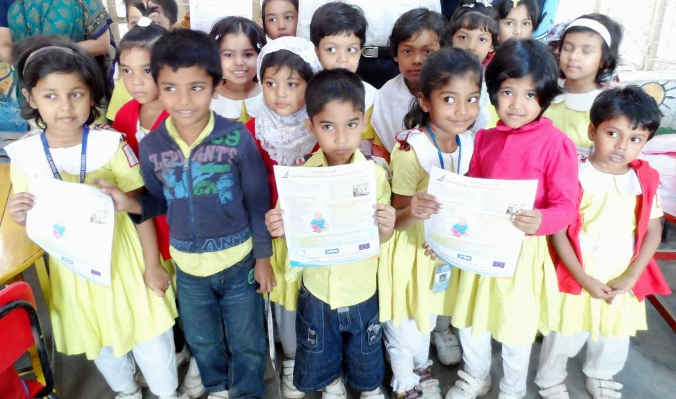
Yet we have a long way to go!
In many countries, it is still legal to use lead paint for decorating homes, schools, and children’s toys
Lead is not a necessary component of paint
Lead-free additives are affordable and easily available
Both industry and governments agree that the solution is enacting and enforcing laws to limit lead in paint in countries worldwide
Notes:
But there is still a long way to go in preventing lead exposure
In countries around the world, lead is still sold on shelves and uses to decorate homes, schools, children’s toys, and all over the environment in which we live everyday.
Lead is intentionally added to paint for drying and color properties, but economically feasible alternatives are available for all lead-containing paint ingredients.
Alternatives to using lead in paint are both affordable and available.
And industry and government are in agreement that the solution to this problem is enacting and enforcing lead paint laws in every country around the world so that the children of tomorrow are not exposed to this serious health risk.

Slide 6

The Lead Paint Alliance
Lead Paint Alliance is a voluntary partnership
Secretariat is UNEP and WHO
EPA is the Chair
Governments, NGOs, Industry are partners and members of the Advisory Group
Alliance is modeled on successful Partnership for Clean Fuels and Vehicles
Goal: Phase out lead paint by 2020
Notes:
The Lead Paint Alliance is working to get the lead out of paint by 2020.
The Lead Paint Alliance is a voluntary partnership that is jointly led by the World Health Organization and UNEP.
EPA serves as the Chair of the Alliance Advisory Group.
Partners to the alliance include government agencies, NGOs, Industry and academics. UNIDO is one of the newer partners and we are glad they are on board.
A subset of governments from each major region in the world, industry, NGOs and international organizations are members of an Advisory Group, which leads the work of the Alliance.
Models PCFV, which was successful in phasing out lead in gasoline.

Slide 7
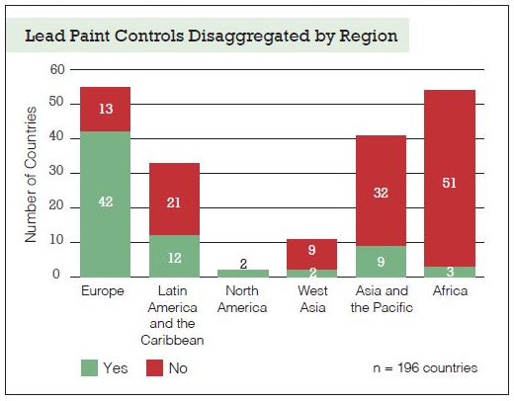
Global Status of Lead Regulations
Notes:
A recent report developed by UNEP in partnership with World Resources Institute highlights the status of lead regulations around the world.
Over the years, legal restrictions on lead have successfully decreased the use of lead in fuel, plumbing and other products and processes. These restrictions have effectively reduced the level of lead exposure in human populations.
However, paints containing lead are still widely manufactured and purchased in many countries across the world.
The global status report on phasing out lead paint is a comprehensive report on legislations and regulations of lead paint limits in countries around the world. The report further analyses the importance of legislation and regulations which are still needed in many developing countries around the world to reduce exposure to lead.
The report highlights the need for lead paint laws to protect children and workers in the developing world.
Regardless of the limits, the report further looks towards enforcement on manufacture, use and trade to phase-out lead in paint.

Slide 8
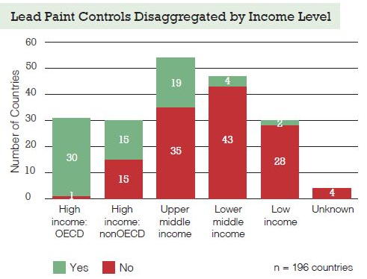
Gaps in Laws, Low-Middle-Income Countries
Notes:
On a continental level, Europe dominated highest number of countries with lead paint laws and Africa has the highest number of countries with no lead paint laws. Showing a direct linkage between lead paint laws and income level of countries.
This graph illustrates even more clearly the imbalance of countries with lead paint laws.
On the brighter side, progress has been made in some countries over the last 5 years, however lead paint still remains largely unregulated or subject to purely voluntary standards in many countries throughout the world.

Slide 9
Estimated Costs of Childhood Lead Exposure in Low- and Middle-Income Countries
Total estimated cost in LMICs = $977 billion (range $728.6–1162.5 billion) of international dollars in 2008
Regional economic losses estimated as:
    Africa: $134.7 billion, i.e. 4.03% of regional GDP
    Latin America & Caribbean: $142.3 billion, i.e. 2.04% of regional GDP
    Asia: $699.9 billion, i.e. 1.88% of regional GDP
Notes:
Lead exposure to children has staggering economic costs.
An NYU study has estimated the annual cost of children's lost IQ in low and middle income countries at $977 billion – almost a trillion dollars per year.
For some countries the economic cost is 3, 5 or even 7 percent of their GDP.

Slide 10
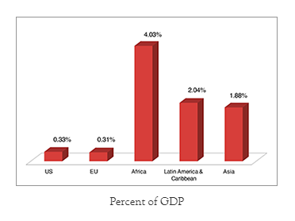
Developing Countries are being left behind
Overall burden associated with childhood lead exposure in LMICs amounted to 1.20% of world GDP in 2011; approximately $977 billion of international dollars in 2008
For comparison, economic impact of lead exposure in high-income countries (such as U.S. and EU countries) is $50.9 and $55 billion, respectively
Notes:
Developing countries suffer higher rates of exposure to lead and bear high costs for lead exposure. Until legal limits are in place, the developing world will continue to bear the burden of these costs.

Slide 11
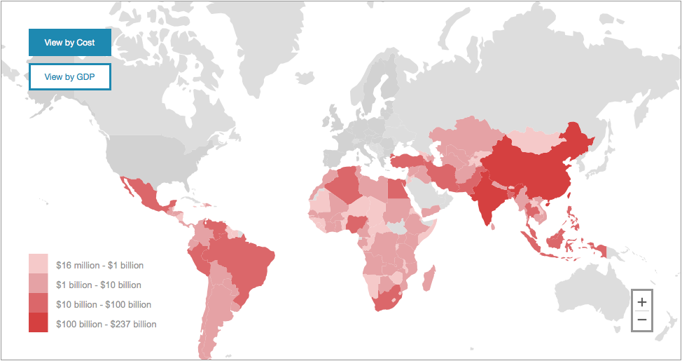
Costs of Childhood Lead Exposure
Total Estimated Cost of lead exposure in countries shown
= $977 Billion USD
Notes:
A new map from NYU can help countries understand the economic cost of childhood lead exposure in their countries.
The map helps stakeholders and decision makers understand and quantify the preventable economic burden of childhood lead exposure in LMICs
The map enables you to click on your country and see the economic cost of childhood IQ loss in your country.
The map displays both the economic cost in dollars and the percent GDP loss for each country.
This view shows the impact by cost.

Slide 12
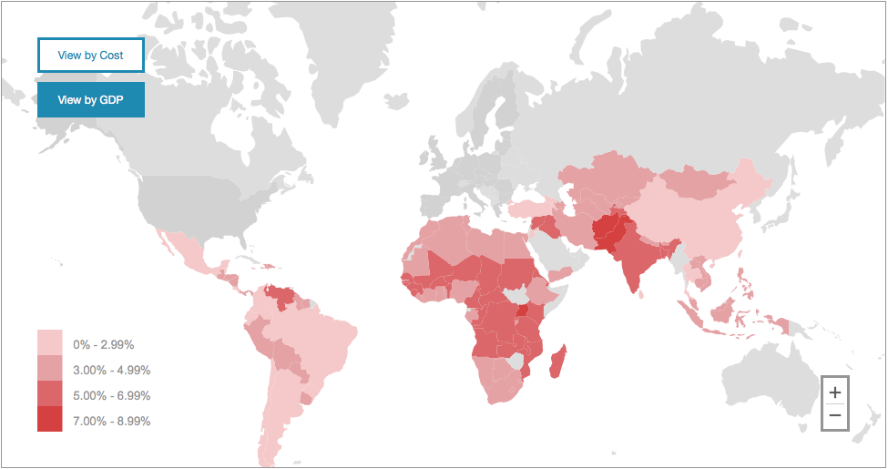
Costs of Childhood Lead Exposure, % of GDP
Notes:
This map shows the economic cost in percent of GDP.
Interactive map based on the findings of this analysis in low and middle income countries and displays cost and corresponding percent GDP loss by country.
It provides comparison information:
among countries in the same region
to the costs in EU countries and the U.S.

Slide 13
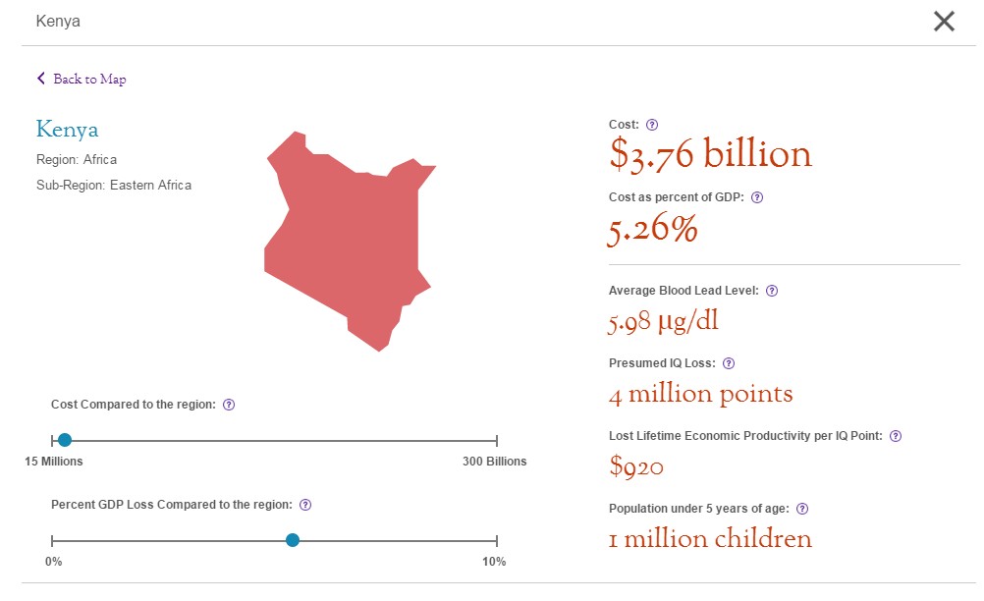
Country specific example: Kenya
Notes:
When you click on a specific country on the map, you will see details from that country, including that country’s cost and GDP loss compared to the region.

Slide 14
Comparison with Net Overseas Development Assistance
Country | Net ODA for 2008 (US $, millions) | Lost economic productivity per each 1-year cohort of children under 5yrs (US $, millions)
Cameroon | $299 | $1,260
Côte d'Ivoire | $200 | $881
Ethiopia | $1,845 | $1,790
Ghana | $726 | $860
Kenya | $955 | $1,504
Mali | $532 | $460
Mozambique | $1,345 | $812
Nigeria | $638 | $4,866
Rwanda | $452 | $316
South Africa | $882 | $8,854
Uganda | $1,009 | $1,062
Zambia | $705 | $721
Sources: OECD ODA statistics (ref B.iii.4) and NYU School of Medicine
Notes:
In many countries, the costs of IQ loss to their children from lead exposure far outweigh the overseas development assistance they receive.

Slide 15
Summary
Lead is harmful to health, especially for children
Banning lead in gasoline is now producing large health and economic benefits in low- and middle-income countries
Lead in paint is the major remaining source of childhood exposure worldwide
Governments can require use of alternatives in paint
Laws are needed
Notes:
So we have heard about the dangers of lead, the benefits of reducing lead exposure, how we can reduce exposure and the tools that are available to help us achieve these goals.

Slide 16
What Can You Do?
Enact laws limiting lead in paint
Enforce existing laws that limit lead in paint
Join the Lead Paint Alliance
noleadinpaint@unep.org
Notes:
And what can we do to solve the problem of lead in paint?
Enact laws and legal restrictions on the use of lead in all paints
We can enforce existing laws that limit lead in paint.
And we encourage governments, private industry, and NGOs to join the Lead Paint Alliance and help get lead out of paint by 2020.
Thank you.

Slide 17
Thank you!

