Slide 1





Ministry of the Environment
Government of Japan
Japan’s Experience in Mercury Management
Shunichi Honda PhD
Section Chief
Ministry of the Environment, JAPAN
shunichi_honda@env.go.jp
Execom Meeting,
Surabaya
29-30 July 2011

Slide 2
Contents
1 | Government Measures
2 | Measures of Industrial Processes
3 | Mercury Waste Management
Hg Execom, 29-30 Jul 2011, Honda

Slide 3
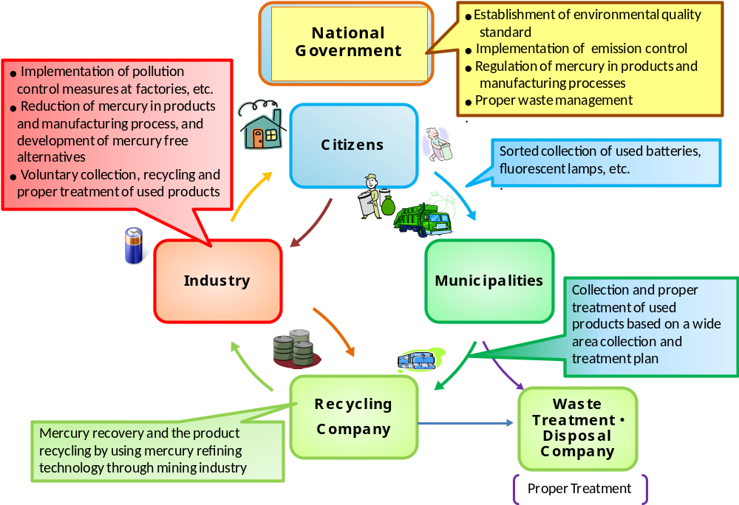
1. Government Measures
Hg Execom, 29-30 Jul 2011, Honda

Slide 4
1. Government Measures
- Control of Hg Use in Products -
Cosmetics | Ban of the use of Hg and its compound
Agricultural chemicals | Ban of the sales and use of agricultural chemicals containing Hg and its compound
Sludge fertilizer | Not exceeding 0.005 mg-THg/L, not detecting Alkyl-Hg
Product recycled from sludge | Not exceeding 0.0005mg-THg/L, not detecting Alkyl-Hg
Household commodity | Not detecting organic mercury compounds
Pharmaceutical products | Not allowed of Hg compound (exemption: if no alternatives exist)
Hg Execom, 29-30 Jul 2011, Honda

Slide 5
2. Measures of Industrial Processes
- Hg Demand Reduction in Products and Industries -
About 12 tons/year
Hg Execom, 29-30 Jul 2011, Honda

Slide 6
2. Measures of Industrial Processes
- Hg Demand Reduction in Caustic Soda Production -
1973 | 113.9 g-Hg/ 1 t-caustic soda production
Ion-exchange membrane
Diaphragm
1979 | 2.3 g-Hg/ 1 t-caustic soda production
1999 | Phase-out of Diaphragm
1986 | Phase-out of Hg process
Mercury
Hg Execom, 29-30 Jul 2011, Honda

Slide 7
2. Measures of Industrial Processes
- Hg Demand Reduction in Batteries -
1983 | Governmental instruction to reduce Hg content in cells and take-back waste cells
1991 | Hg free manganese cells
1992 | Hg free alkaline cells
1995 | End of Hg cell production
About 1 ton/year
1970- | Hg emission emitted from incinerators which incinerated MSW with Hg cells
Hg Execom, 29-30 Jul 2011, Honda

Slide 8
2. Measures of Industrial Processes
- Hg Demand Reduction in Lamps -
Average Hg Content in FL
Policy for Procurement (2001-)
FL (40W straight) | 10 mg or less
Bulb-type FL | 5 mg or less
mg/unit
Hg Use in Hg-Lamps
2002 | Updated manual to reduce Hg content in lamps
2005 | Guidelines for Hg content in lamps
Hg Execom, 29-30 Jul 2011, Honda

Slide 9
2. Measures of Industrial Processes
- Hg Demand Reduction in Medical Equipment -
Hg-in-glass manometers and thermometers → Digital manometers and thermometers
Hg Execom, 29-30 Jul 2011, Honda

Slide 10
3. Mercury Waste Management
- Municipal/Industrial Waste Collection System -
Hg wastes
Municipality's responsibility
Other wastes
FL, batteries, thermometers, etc
Wastes from households
Other wastes
Oversized wastes
MSW
Wastes from businesses
FL, batteries, thermometers, etc
Night solids
Wastes
Wastes
contaminated
with Hg
Specially controlled MSW
Industrial wastes
Ashes, sludge, waste oil, waste acid, waste alkali, waste plastics and others from businesses
Wastes
contaminated
with Hg
Specially controlled industrial wastes
Medical devices, etc
Business's responsibility
Hg Execom, 29-30 Jul 2011, Honda

Slide 11
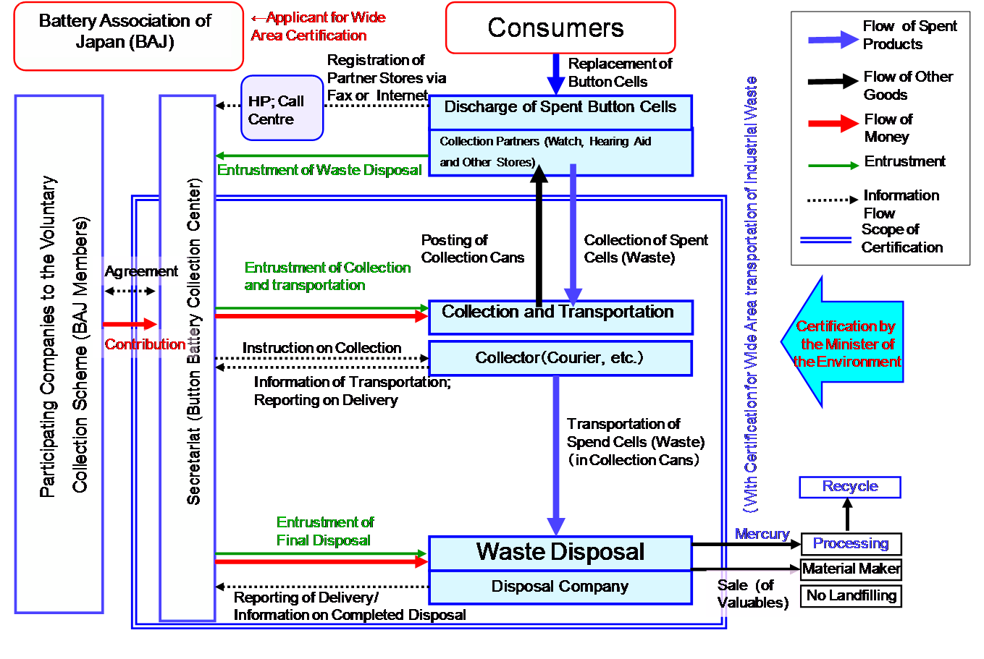
3. Mercury Waste Management
- Voluntary Collection of Button Cells -
Hg Execom, 29-30 Jul 2011, Honda

Slide 12
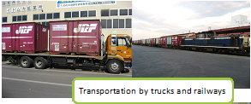
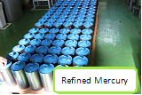
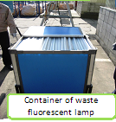
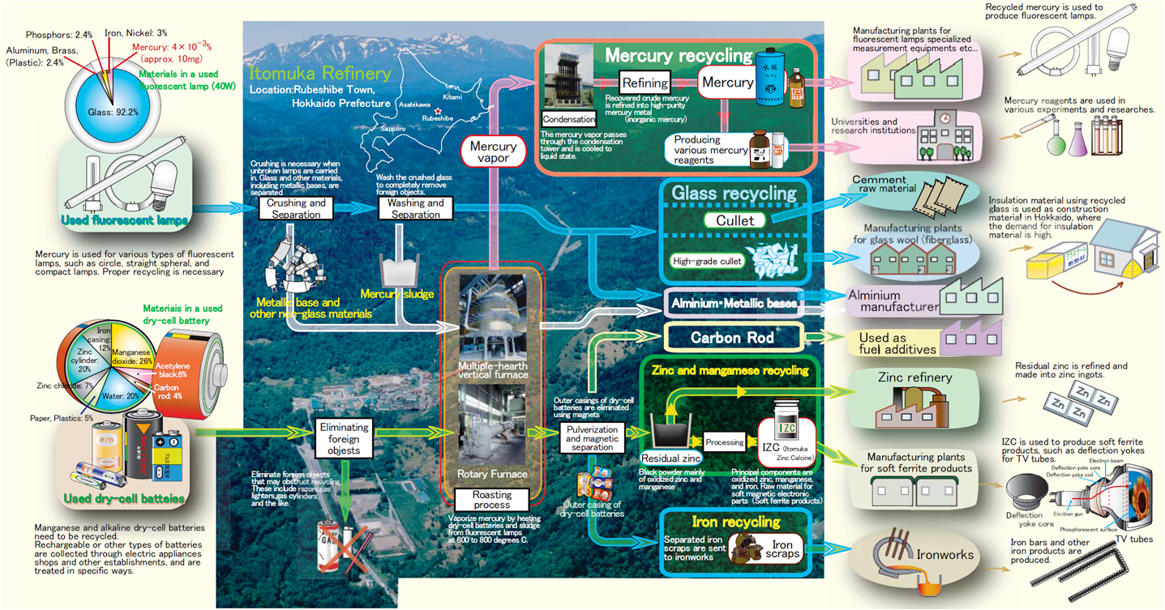
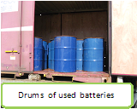
3. Mercury Waste Management
- Hg Waste Treatment -
Hg Execom, 29-30 Jul 2011, Honda

Slide 13
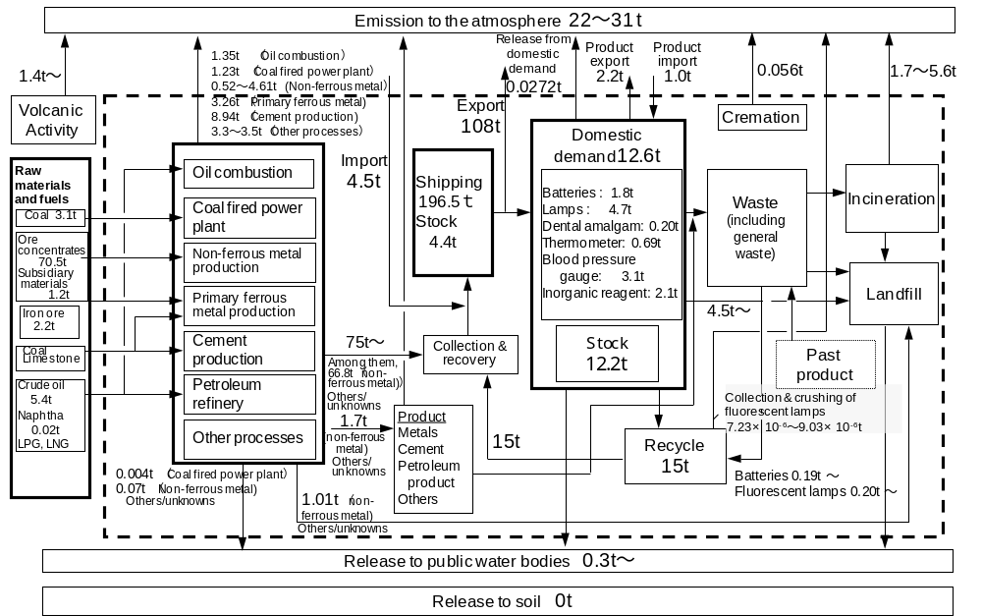
3. Mercury Waste Management
- Material Flow of Hg (2002-2006 data) -
Hg Execom, 29-30 Jul 2011, Honda

Slide 14

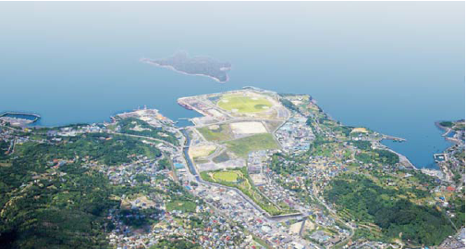
Lessons from Minamata Disease
And Mercury Management in Japan
January 2011
Ministry of the Environment, Japan
www.env.go.jp/chemi/tmms/pr-m/mat01/en_full.pdf

