Slide 1
MOPAN
2020 Assessment of UNEP
Presentation to Member Countries
10 December 2020

Slide 2
Agenda
Joint statement by Institutional Lead countries
What is MOPAN?
What is a MOPAN assessment?
What are the upcoming milestones for you?
Notes:
.

Slide 3
Agenda
Joint statement by Institutional Lead countries
What is MOPAN?
What is a MOPAN assessment?
What are the upcoming milestones for you?

Slide 4



















MOPAN is a network…
The Multilateral Organisation Performance Assessment Network (MOPAN) is a network of 19 member countries with a common interest in assessing the effectiveness of the major multilateral organisations that they fund.
Australia
Germany
Norway
Belgium
Ireland
Republic of Korea
Sweden
Canada
Italy
Switzerland
Denmark
Japan
United Arab Emirates
Finland
Luxembourg
The United Kingdom
France
The Netherlands
The United States of America
Notes:
MOPAN is a Network of governments that provide funding to multilateral organisations.
The Network represents approximately USD 65 billion of investments channeled through the multilateral system.

Slide 5
…that has a dual mission:
Promote accountability
Enhance learning
Enhance Accountability
by supporting members in assessing organisational and development effectiveness of multilateral organisations they fund.
by informing strategic engagement and dialogue between and among multilateral organisations and development partners.
Responding to members’ accountability needs
Informing policy/decision making on specific organisations
Supporting dialogue in governance bodies
Identifying and sharing good practice
Providing impetus for self-improvement for organisations
Provide learning opportunities for donors / members
Promote Learning
Notes:
Promote Accountability - streamline data collection and better meet accountability and engagement information needs
Enhance Learning – to improve the functioning of orgs, and as a kind of mirror for them to hold up to themselves

Slide 6
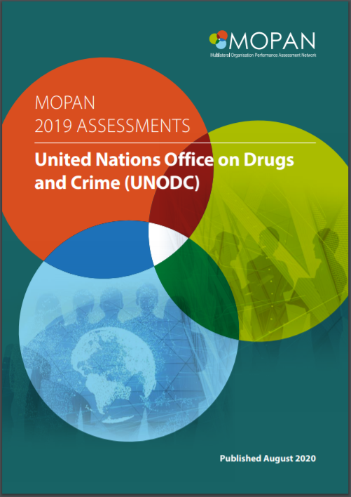
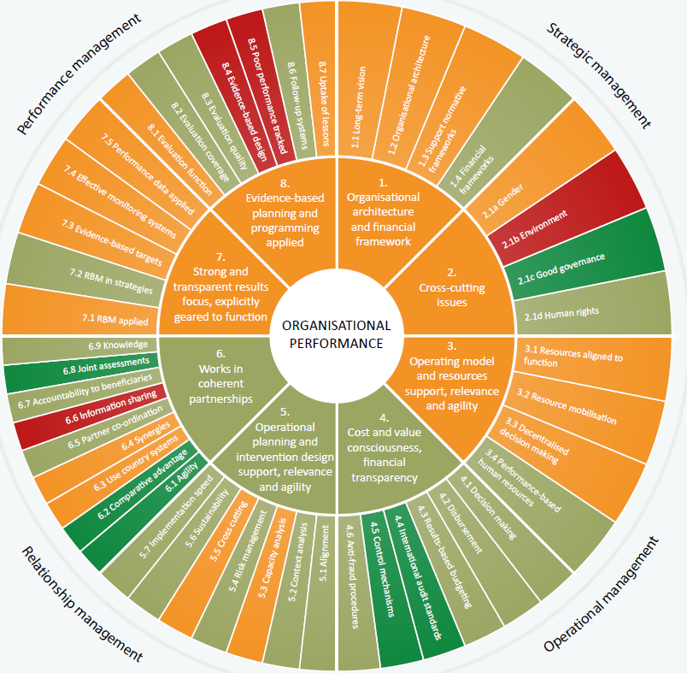
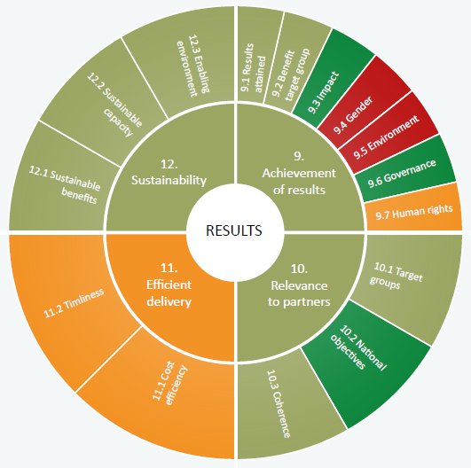
MOPAN core products are institutional assessments...
Snapshot of an organisation’s current performance
Rigorous, independent and comprehensive.
37 assessments in 2015-20

Slide 7
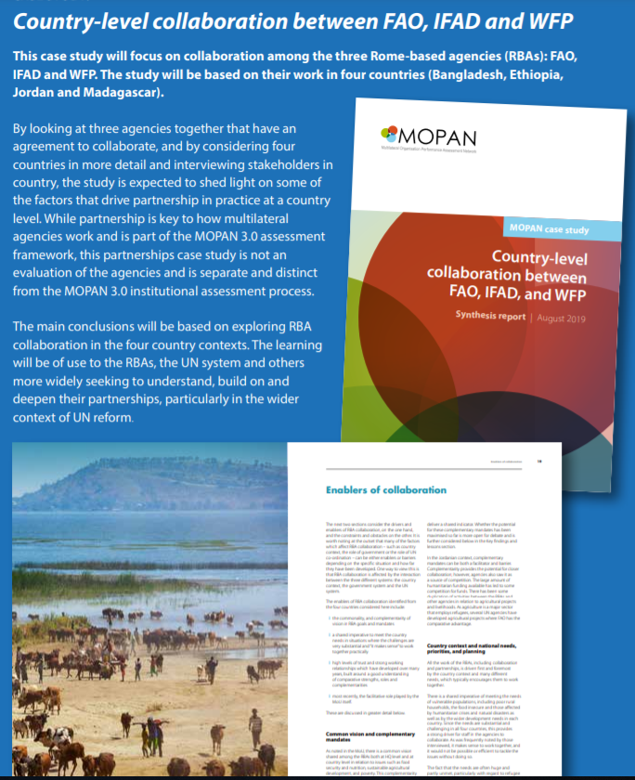
…complemented by analytical studies to inform policy.
Provide unique insights about the multilateral system
Country-level collaboration between Rome-based agencies (2019)
Progress of UNDS reforms & performance of humanitarian organisations (2020)
Multilateral system’s response to COVID-19 and climate change (2021)

Slide 8
Agenda
Joint statement by Institutional Lead countries
What is MOPAN?
What is a MOPAN assessment?
What are the upcoming milestones for you?

Slide 9
A MOPAN assessment tries to provide an answer to four questions
Does the organisation sufficiently understand current and future needs and demands? (in particular with respect to the 2030 Agenda)
Is the organisation currently using its assets and comparative advantages to maximum effect and leveraging them as part of effective partnerships? Is it prepared for the future?
Are the organisation’s systems, planning and operations fit for purpose? Are its operations geared to deliver on its mandate? Is it able to chart and manage internal change at the required pace?
Is the organisation delivering and demonstrating relevant, sustainable results in a cost-efficient way?
Notes:
On point 3: 2020 assessments will include s structured description of responses to the Covid-19 crisis, not an assessment

Slide 10
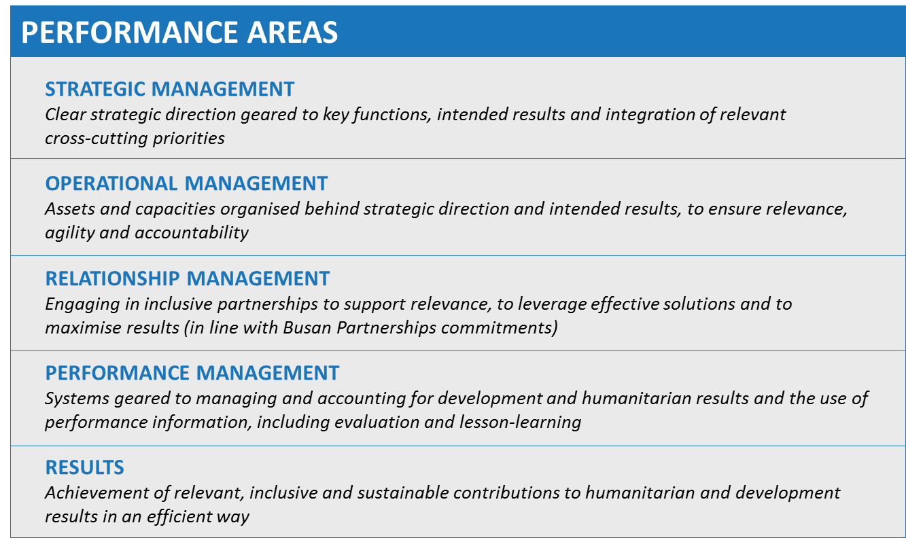
For doing so, the assessment uses an indicator framework
NEW (2020):
+ Agenda 2030
+ UNDS Reform
+ SEA/SH
Amended
Streamlined Results KPIs
Flexible survey countries
Scoring / Rating (next slide)
Bolstered Inception
Over 1 year (not 2)
ORGANISATIONAL EFFECTIVENESS
Source: MOPAN 3.1 Methodology
Notes:
These are the 5 performance areas MOPAN looks at.
Four of the five performance areas – Strategic, Operational, Relationship, and Performance Management – relate to organisational effectiveness.
The fifth area covers the results an organisation has achieved against its mandate.
MOPAN looks at 5 performance areas, through an indicator framework that is generic, but that we adapt to different types of organisations. It captures these 5 performance areas in 12 KPIs. Under those, 62 micro-indicators and something close to 212 elements which are developed / build upon / informed by international standards of best practice.
The framework has evolved recently introducing new measures related to the 2030 Agenda, prevention of SEA/SH, and UN reform. (see later slides)
Organisational effectiveness is assessed under 8 Key Performance indicators with multiple elements looking at a range of areas including strategic, operational, relationship and performance management, building on international standards / models of good practice. Through this, MOPAN seeks to understand:
Are there clear structures and policies in place?
How are they applied in practice?
How are partnerships managed?
What systems are in place to manage performance of the organisation?
Results: MOPAN has 4 Key Performance Indicators looking at the results the org has set for itself. From documentation – mainly evaluations and results reporting, we seek to understand whether the organisation achieves the results it says it is going to achieve, and whether they are sustainable and delivered in an efficient way.
3.0
KPIs 1-8, 48 Mis, 242 elements
KPIs 9-12 16 MIs
3.1
KPIs 1-8; 48 Mis, 223 elements
KPIs 9-12 9 MIs

Slide 11
An updated presentation of ratings is used in 2020
The new rating scale (introduced in 2019) reflects the increasing demands on, and maturity of, organisations
Score range
Rating MOPAN 3.0
Rating MOPAN 3.1
3.00 – 4.00 |  | Highly satisfactory |  | Highly satisfactory
 |  |  |  | Satisfactory
2.00 – 3.00 |  | Satisfactory
 |  |  |  | Unsatisfactory
1.00 – 2.00 |  | Unsatisfactory
 |  |  |  | Highly Unsatisfactory
0.00 – 1.00 |  | Highly Unsatisfactory

Slide 12
A MOPAN assessment involves different actors
Assessment
MOPAN Steering Committee
GOVERN
Institutional Leads: Belgium, the Netherlands, Switzerland
CHAMPION
UNEP
MOPAN Secretariat
OVERSEE, IMPLEMENT
Service Provider: Centennial
IMPLEMENT

Slide 13
The MOPAN assessment follows this process
Inception
Document review
Survey of external partners
Interviews
Drafting & quality assurance
Management response Presentation
Focal points for CPR requested to respond to a survey
Focal points for UNEA / CPR informed of the assessment
Aug - Oct 21
Mar – Jul 21
Sep 20 – Mar 21
Jan – Feb 21
Focal points for UNEA / CPR get access to the report and invited to discuss findings
Sep 20 – Feb 21
Jul - Oct 20
Notes:
Include

Slide 14
Agenda
Joint statement by Institutional Lead countries
What is MOPAN?
What is a MOPAN assessment?
What are the upcoming milestones for you?

Slide 15
The upcoming milestones for members are the following
Milestones | Member countries
Survey | January 2021
Progress update | May-June 2021 (tbc)
Final report | August 2021
Presentation | October 2021 (tbc)
Other assessments in 2020
ILO
OCHA
UNDP
UNICEF
UNOPS

