Slide 1




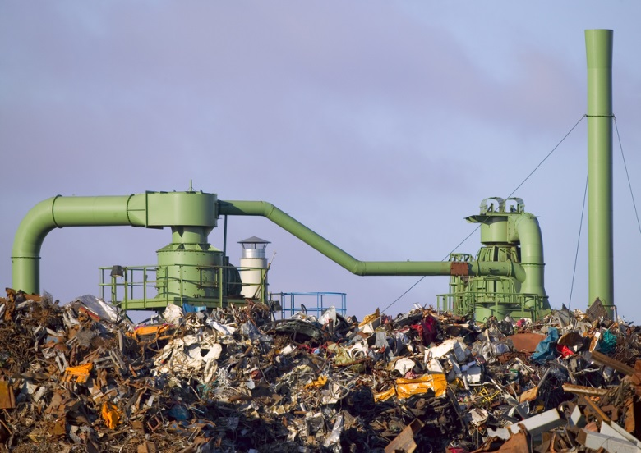

Resource Efficiency
Programme Performance Report Jan- June 2018
Draft Programme of Work 2020-21
5th Annual Subcommittee Meeting, 24 Oct 2018
Notes:
1

Slide 2


Overview of presentation
Medium Term Strategy 2018-2021
2030 vision aligned to Sustainable Development Goals
Overall strategic direction
Programme of Work
2018-2019
First biennial plan -
6 month performance
Programme of Work
2020-2021
Second biennial plan - revisions design

Slide 3

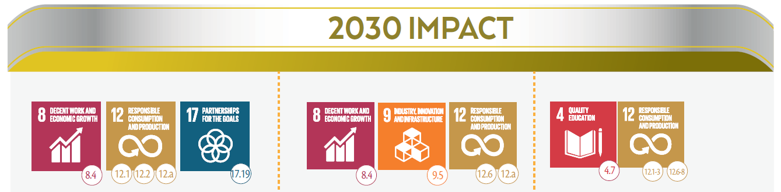
Resource Efficiency in support of the Sustainable Development Goals
“ Countries transition to sustainable development through multiple pathways, including green economy and trade, and the adoption of sustainable consumption and production patterns, increasingly decoupling economic growth from unsustainable resource use and environmental impact while improving human well being.”
Sustainable development pathways are adopted and implemented
Businesses, public and private, adopt more sustainable practices
Sustainable lifestyles and consumption patterns are increasingly adopted

Slide 4
“Sustainable Resource Management and Resource Efficiency are essential for Sustainable Development.”
“Without significant improvements in resource efficiency, it will be difficult and substantially more expensive to achieve the Paris agreement target.“
Source International Resource Panel: Key messages for the Group of 20, 2018

Slide 5
Programme Performance
2018-2019
Medium Term Strategy 2018-2021
Programme of work
2018-2019
Programme of work
2020-2021

Slide 6

Medium Term Strategy 2018-2021
Key Changes
Fully aligned to the 2030 Agenda for Sustainable Development
Integrated outcome pathway
(outcome maps) towards 2030
Raising the bar: focus on scaling up, implementation, impact
Resource Efficiency and Sustainable Consumption and Production as enabler for systemic change towards circularity
Increased number of indicators

Slide 7
Expected Accomplishment A
Enabling Policy
Environment
Expected Accomplishment B
Sustainability in
Businesses
Expected Accomplishment C
Lifestyles and
Consumption
Overview of Portfolio
Focus Areas by Expected Accomplishment
Green Economy Research, Modelling, Advisory
Partnership for Action on Green Economy
One Planet Network
Regional Programmes promoting Sustainable Consumption and Production, Green Econ.
Environment and Trade Hub
Resource Efficient Cities
Green and Sustainable Finance: UN Environment Finance Initiative
Circular Economy and Value Chains
Sustainability Reporting
Eco-innovation
Cleaner Production
Sustainable Tourism
Buildings & Construction
Sustainable Food Systems
Sustainable Lifestyles and Education
Food Waste
Sustainability Campaigns
Consumer Information & Eco-labeling
Sustainable Public Procurement
Behavioral Change
Science-Policy Interface:
International Resource Panel - Green Growth Knowledge Platform - Life-Cycle Initiative

Slide 8
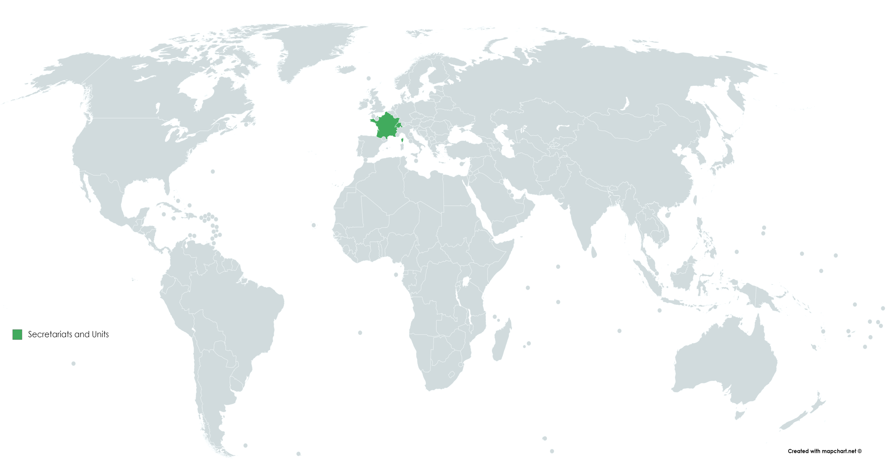






Resource Efficiency Footprint
10-Year Framework of Programmes on
Sustainable Consumption & Production Patterns: projects
Finance Initiative (UNEP FI): members in countries
Finance Initiative (UNEP FI): trainings
National Action Plans for Sustainable Consumption and Production
Partnership for Action on Green Economy
Switching to more sustainable consumption & production patterns (SWITCH)
Note: This map features a selection of projects and initiatives under the area of decoupling, but is not a comprehensive list.
.

Slide 9



Green Economy and Sustainable Consumption and Production Pathways are adopted
Expected Accomplishment A: Enabling Policy Environment
5 countries joined in 2018: Argentina, India, Indonesia, Guatemala and Kazakhstan
Reports on Sustainable Development Goal 12 at the High Level Political Forum
Adopts a new strategy : “One Plan for One Planet” 2018-2022 strategy launched in May
Establishes One Planet Multi-Partner Trust
Fund for Sustainable Development Goal 12

Slide 10
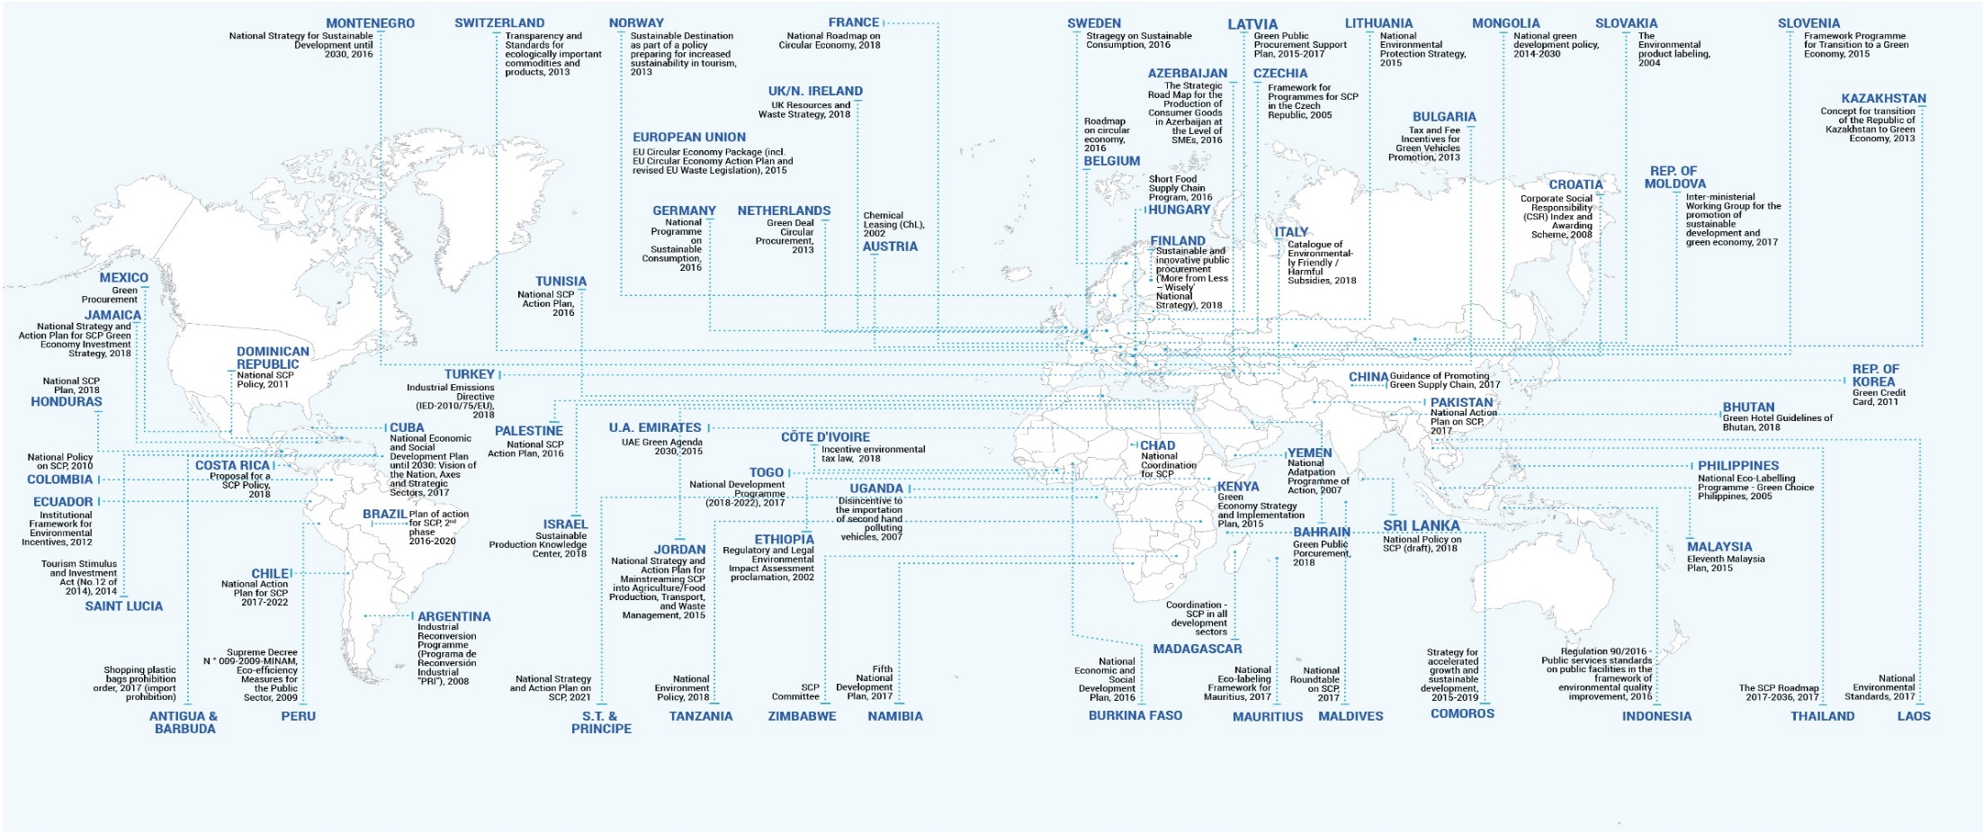

Change is underway on Sustainable Consumption and Production (SCP)
71 countries that already reported on SDG 12.1
Source: Pilot reporting on SDG 12.1.1 featured in One Planet Network mid-term magazine Five Years In: The One Planet Network 2012-2017 page 26 - 27

Slide 11


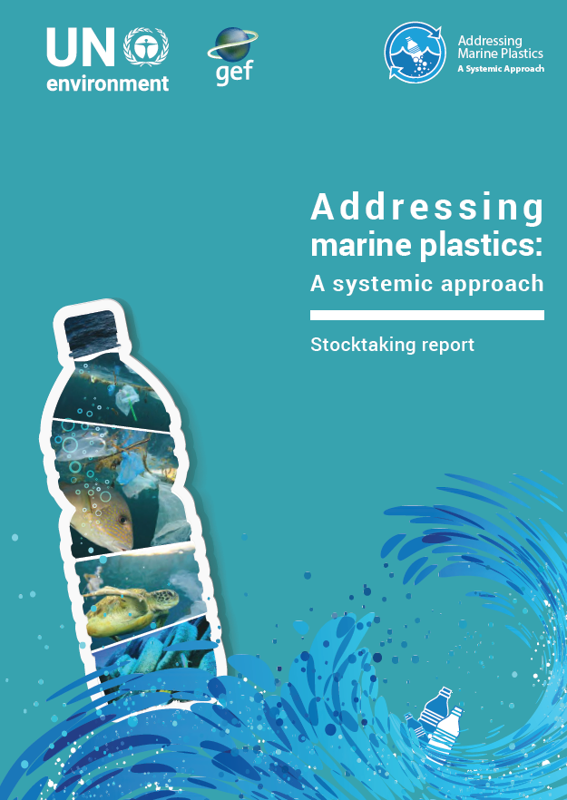
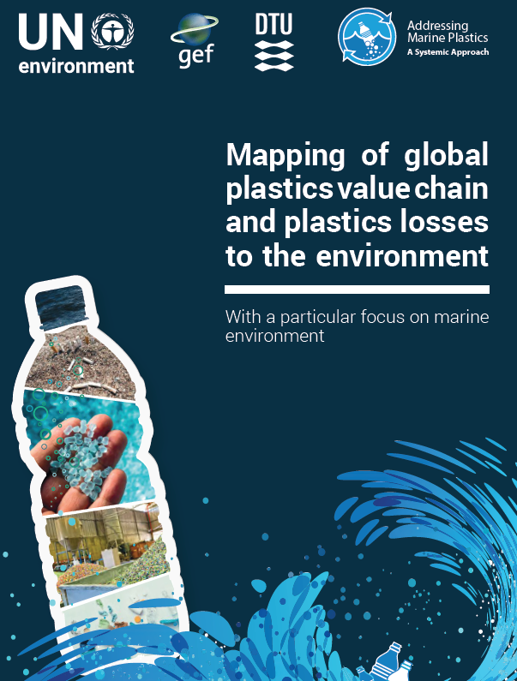
Science and knowledge in support of resource efficiency is provided
The International Resource Panel support for:
G20 resource efficiency dialogue
Global Resource Outlook (UNEA 4)
Redefining Value – The Manufacturing Revolution: Remanufacturing, Refurbishment, Repair and Direct Reuse in the Circular Economy
Supporting decision making with science-based life cycle approaches in key sectors such as plastics:

Slide 12






Businesses adopt more sustainable practices
15 financial institutions and Insurers have adopted sustainable finance practices
7 countries have adopted national processes and frameworks that mainstream sustainable finance
Global Plastics Platform launched
Reporting now against 5 indicators:
Life-Cycle Thinking based decision making
Adoption of Sustainable Finance Principles
Sustainable Tourism Policies
Sustainable Management Practices
Sustainable Buildings and Construction
Expected Accomplishment B: Sustainability in Businesses
12

Slide 13
Sustainable Lifestyles and Consumption advanced
Sustainable public procurement policies - 4 additional countries by end of 2018
Product sustainability information guidelines - 4 capacity development events organized
Food waste - methodology to measure food waste under development - 7 countries started measuring at national level
Reporting against 3 indicators:
Sustainable public procurement
Sustainable lifestyles campaigns and outreach, consumer information
Food waste
Expected Accomplishment C: Sustainable Lifestyles & Consumption
13

Slide 14

UN Environment Assembly Resolutions
2/8. Sustainable Consumption and Production
10 Year Framework of Programmes on Sustainable Consumption and Production Patterns, secretariat
Monitoring SDG targets, indicators
Capacity development, standard setting
Networking at regional, national, sub national levels
Scientific reports
Progress to date
Multi-Partner Trust Fund
One Planet Network as core implementation network launched
SDG 12 reporting during High Level Political Forum in July 2018
Monitoring & Evaluation Framework
International Resource Panel reports
Challenges
Reporting by member states voluntary
Additional resources needed to support upscaling

Slide 15
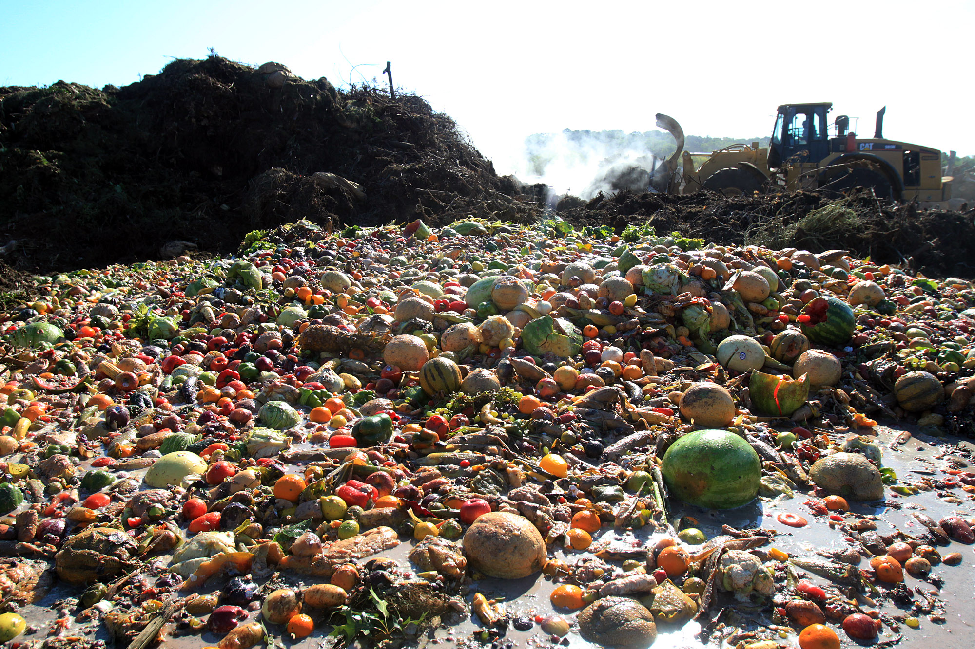
UN Environment Assembly
Resolutions
2/9. Prevention, reduction and reuse of food waste
Sustainable Development Goal 12, target 12.3
Champions 12.3
UN-wide coherence on food loss and waste
Capacity development and implementation support
Progress to date
12.3 Food Waste Indicator methodology being developed by UN Environment, UN Food and Agriculture Organization and other key global partners (to be completed in early 2019)
Regional capacity development and reporting tools being developed
Awareness raising at global events such as the High Level Political Forum, July 2019
Challenges
Additional resources required
Challenging for countries to invest in measurement

Slide 16
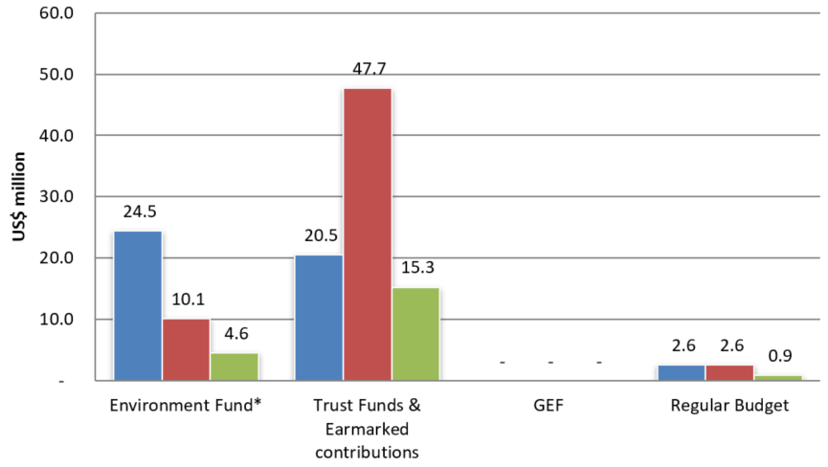
Jan - June 2018 Expenditure
Annual budget (2018): 47.6 m
Expenditure (June 2018): 20.8 m
Expenditure ratio: 44 %

Slide 17
Opportunities and Challenges
Opportunities
  System-wide transformation through mainstreaming resource efficiency
  Cleaner Planet through sustainable lifestyles and consumption, and circular approaches
  High level engagement with Group of 7 and Group of 20
  4th UN Environment Assembly: Focus on innovative solutions and sustainable consumption and production
Challenges
  Mainstreaming and implementation at country level
  Greater private sector engagement
  Sharing of good practices across countries

Slide 18
Programme of Work
2020-2021
Medium Term Strategy 2018-2021
Programme of Work
2018-2019
Programme of Work
2020-2021

Slide 19
2020-21 Programme of Work
Greater alignment to Sustainable Development Goals (alignment at indicator level)
Guided by relevant UN Environment Assembly resolutions
Rationalization of some indicators under expected accomplishment b) from 5 indicators to 2
Strategy updated to make it more focused on green finance and economy, sustainable cities and sustainable lifestyles
Greater integration of the different resource efficiency agendas to deliver better on climate, pollution and Sustainable Development Goals

Slide 20













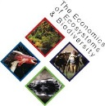
















Collective Impact through integration and partnerships
UN Country Teams
DELIVERING
IMPACT
SHARING
KNOWLEDGE
GENERATING
KNOWLEDGE
20

Slide 21

Creating Impact and Scale through Partnerships
Multi-stakeholder partnerships and platforms
Countries implement Sustainable Consumption and Production Action Plans, Green Economy Policies
Inclusive Green Economy, Sustainable Trade, and Sustainable Consumption and Production policies and plans are implemented
Increased energy, material and resource efficiency
Target 12.1 Implement the 10-Year Framework of Programmes on Sustainable Consumption and Production Patterns
Target 12.2 By 2030, achieve the sustainable management and efficient use of natural resources
Target 8.4 Improve progressively, through 2030, global resource efficiency in consumption and production and endeavour to decouple economic growth from environmental degradation

Slide 22
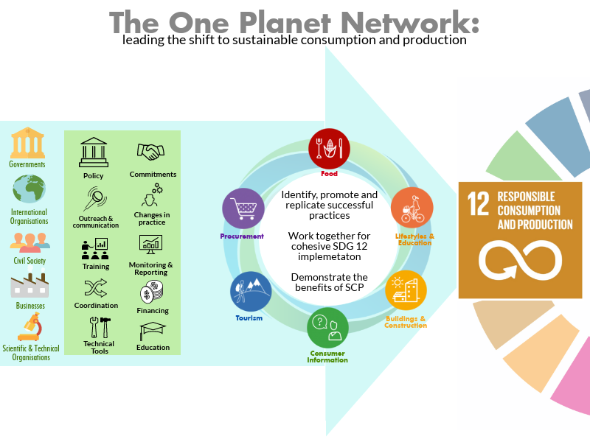
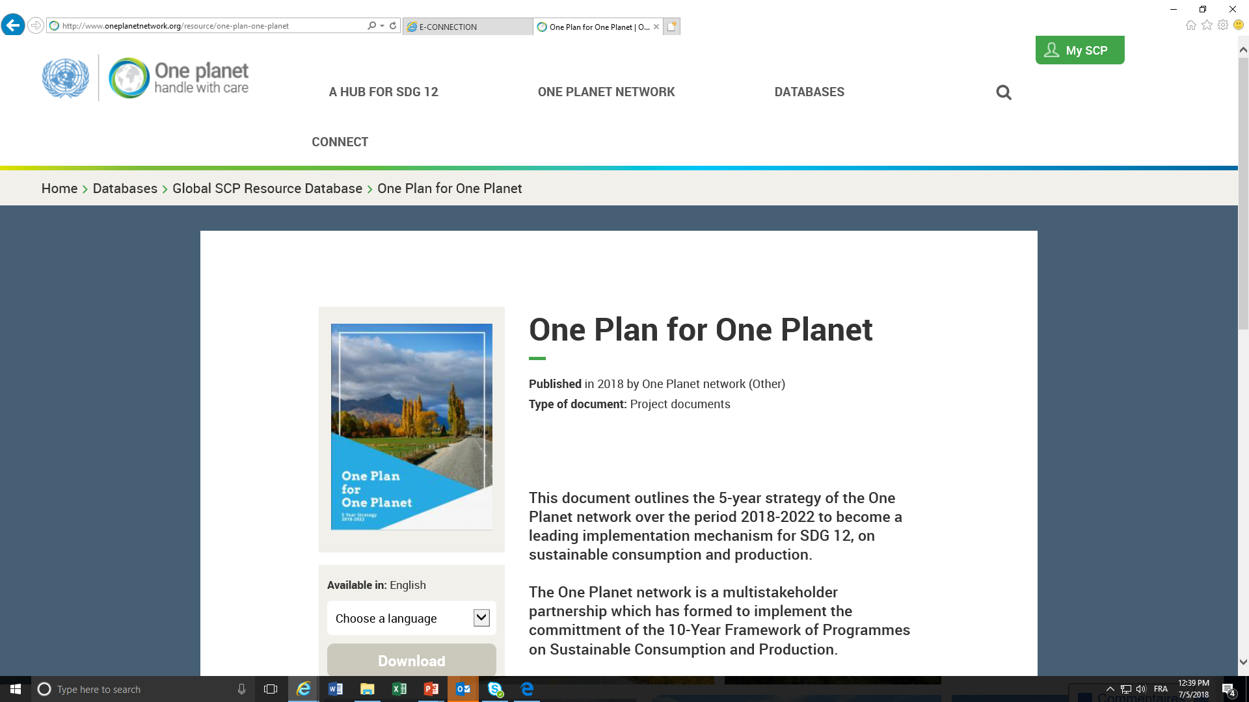



Example: Scaling up
Sustainable Consumption and Production
611
Programme
Partners
New strategy and Multi-Partner Trust Fund: to resource the Sustainable De- velopment Goal 12 better and have to a more coherent en- gagement of the UN system to support implementation.
22
UN entities in the
10YFP Inter-Agency
Coordination Group
130
National
Focal Points

Slide 23
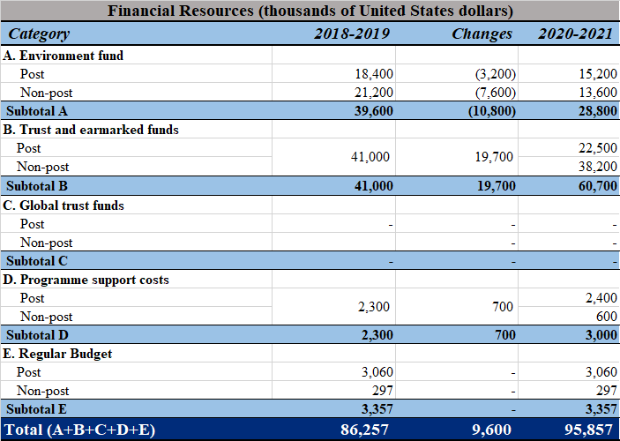
Programme Budget 2020-21

Slide 24
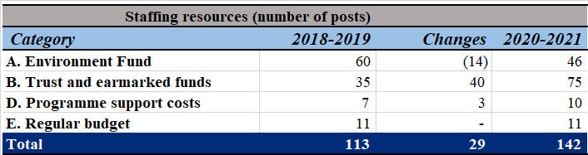
Staffing Resources 2020-21

Slide 25

Contact Us
Programme Lead Director
Ms. Ligia Noronha
Director, Economy Division
UN Environment, Nairobi
Ph: +254 (0)20 7625264
Email: ligia.noronha@un.org
Programme Coordinator
Mr. Dirk Wagener
Economy Division
UN Environment, Nairobi
Ph: +254 (0)20 7624238
Email: dirk.wagener@un.org

