Slide 1


UNEP South-East Europe Platform to beat Pollution (SEEPP), Western Balkans Regional Soil Pollution Conference
Vienna, 26 - 27.03.2026 Kristina Buzharoska National Project Coordinator, UNEP Project Office, North Macedonia

Slide 2
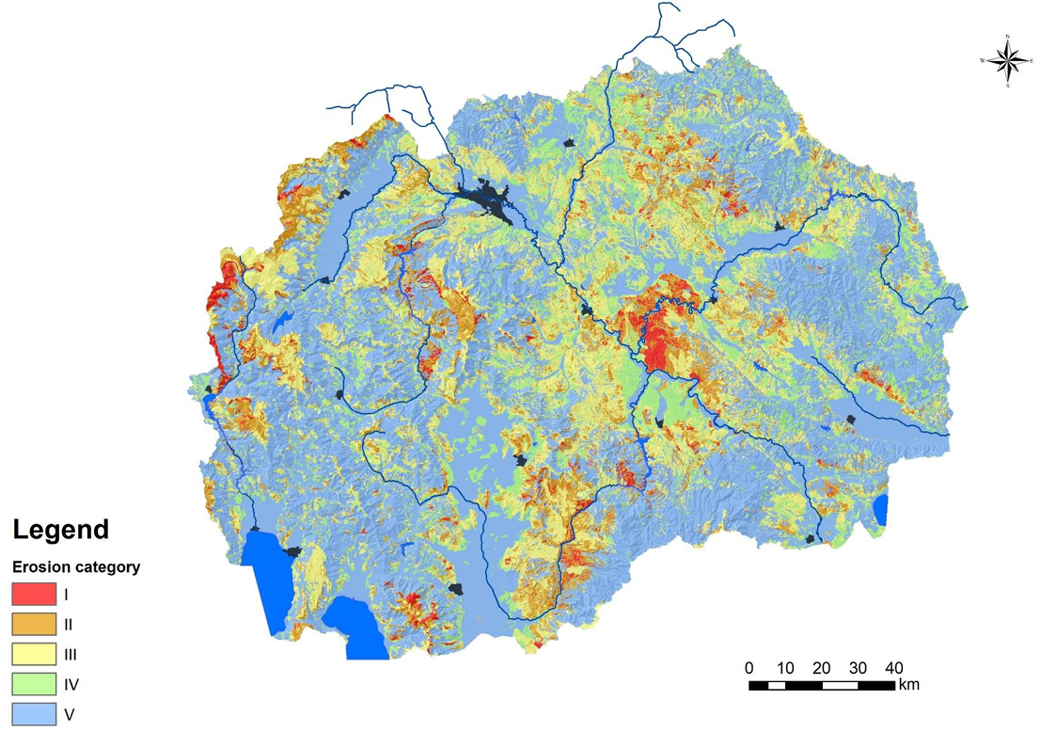



NORTH MACEDONIA OVERVIEW
Country area 25,713 km²
Land composition: 2% water (lakes), 19.1% plains and valleys, 79%, hills and mountains. About 76% of land has a slope >11%, making high vulnerability on erosion and land degradation
Continental and Mediterranean influence, 28%¹ of the territory vulnerable to drought and desertification
Soil is important natural resource for agriculture, forestry, biodiversity, water regulation and climate resilience
Main soil pollution issues :
  Mining and industrial pollution 11 hotspots are identified: Sasa, Zletovo, Lojane (arsenic), Radusha (chromium), Veles (lead and zinc), and OHIS Skopje (historical hazardous waste).
  Agricultural pressures: high erosion rates, disproportionate use of fertilizers and pesticides, unsustainable practices, and inefficient irrigation.
  Urbanization: increased soil sealing around Skopje and other rapidly growing urban areas.
  Natural hazards: frequent wildfires, floods, landslides, and Climate impacts: expanding drought‑prone zones and regions elevated erosion levels
Notes:
1’Atlas on Erosion, Drought and Desertification of the Republic of North Macedonia Authors: Ivan Blinkov, Aleksandar Trendafilov, Dusko Muaketov, Suzana Monevska Alcinova, Silvana Stevkova, Aleksandra Stevkov, Ivan MIncev, Bozin Trendafilov 2020[1]

Slide 3
LEGAL FRAMEWORK RELATED TO SOIL PROTECTION AND CONTAMINATED SITES
Law | Regulates
Law on Environment | Management of contaminated sites (Methodology for identification of a specific site for contamination, Management plan for contaminated sites) Liability for damage caused to the environment in a separate Chapter XVI Rulebook on measures for remediation of caused environmental damage Soil protection from desertification and mitigation of drought effects SEA- Strategic Environmental Assessment / EIA- Environmental Impact Assessment
Law on Agricultural Land | Erosion and flood protection Management and protection of agricultural land
Law on Waters | Erosion and flood protection, nonpoint-source pollution and soil protection from the negative impacts of sludge
Law on Forests | Forest measures for erosion prevention
Law on Mineral Resource | Soil protection in the context of geological exploration and mineral resource exploitation
Law on Construction Law on Urban Planning | Soil protection during construction and spatial planning/ soil sealing
Law on Waste Management | Waste disposal, landfills impacting soil. National Plan for Waste Management of the Republic of North Macedonia 2021-2031
Notes:
In Macedonia the Soil is the only environmental medium that is not regulated by a separate law. In the current legal and regulatory frameworks, soil protection measures are mainly pointed at achieving certain environmental goals, such as reducing contamination, liability for environmental damage, and preventing wider environmental risks. Legal framework related to soil protection and contaminated sites in Macedonia is mainly regulated by Environment Law.

Slide 4



First Draft Soil Protection Law in North Macedonia
Soil as a limited, nonrenewable, and vital natural resource, setting soil protection in the public interest
Objective is to maintain and improve soil health so that soils continue providing essential ecosystem services
National Soil Council
Ministries
Municipalities
Companies & land users
Planning documents
National Strategy for Soil Management 30 year
Contaminated and potentially contaminated sites
National Methodology for Identification
Monitoring Soil Health
Soil regions & area
Indicators and criteria
National Plan for Soil Protection 30 year
Action Plan 5 year
Soil Monitoring Methodology & Plan
Financing
Soils register
Soil information system
National Register
Management plans
Procedure for Restoration and remediation of soils
Obligation for remediation and reclamation of soil
Desertification Measures
Risk Assessment
National Plan for Combating Desertification
Programme for Achieving Land Degradation Neutrality Targets
Early‑warning systems
Drought‑risk management
Restoration of degraded lands
State & Municipal Budget
Environmental & Climate programmes
Projects
Target EU SML
Land/Soil
Public consultations
Alignment: Environmental Liability Directive (2004/35/EC), Industrial Emissions Directive (IED),2010/75/EU,
EU Soil Strategy and Soil Monitoring Law, Strategic Environmental Assessment (SEA)

Slide 5

INSTITUTIONAL SET-UP
Key institutions responsible for:
Ministry of Environment & Physical Planning (MoEPP): for soil protection
Ministry of Agriculture, Forestry & Water Economy (MAFWE): soil/land use agricultural land, erosion control, irrigation, and land management practices
State Environmental Inspectorate: enforcement of environmental compliance
Hydrometeorological Service in the Republic of North Macedonia (UHMR): monitoring of climate indicators relevant to soil and drought metrics
Local governments and spatial planning bodies: land‑use planning and management of soil sealing trends
Public health institutions: health risk assessments related to contaminated sites
Notes:
Ministry of Environment & Spatial Planning (MoEPP): lead authority for contaminated sites, environmental monitoring,
Ministry of Agriculture, Forestry & Water Economy (MAFWE): responsible for agricultural soils, erosion control, irrigation, and land management practices.
State Environmental Inspectorate: enforcement of environmental compliance.
Hydrometeorological Administration (UHMR): monitoring of climate indicators relevant to soil, including drought metrics.
Local governments and spatial planning bodies: land‑use planning and management of soil sealing trends.
Public health institutions: health risk assessments related to contaminated areas.
Universities and research institutes: soil analysis, erosion studies, mapping systems such as MAKSOIL

Slide 6
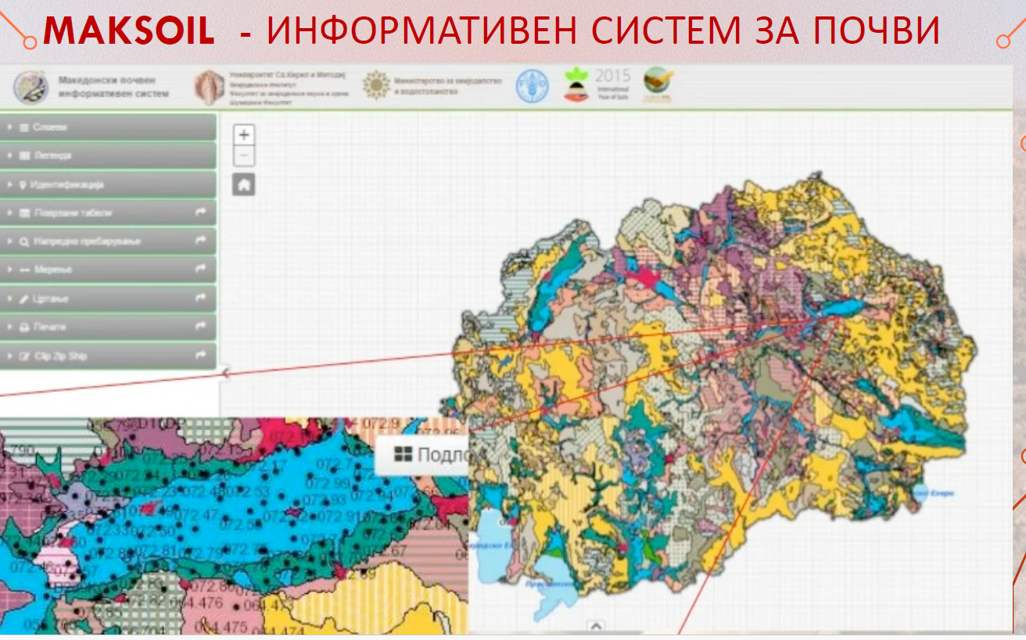
IMPLEMENTATION STATUS
Methodology for the Identification of Contaminated Sites
Identified 11 hotspots, ranked by contamination and risk
Register of Discharge and Transfer of Pollutants (RIPZ, https://ripz.moepp.gov.mk/)
MAKSOIL http://www.maksoil.ukim.mk/masis/, data base of 63 soil maps, universities and research institutes
Ongoing projects:
  “Cleaning of the contaminated site at the former OHIS factory - remediation of the “small” delta HCH dumpsite financed by GEF), co-financed by Ministry of Environment and Physical Planning, European Union and Norway, implemented by UNI DO and UNOPS the “Guidelines for the Sustainable Management of Contaminated Sites with lindane (HCH) in OHIS-Skopje
  Project “Strengthening the national capacities for the implementation of the Minamata Convention on Mercury with a focus on developing a strategy for the assessment of a location contaminated with mercury”, MoEPP, through the Project Office of Persistent Organic Pollutants (POPs),
  GEF6 project on Sustainable Land Management, financed by GEF, implemented by MoEPP with support by UNEP, ongoing is drafting of the first Soil Protection Law, Soil Protection Strategy and Guidelines for Establishing Soil Quality Monitoring Programme

Slide 7

MAIN CHALLENGES AND GAPS
Absence of Soil protection legislation
Absence of Monitoring system and standardised data on soil, contaminated and potentially contaminated sites
Absence of clear definition of institutional competences and overlapping management
Insufficient law enforcement and control on pollution sources
Lack of a national contaminated site inventory and remediation of contaminated sites
Insufficient awareness among decision makers and general public
Limited administrative capacities at national and local level
Limited financial resources

Slide 8

PRIORITY NEEDS AND OPPORTUNITIES
Soil Protection Law and Strategy
Guidelines for Establishing Soil Quality Monitoring Programme
Development of National Soil Monitoring System (indicators, methodology, continuous reporting)
Clear institutional competencies and improved inter-ministerial coordination
Clear coordination among national and local authorities
Capacity building on soil monitoring, reporting and law enforcement
Regional cooperation and knowledge exchange

Slide 9
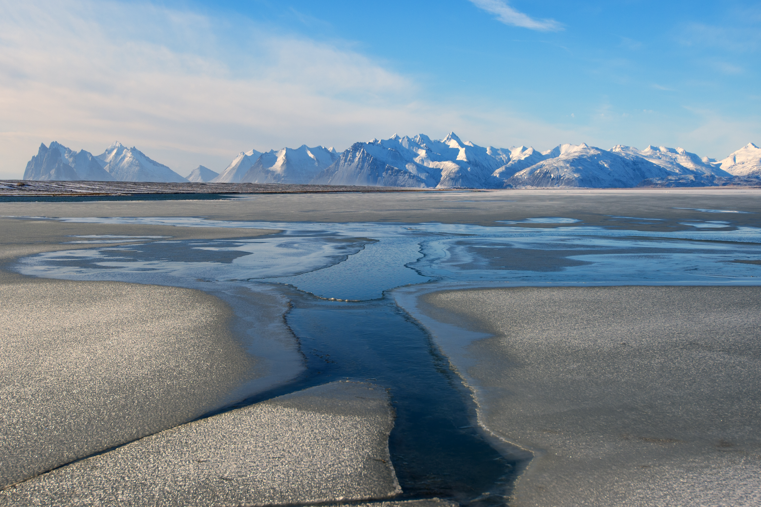
Thank you for your attention
Kristina Buzharoska, National Project Coordinator, UNEP Project Office, North Macedonia Kristina.Buzharoska@un.org
www.unep.org

