Slide 1
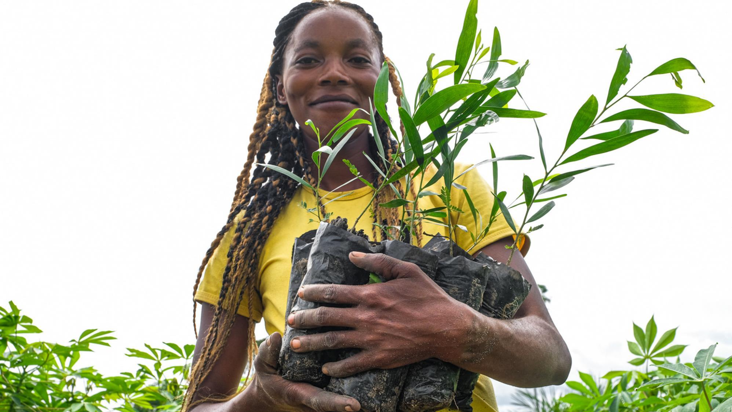


United Nations Decade on Ecosystem Restoration
Opportunities

Slide 2
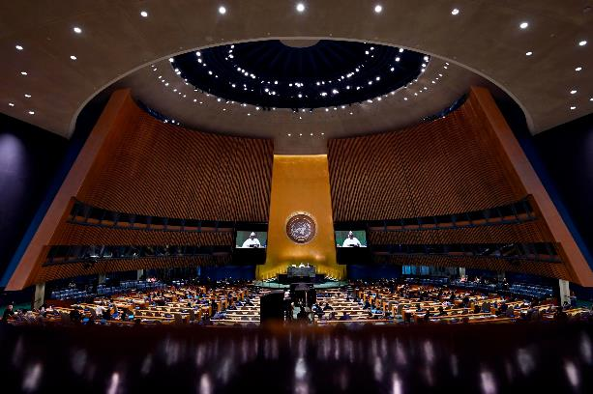


Background
UNGA resolution, broadly supported by member states
(1 March 2019):
  Inviting UNEP and FAO to “lead the implementation of the Decade, in collaboration with the secretariats of the Rio conventions, other relevant multilateral environmental agreements and entities of the United Nations system […]”
UNGA resolution does not foresee additional goals or reporting plans, but builds on existing conventions and efforts:
Paris climate agreement, bending curve on biodiversity loss and SDGs cannot be achieved without additional repairing degraded ecosystems
UN Decade designed to build a global movement to accelerate progress on restoration goals

Slide 3
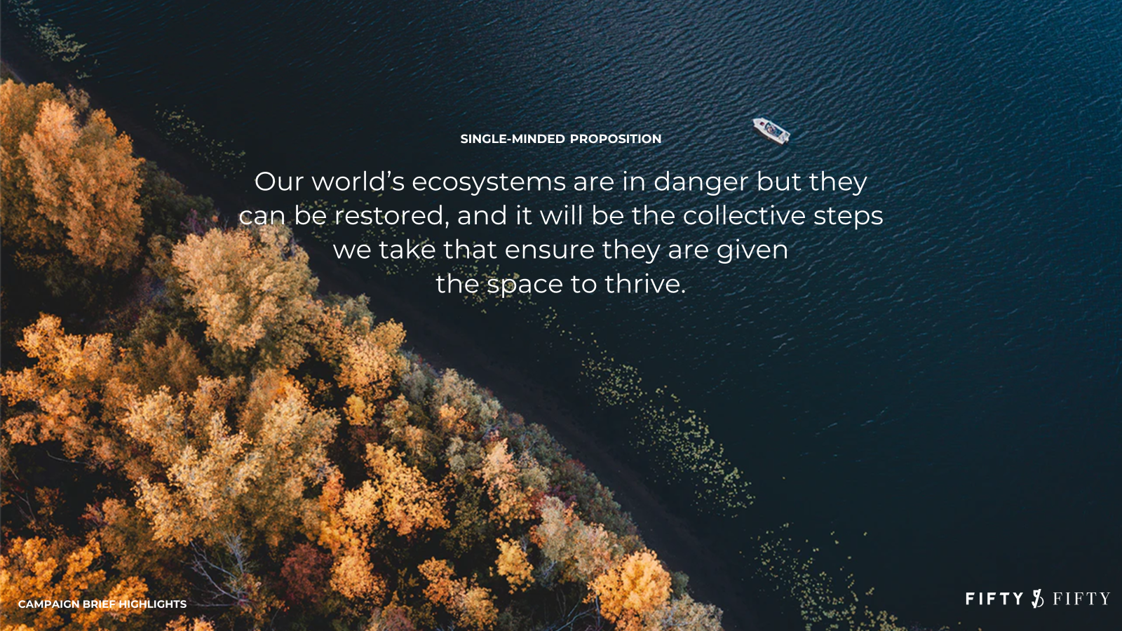


World Environment Day 2021
Host for World Environment Day 2021 is Pakistan The theme: Ecosystem Restoration The official launch of the UN Decade of Ecosystem Restoration
Campaign message
Join
#GenerationRestoration

Slide 4
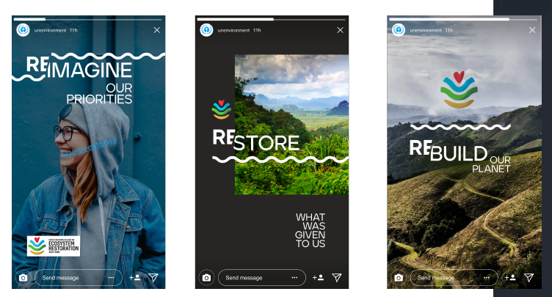

Kicking off a global restoration movement
Since 2020
  Partnership building
  Sharable and Adaptable campaign assets developed
World Environment Day
  Official UN Decade Launch -> topic of Ecosystem Restoration
  First-ever flagship report assessing opportunities across sectors and ecosystems
  Worldwide out-of-home advertisement campaign (200k+ in value, in-kind)
  Film on restoration decade in Africa, launched on National Geographic in 45+ countries
  Videos, stories, media outreach
  Gamified practical guide
  Celebrity engagement, song production for #GenerationRestoration by A-list musicians
  Digital hub for registering restoration action operational
  and more….

Slide 5

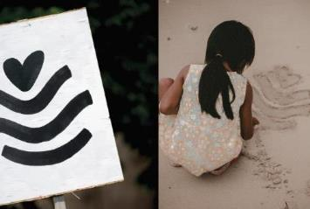
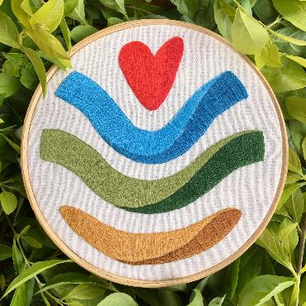
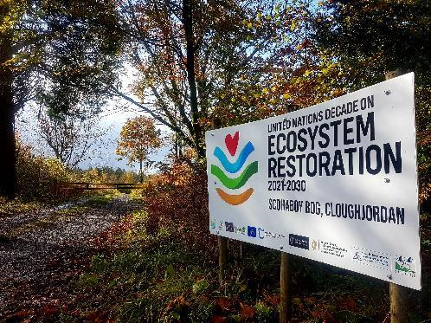


Visual Identity
Share it.
Adapt it.
Make it your own!
Notes:
The slogan “Make it Your Own” is not an empty phrase. Since we introduced the visual identity just a few months ago, we have seen a groundswell of enthusiasm for restoration.
Many individuals and organizations have chosen to use the logo to show their support.
Just some examples: A group of students in the United Arab Emirates organized a logo competition to adapt the logo to the local context, an organization restoring forests for wild honey in Uganda designed their own version for honey jars and a new peatland initiative in Ireland decided to take the logo for their own sign post.
All these actions were taken spontaneously – and we see many more starting up. This is New Power.

Slide 6
The momentum is building

Slide 7
Official UN Decade Launch Celebrations
Events hosted by 100+ partners, from global institutions, to restoration leaders on the ground
  250 speakers
  10+ Ministers and Heads of States, 20+ CEOs, 50+ Heads of Organizations
  20,000+ participants in partner events
Hundreds of millions reached through global campaign
UN Decade Official Launch Event – 4 June
  Dignitaries expected to join include SG Antonio Guterres, His Holiness Pope Francis, Heads of Rio Conventions, Jane Goodall, celebrities from music and culture
World Environment Day Celebration hosted by Pakistan – 5 June
Regional Events and celebrations, including:
  Billie Eilish, Maroon 5
  Commitments and announcements Prime Minister of Pakistan, Germany, Egypt, China, and many more
  Policy announcement on farmland restoration by Governor of California, Gavin Newsom

Slide 8


















Slide 9
Wide range of communication channels
Pro bono out-of-home campaign on digital screens and billboards across four continents
#GenerationRestoration mural kick-off with street artists in New York City
National Geographic Documentary “Our Decade for Restoration” screened across 45 countries in Africa
DJ Don Diablo and rapper Ty Dolla Sign releasing music video for #GenerationRestoration (50+ million reach)
Spoken word poetry developed for curtain raiser video by award-winning artist and climate activist, link to Hip-Hop Caucus
Comic book co-produced with artists from Marvel & Co

Slide 10
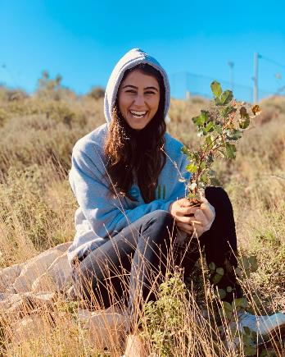
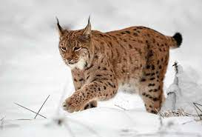
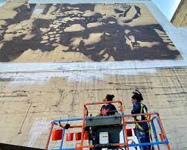
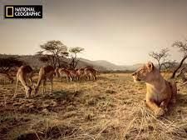
Augmented reality experience for Instagram in Asia and the Pacific that allows you to step through a portal to discover an ecosystem in various stages of recovery
“Biodiversity in the Balkans: North Macedonia’s designation of a new national park creates a safe space for the Balkan Lynx”
European Parliament youth engagement campaign

Slide 11
Ways to get involved…

Slide 12
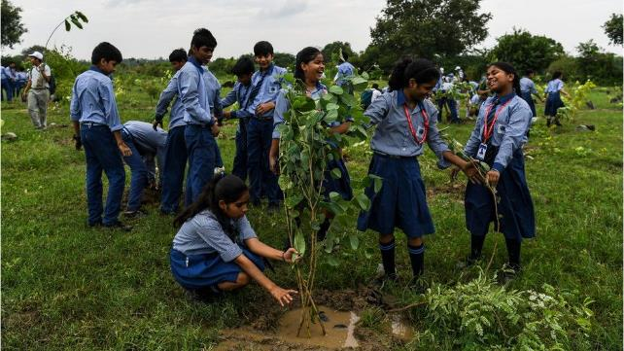
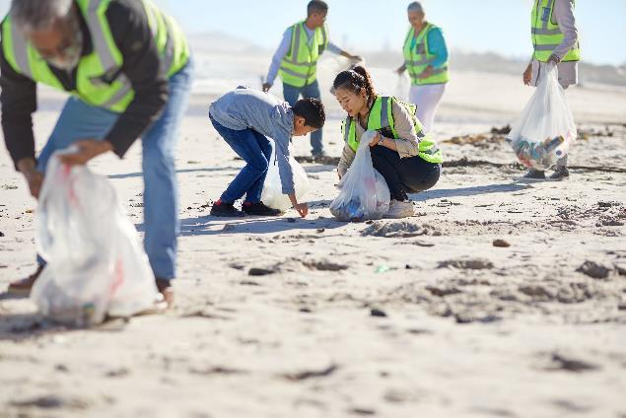
Take action for World Environment Day
Ecosystem Restoration Playbook with inspiration for action on the ground launched 22 April (Earth Day)
Event registration open: April 15
  https://tinyurl.com/3xbvt449
Interactives, gamifications and more: May 25

Slide 13
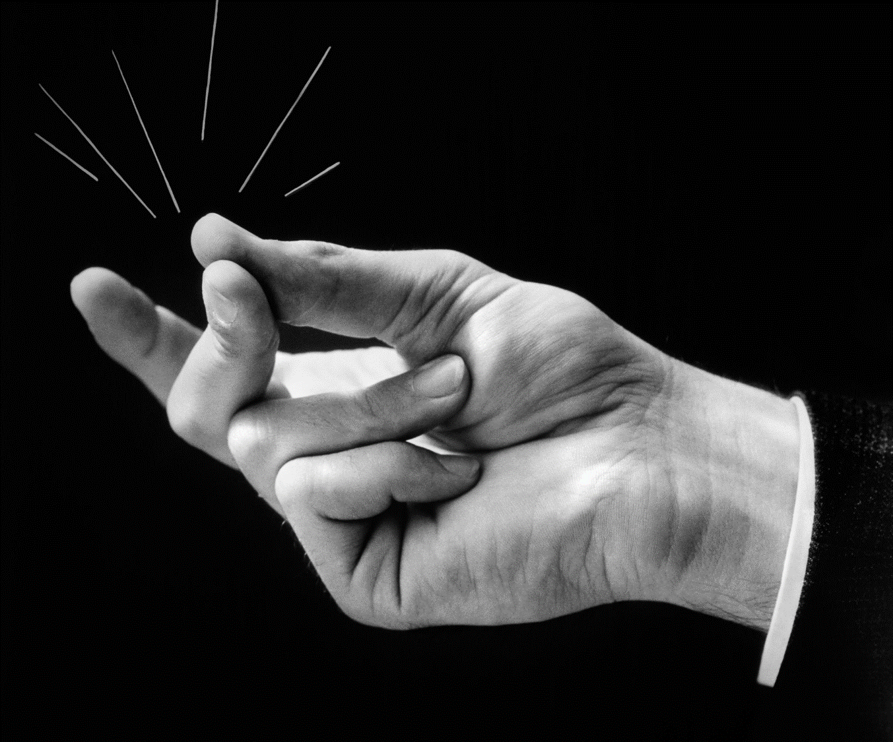
Participate in the snap challenge!
Show us how you transform ecosystems for the better with a snap of your finger
Snap – plant a tree
Snap – choose better food
Snap – show your creative vision for the future
Guidelines coming 30 April

Slide 14
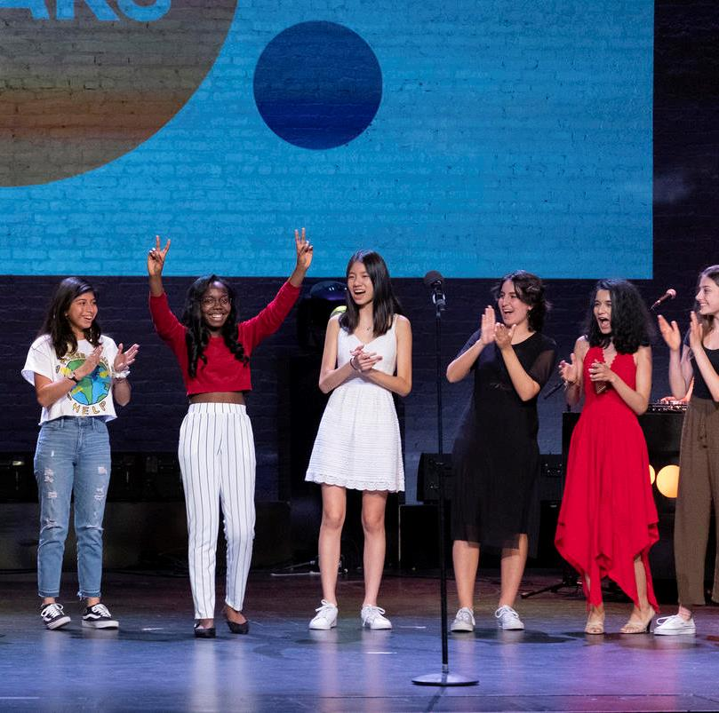
Share our Curtain Raiser film
We are working with multicultural climate change spoken word artist Jordan Sanchez and award-winning director / producer Tom Mustill (Gripping Films) on a poem for #GenerationRestoration, set against images of our rapidly changing planet.
Be among the first to receive and share a copy.
Available exclusively to partners 17 May

Slide 15
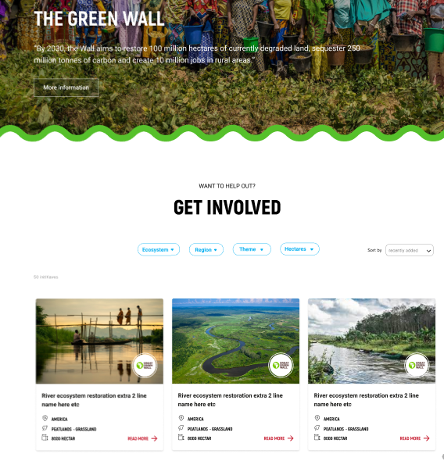
After World Environment Day
100+ leading organizations as official UN Decade Partners
Register restoration initiatives supported by you through the UN Decade’s Digital Hub – to shine a light on local efforts and garner policy and funding support
Join the wider campaign and participate in individual events
Mockup only, full hub coming

Slide 16
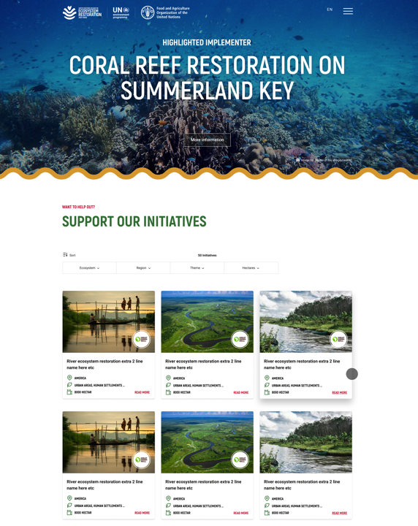

BUILDING
The largest single database of ecosystem restoration initiatives
A platform uniquely focused on the grassroots perspectives and needs of restoration implementers
A focal point on the web dedicated to uniting trusted restoration resources

Slide 17
Member State opportunities: UN Decade on Ecosystem Restoration
At launch of the UN Decade on Ecosystem Restoration around World Environment Day (4-5 June)
  Publicly announce your country’s support to the UN Decade & issue new commitments for restoration
  Publicize plans or policies that help ensure existing commitments are met, such as the Bonn Challenge. What innovative measures is your country taking to help restoration?
  Be part of the global movement!
    Share videos & stories from restoration activities in your country – from beach cleanups to tree plantings and more
    Participate in the “Snap Challenge” on social media – more information will follow
    Videos from Heads of States and Ministers committing to the UN Decade
    Tag all #GenerationRestoration
Beyond the launch
  Build the UN Decade momentum in your country, e.g. national language(s) website; stakeholder meetings; national targets
  Make restoration part of economic recovery plans & include restoration in NDCs, NAPAs & other key national plans
  Consider joining the informal “Friends of the UN Decade” exchanges among Governments
  Identify and propose national or regional ‘Flagship Initiatives’ for restoration (from Q4, 2021)
  Consider contributing to the UN Decade Multi-Partner Trust Fund, among the first donor countries

Slide 18
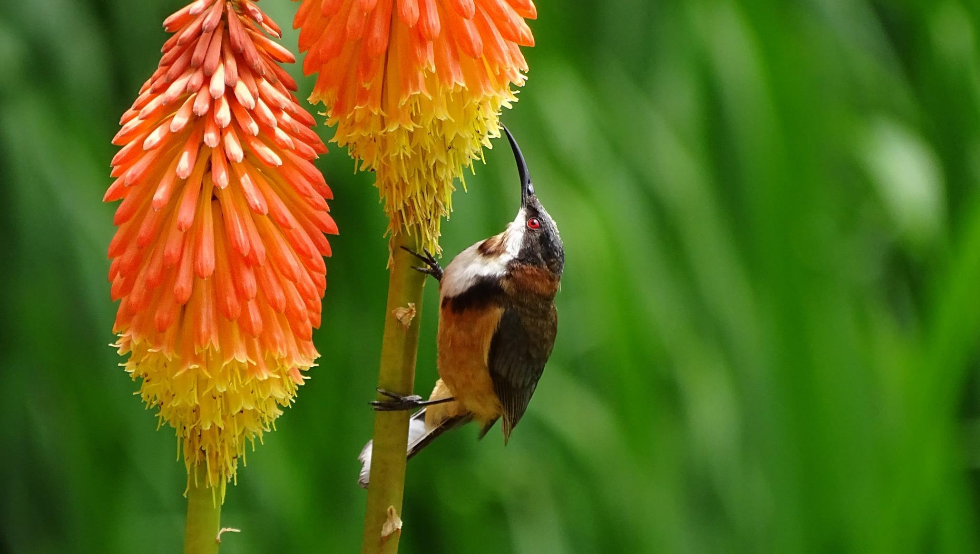


Join #GenerationRestoration
Thank you

